Slide 1
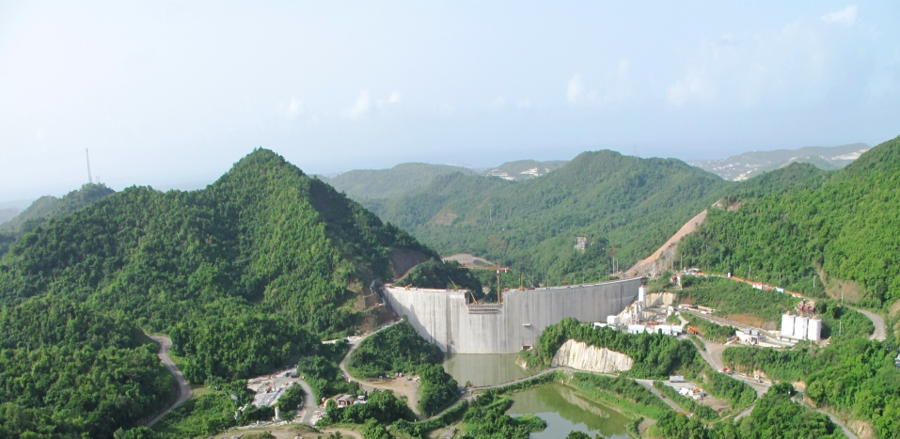
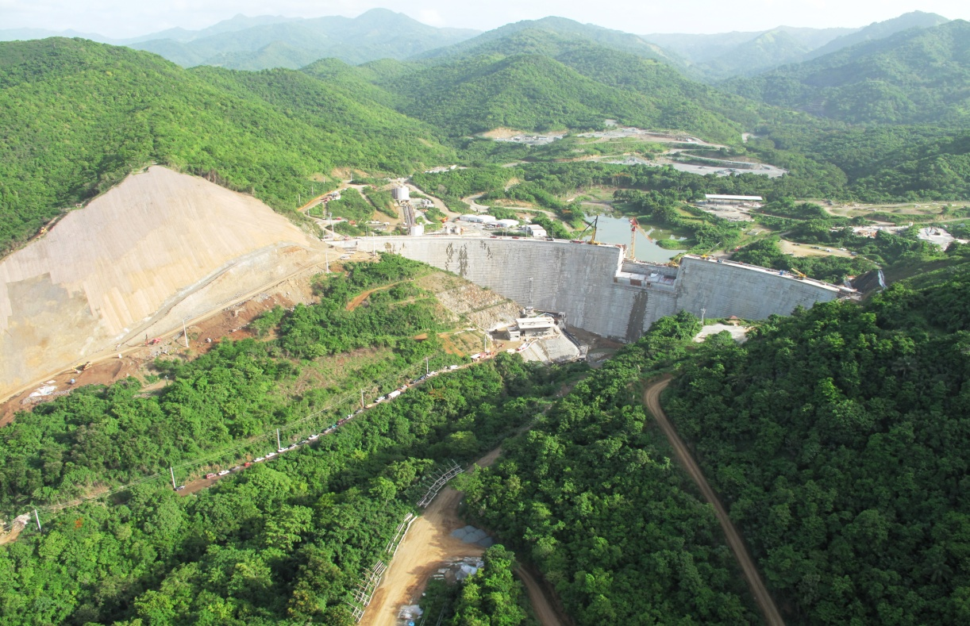
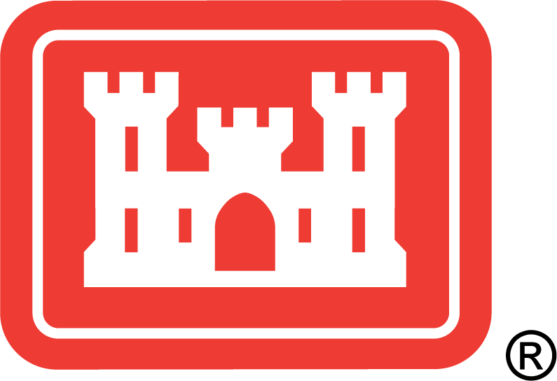
Operational Guidance/Water Control Plan for Portugués Dam and Reservoir
Jacksonville District Presentation to
Residents, Stakeholders and the Autonomous Municipality of Ponce
July 9, 2013

Slide 2
Topics
Background
Project Timeline
Project Purposes
Overview of Operational Guidance/Water Control Plan
Portugués Dam Operational Criteria
Portugués Dam Storage and Principal Elevations
Decision-Making Process
Deviation from Normal Regulation
Roles and Responsibilities

Slide 3
Background
“City of Ponce is subject to extensive damage from flooding when either or both rivers overflow (i.e. Portugués and Bucaná Rivers)” – EA dated 22 Oct 1970
“Within the municipality of Ponce, 500 people died, mostly from drowning. Streets were flooded, waterfront businesses were destroyed, and several government buildings were damaged. Telephone, telegraph, and electrical services were completely lost. Ponce was described as an image of "horrible desolation" by its municipal council.” Hurricane San Ciriaco of 1899 - Wikipedia

Slide 4
Project History
Ponce subject to significant seasonal flooding due to hurricanes and rainfall
Initial assessments began in the 1940s
Detailed studies began in 1965
Public hearing on 23 Mar 1965
Plan: Two multiple-purpose reservoirs and associated channels

Slide 5
Project Timeline
1940
1950
1960
1970
1980
1990
2000
2010
Initial Assessments (1940s)
Portugués Dam complete (2013)
Detailed Studies began (1965)
Public meeting on 23 March 1965
Cerrillos Dam complete (1991)
Channels constructed (1980s)
Project approved (1970)

Slide 6
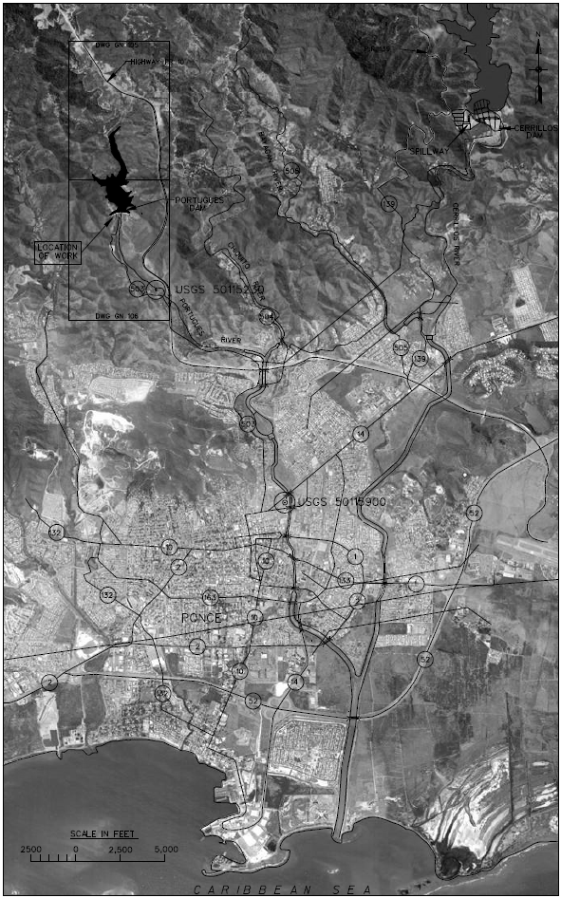

Slide 7
Project Purposes
Portugués and Bucaná Rivers Project, authorized in 1970, included 2 dams and channelization of both rivers for:
Flood Control
Water supply
Recreation
Fish and wildlife enhancement

Slide 8
Project Purposes
1970 Authorization
2013 Construction
Flood Control
Water supply
Recreation
Fish and wildlife enhancement
Flood Control

Slide 9
Overview of Operational Guidance/Water Control Plan
The purpose of an Operational Guidance/Water Control Plan is to assist project personnel in the day-to-day operation of a water resource. This includes:
Reservoir Storage Allocation
Water Management Operations
Deviations from Normal Regulation
Additionally, this Plan resides within a Water Control Manual, which serves as a source for reference containing other information pertinent to the project.

Slide 10
Portugués Dam
Operational Criteria
If the Reservoir elevation is at or below 439.8 feet, MSL, no flood control releases are required.
However, releases may be made for environmental water supply downstream or in anticipation of a storm/significant rainfall event.
If the Reservoir elevation is above 439.8 and at or below 512.75 feet, MSL, flood control releases will typically occur.
If the Reservoir elevation is above 512.75 feet, MSL, flood control releases will occur via the emergency spillway.

Slide 11
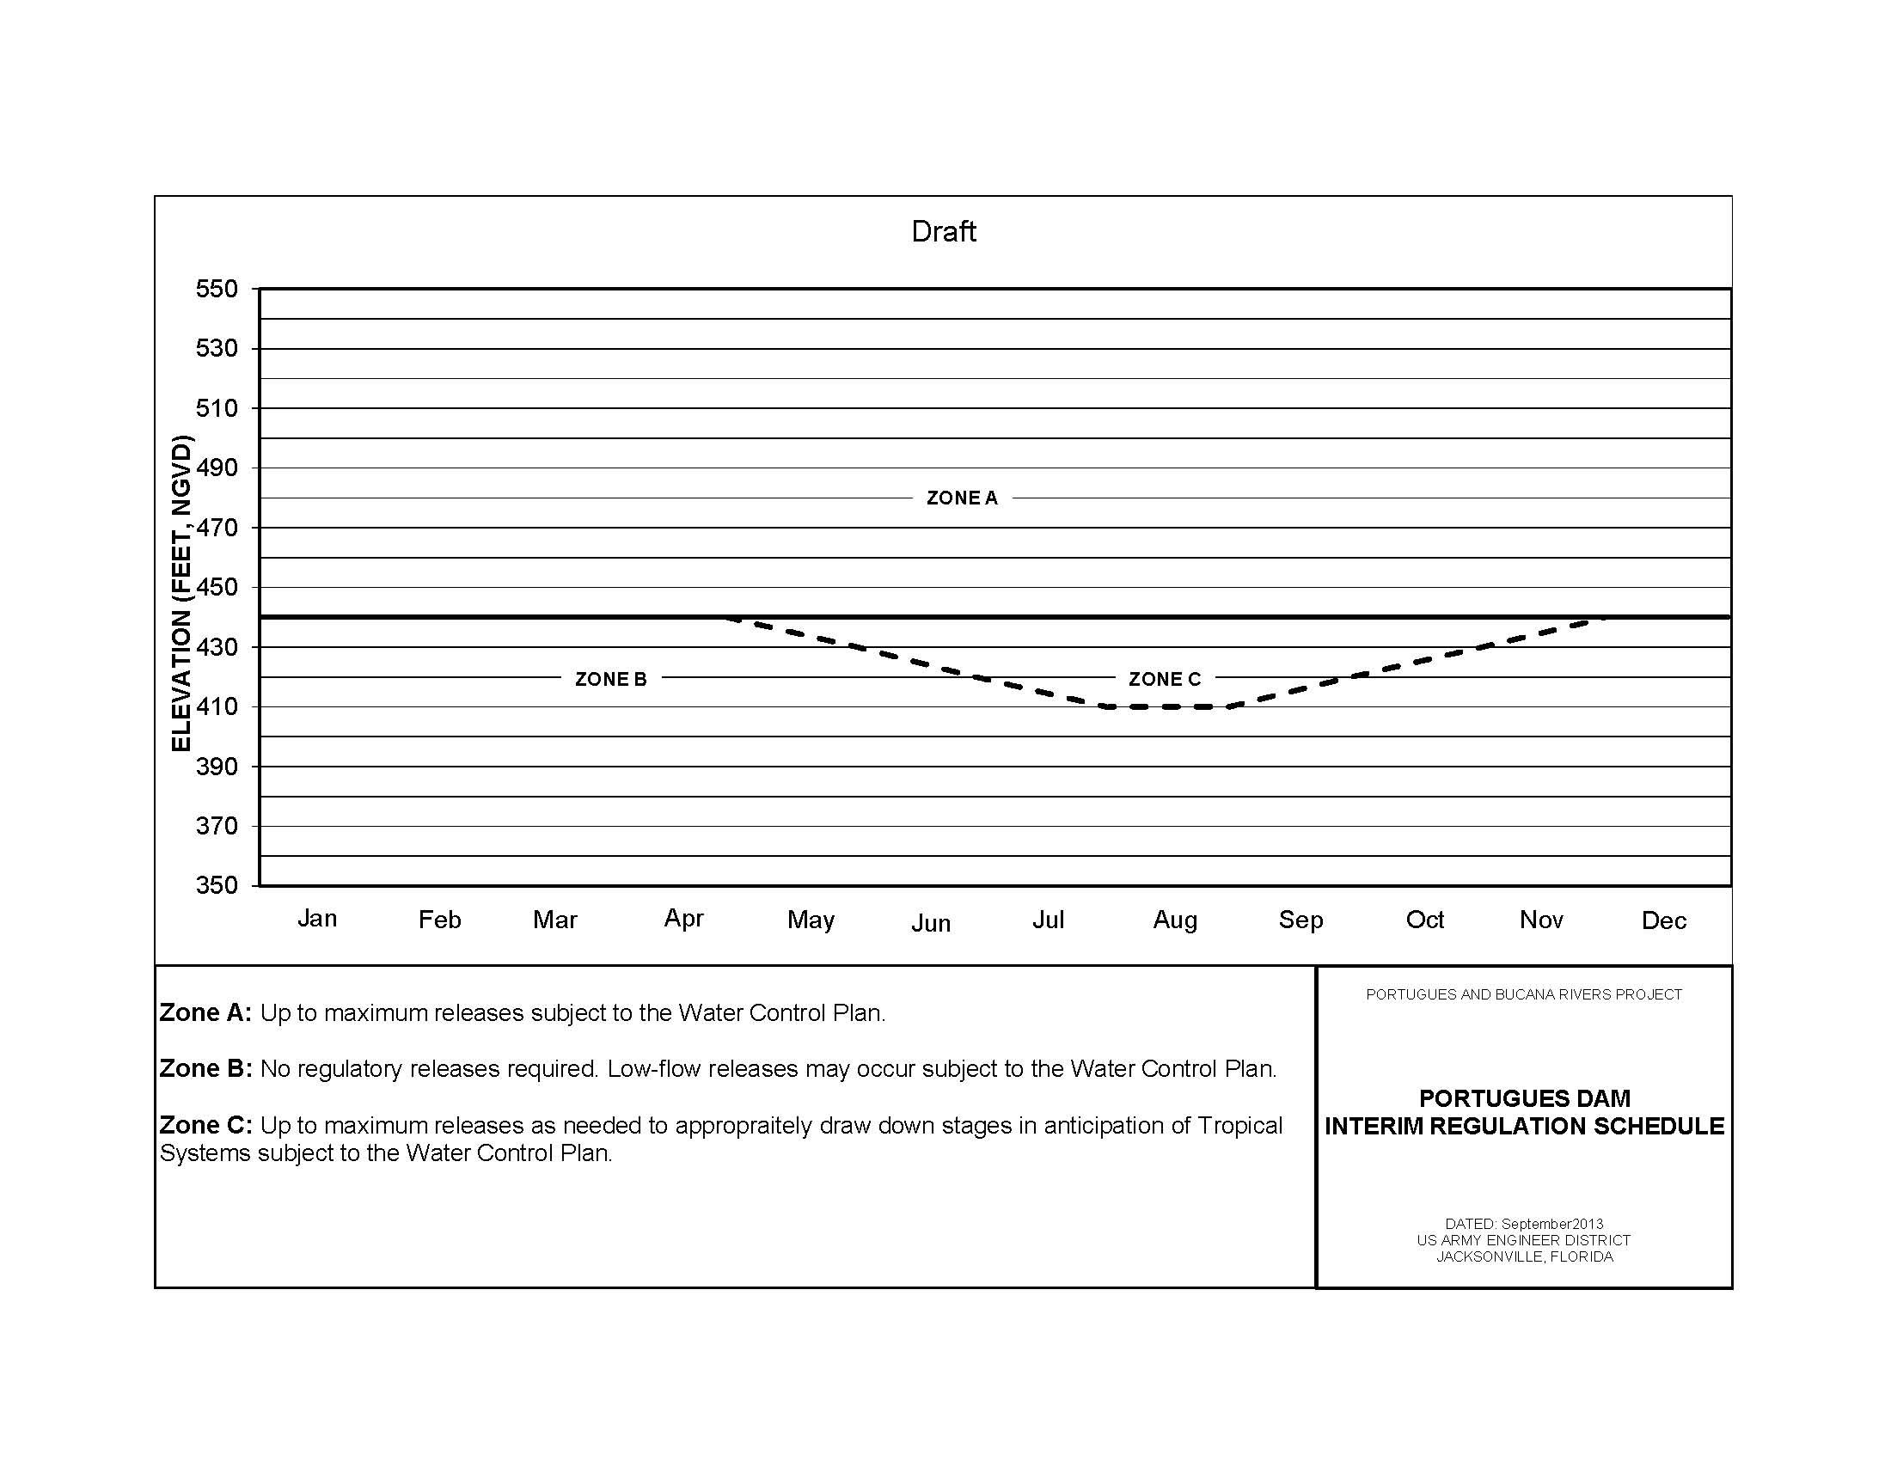
Portugués Dam Storage
and Principal Elevations
512.75’: spillway crest
Allowed drawdown
439.8’ optimum pool

Slide 12
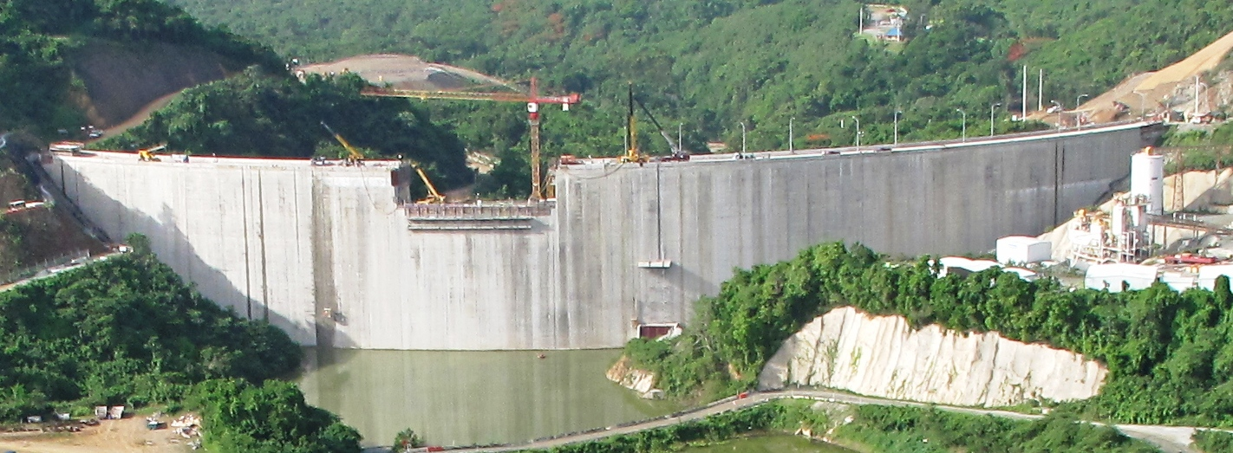
Portugués Dam Storage
and Principal Elevations
512.75’ - spillway crest
439.8’ - optimum pool
372.0’ – Max. drawdown

Slide 13
Decision-Making Process
The decision-making process to determine quantity, timing, and duration of the potential releases from Portugués Reservoir includes consideration of various information. This information includes but is not limited to:
P&B watershed conditions
Historical Portugués Reservoir water levels (TBD)
Reservoir ecological condition/needs
Storage capacity
Environmental Water supply conditions/needs
Current climate conditions
Projected Portugués Reservoir water level rise/recession
Downstream ecological conditions/needs
Climatic forecasts
Hydrologic outlooks

Slide 14
Portugués Dam
Deviation from Normal Regulation
Any deviation from the normal flood control procedures outlined in the Portugués Dam Water Control Manual shall be approved in advanced, except in the case of emergencies or unplanned minor construction deviations, by the USACE.
Typically, DNER will be responsible for making deviation requests to the USACE - Jacksonville District.

Slide 15
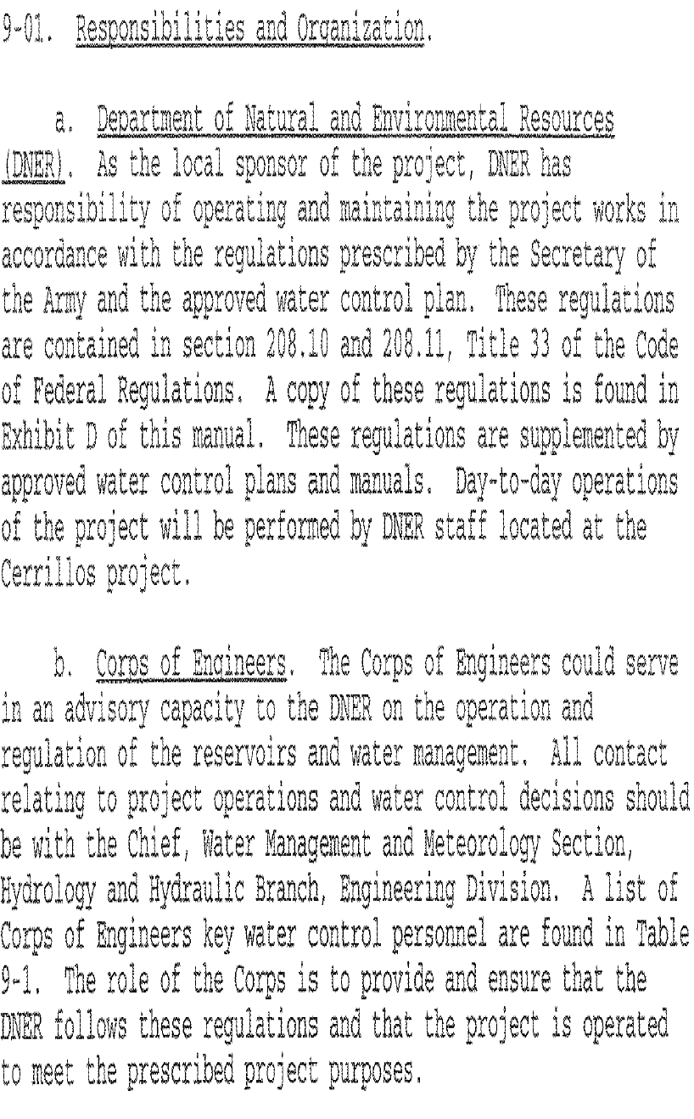
Roles and Responsibilities
(Portugués & Bucaná Rivers Project)
DNER (Local Sponsor):
Operate and maintain the project in accordance with regulations prescribed by the Secretary of the Army and the Water Control Plan.
USACE (Regulatory Agency):
Provide and ensure that DNER follows these regulations and that the project is operated to meet the prescribed project purposes.

Slide 16
Thank You
Luis Alejandro
Hydraulic Engineer
904-232-3034
Luis.A.Alejandro@usace.army.mil
Anthony Rodino III
Hydraulic Engineer
904-232-1047
Anthony.Rodino@usace.army.mil
Address:
U.S. Army Corps of Engineers Jacksonville District
701 San Marco Blvd.
Jacksonville, FL 32207
Website:
www.saj.usace.army.mil

Slide 17
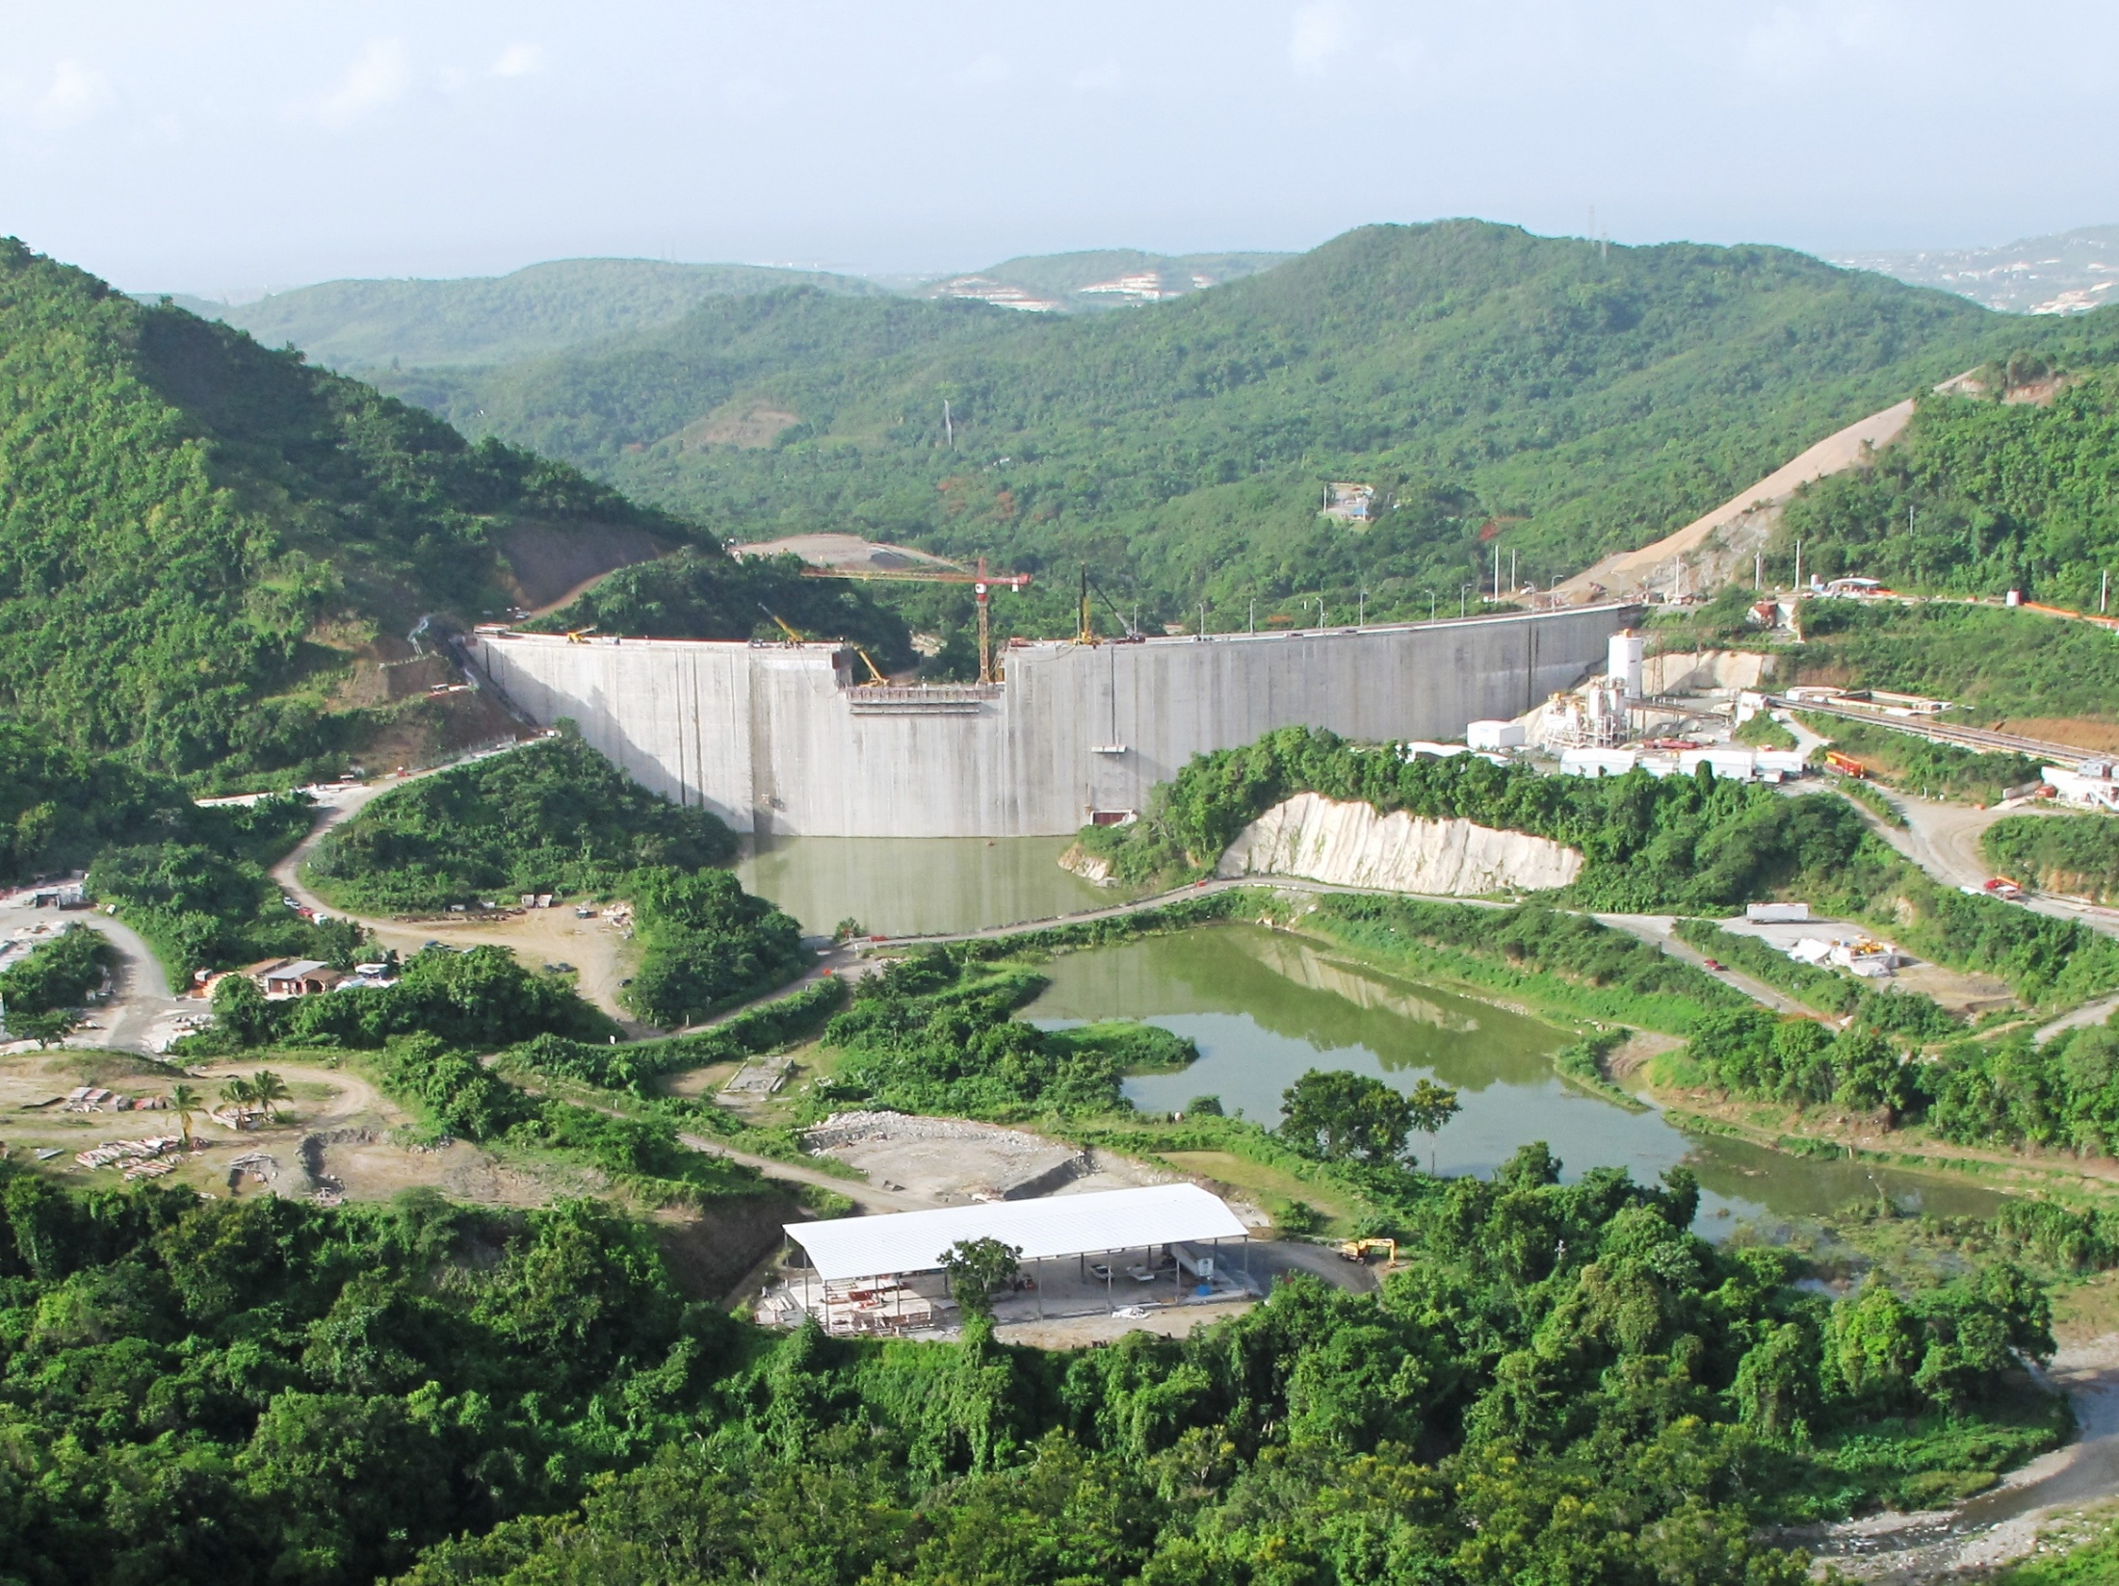
Portugués Dam and Reservoir
Water Management

