Slide 1
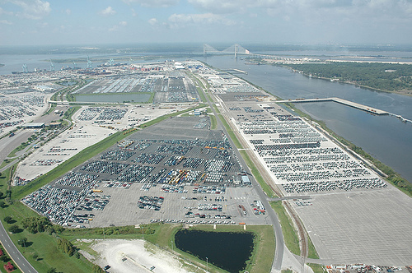
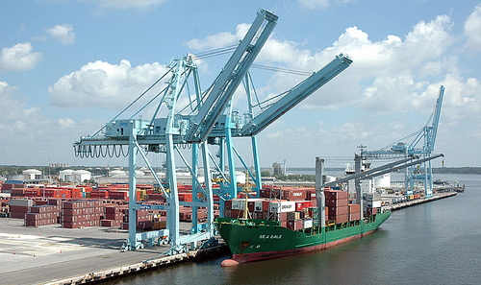
JACKSONVILLE HARBOR NAVIGATION STUDY
Duval County, Florida
Public Meeting
September 24, 2013
BUILDING STRONG®
BUILDING STRONG®
U.S. ARMY CORPS OF ENGINEERS | Jacksonville District
U.S. ARMY CORPS OF ENGINEERS | Jacksonville District

Slide 2
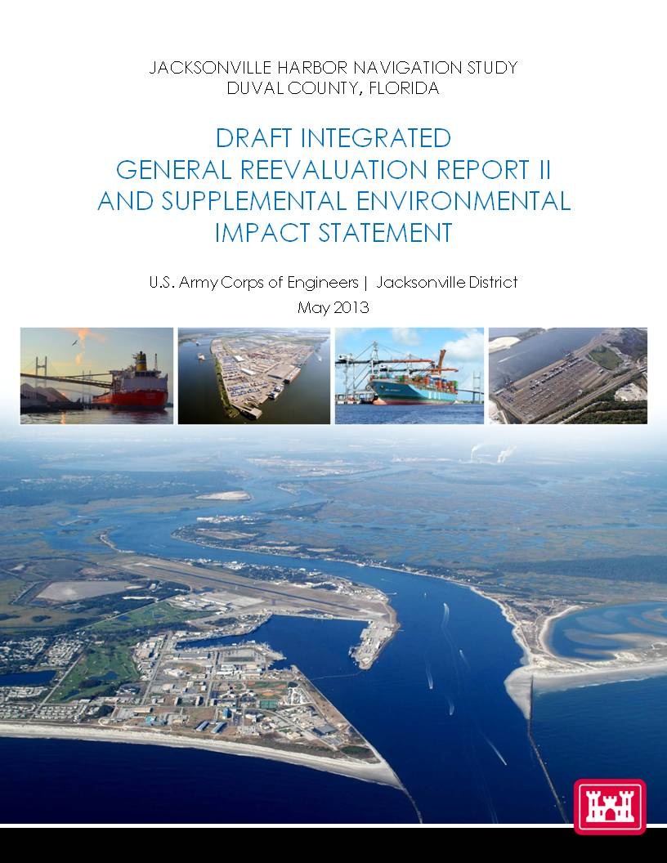
PUBLIC INVOLVEMENT UPDATE
~ 300 emails, letters, and phone calls received on the draft report
All will be forwarded with the draft report to our chain of command and Congress
COMMENT PERIOD EXTENDED UNTIL OCTOBER 24

Slide 3
PROJECT IMPLEMENTATION
Key Dates:
October 24, 2013: Public and Agency Comments Due
January 2014: Civil Works Review Board
April 2014: Chief of Engineer’s Report
2016: Begin Construction Pending Authorization and Appropriations
Construction Duration:
Approximately 4-6 Years
BUILDING STRONG®
US ARMY CORPS OF ENGINEERS | Jacksonville District
Notes:
January 29th CWRB

Slide 4
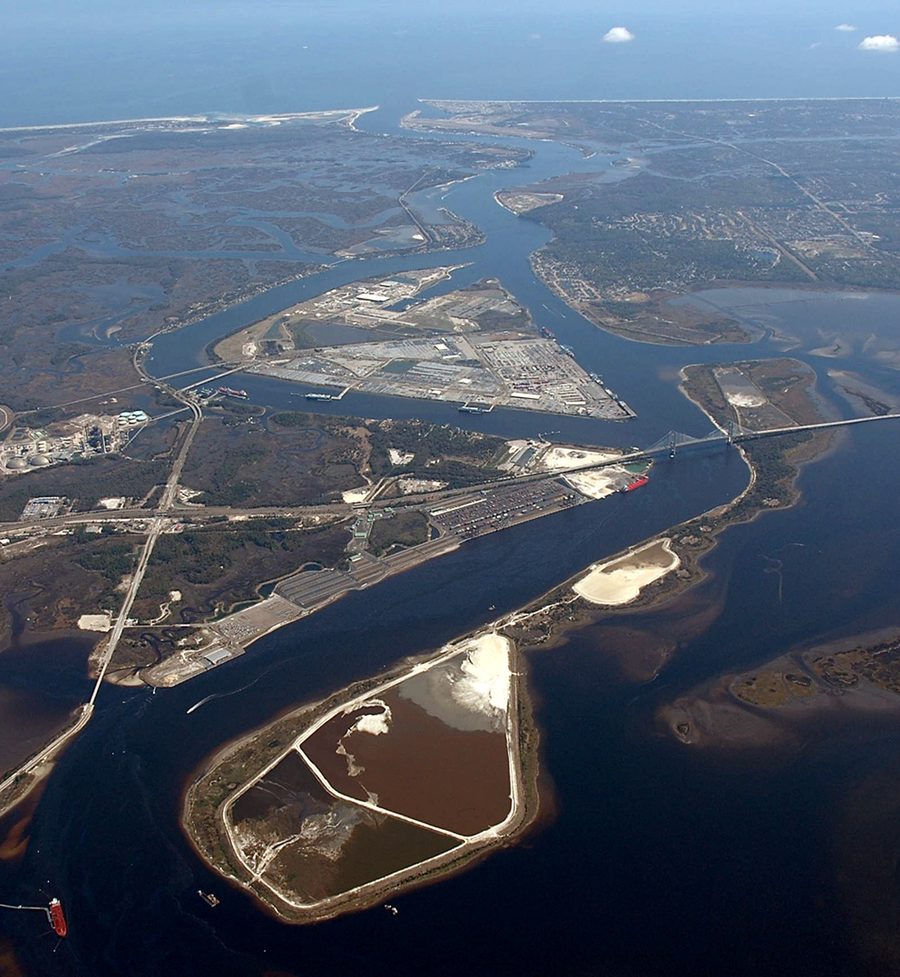
MAYPORT NAVAL STATION
MILE POINT
BLOUNT ISLAND
DAMES POINT
YOU ARE HERE

Slide 5
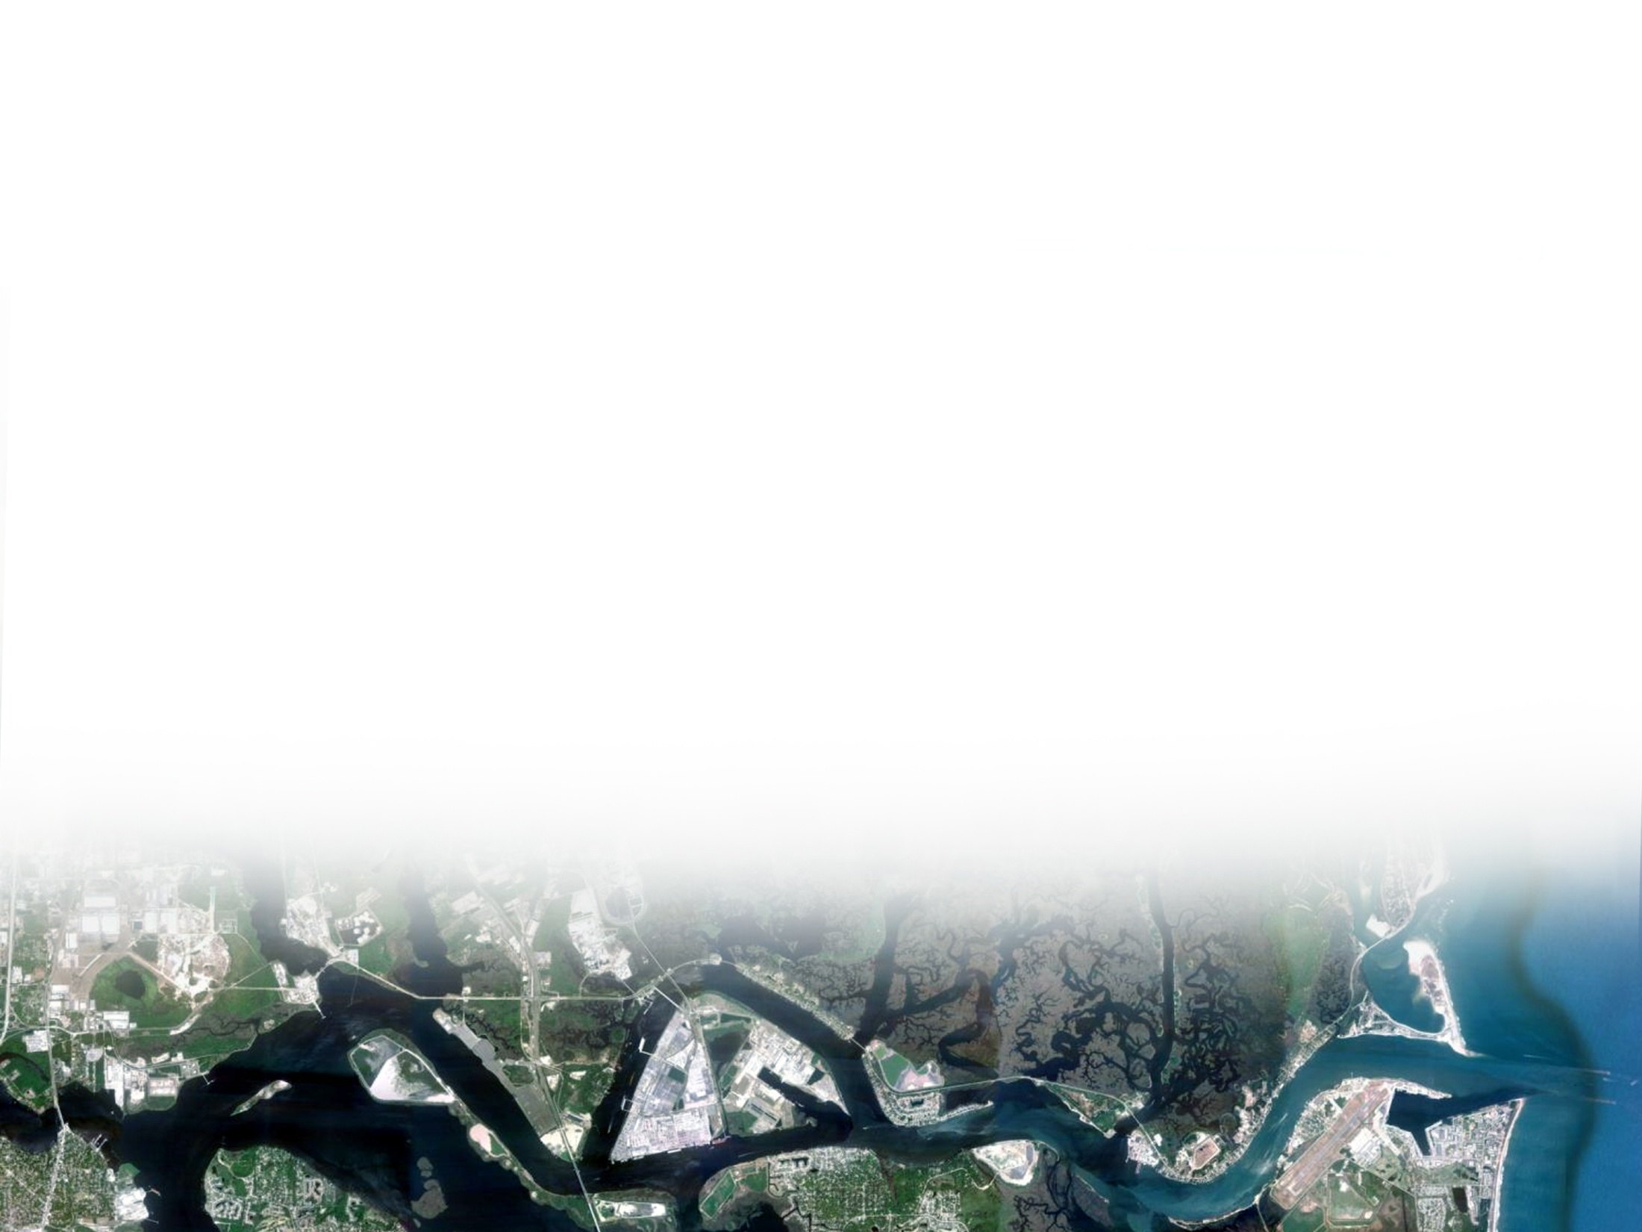
PURPOSE
Reduce Navigation Transportation Costs
Reduce Navigation Constraints (one-way traffic areas)
Accommodate Larger Vessels
Develop an Environmentally Acceptable Recommended Plan

Slide 6
PROJECT OVERVIEW
JEA TERMINALS
MILE 0
BRILLS CUT
TB
MOL TERMINALS
JPA BLOUNT ISLAND TERMINALS
JPA BULK TERMINALS
MAYPORT NAVY TERMINALS
MILE 13
BLOUNT ISLAND TB
CENTERLINE
EXTENT OF DEEPENING
WIDENING AREAS
TURNING BASIN EXPANSION
Deepen to 47 feet from the entrance channel to ~ River Mile 13
Widen at Training Wall Reach and St. Johns Bluff Reach
Turning Basins at Blount Island and Brills Cut
BUILDING STRONG®
US ARMY CORPS OF ENGINEERS | Jacksonville District
Notes:
Deepening from the entrance Channel to approximately River Mile 13.
Breakpoint will shift 47|49
Deepening Areas:
Deepen from the Entrance Channel to approximately River Mile 13 from the existing 40-foot depth to 47 feet (LPP), 45 feet (NED)
Widening Areas:
Area 1: Mile Point: increase to the north by 200 feet for Cuts 8, 9, 10, 11, 12, & 13
Training Wall Reach: increase to the south 100 feet by Cuts 14/15 & 16 transitioning to 250 feet for Cut 17 and back to 100 feet for Cuts 18 & 19
Area 2: St. Johns Bluff Reach/White Shells Cut: both sides of the channel by varying amounts of up to 300 feet for Cuts 40 & 41
Turning Basin Areas:
Blount Island: ~ 2700' long by 1500' wide located in Cut 42
Brills Cut: ~2500' long by 1500' wide located in Cut 45

Slide 7
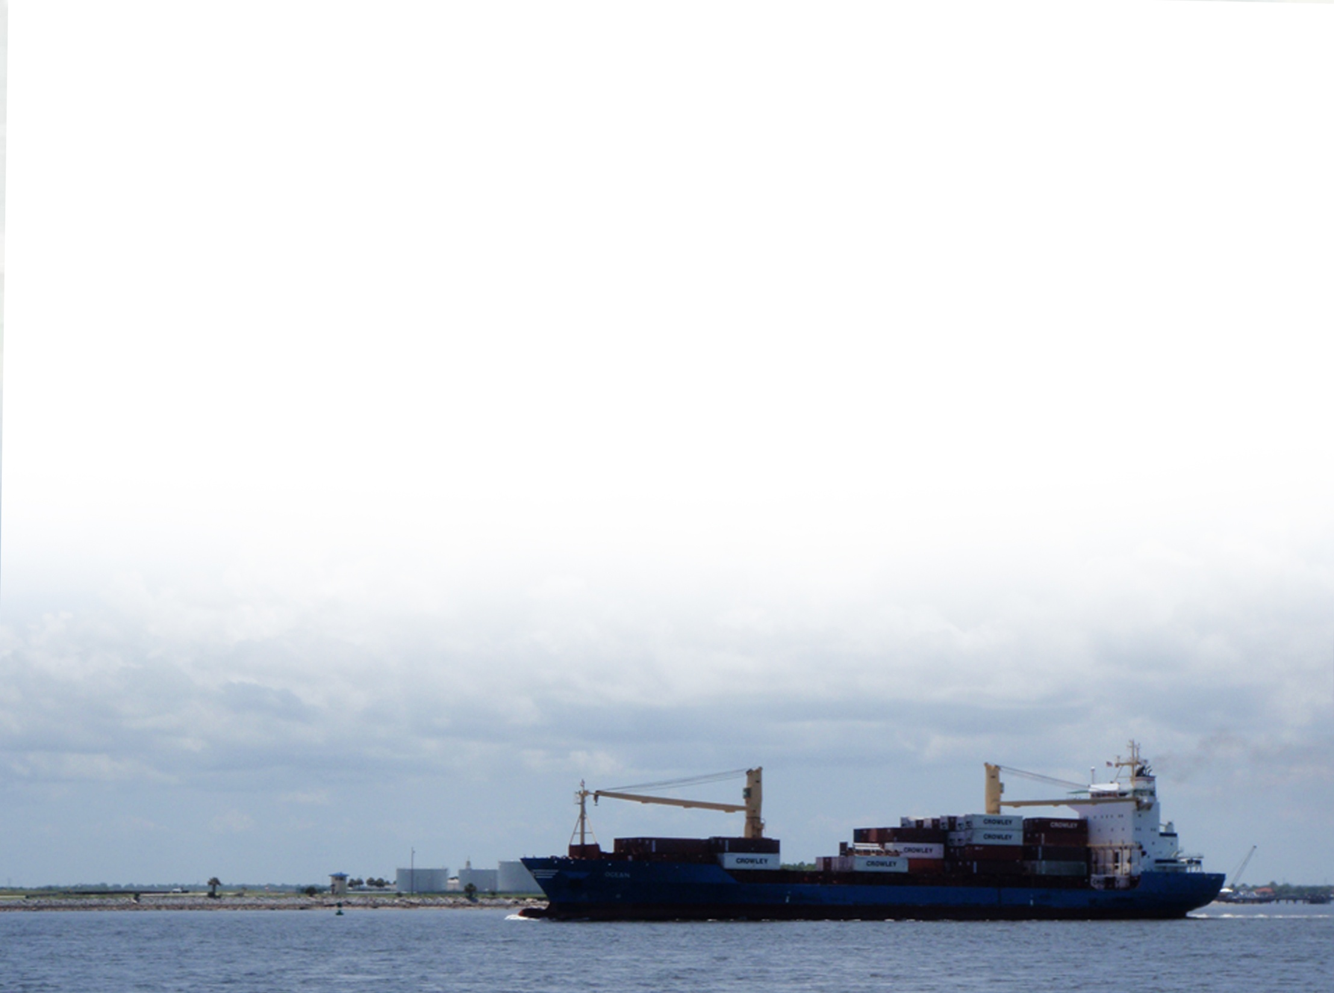
ECONOMICS OVERVIEW
Why we do economic analyses
What is National Economic Development (NED)?
NED and Jacksonville Harbor
Why is 45’ the NED Plan?
BUILDING STRONG®
BUILDING STRONG®
US ARMY CORPS OF ENGINEERS | Jacksonville District
US ARMY CORPS OF ENGINEERS | Jacksonville District
Notes:
Econ Slide #1
Take-Away
To discuss why USACE does an economic analysis on navigable waterway improvements
Explain the concept of NED in terms of what it is, and what it isn’t
Explain the relationship between NED and Jacksonville Harbor
Explain NED vs LPP

Slide 8
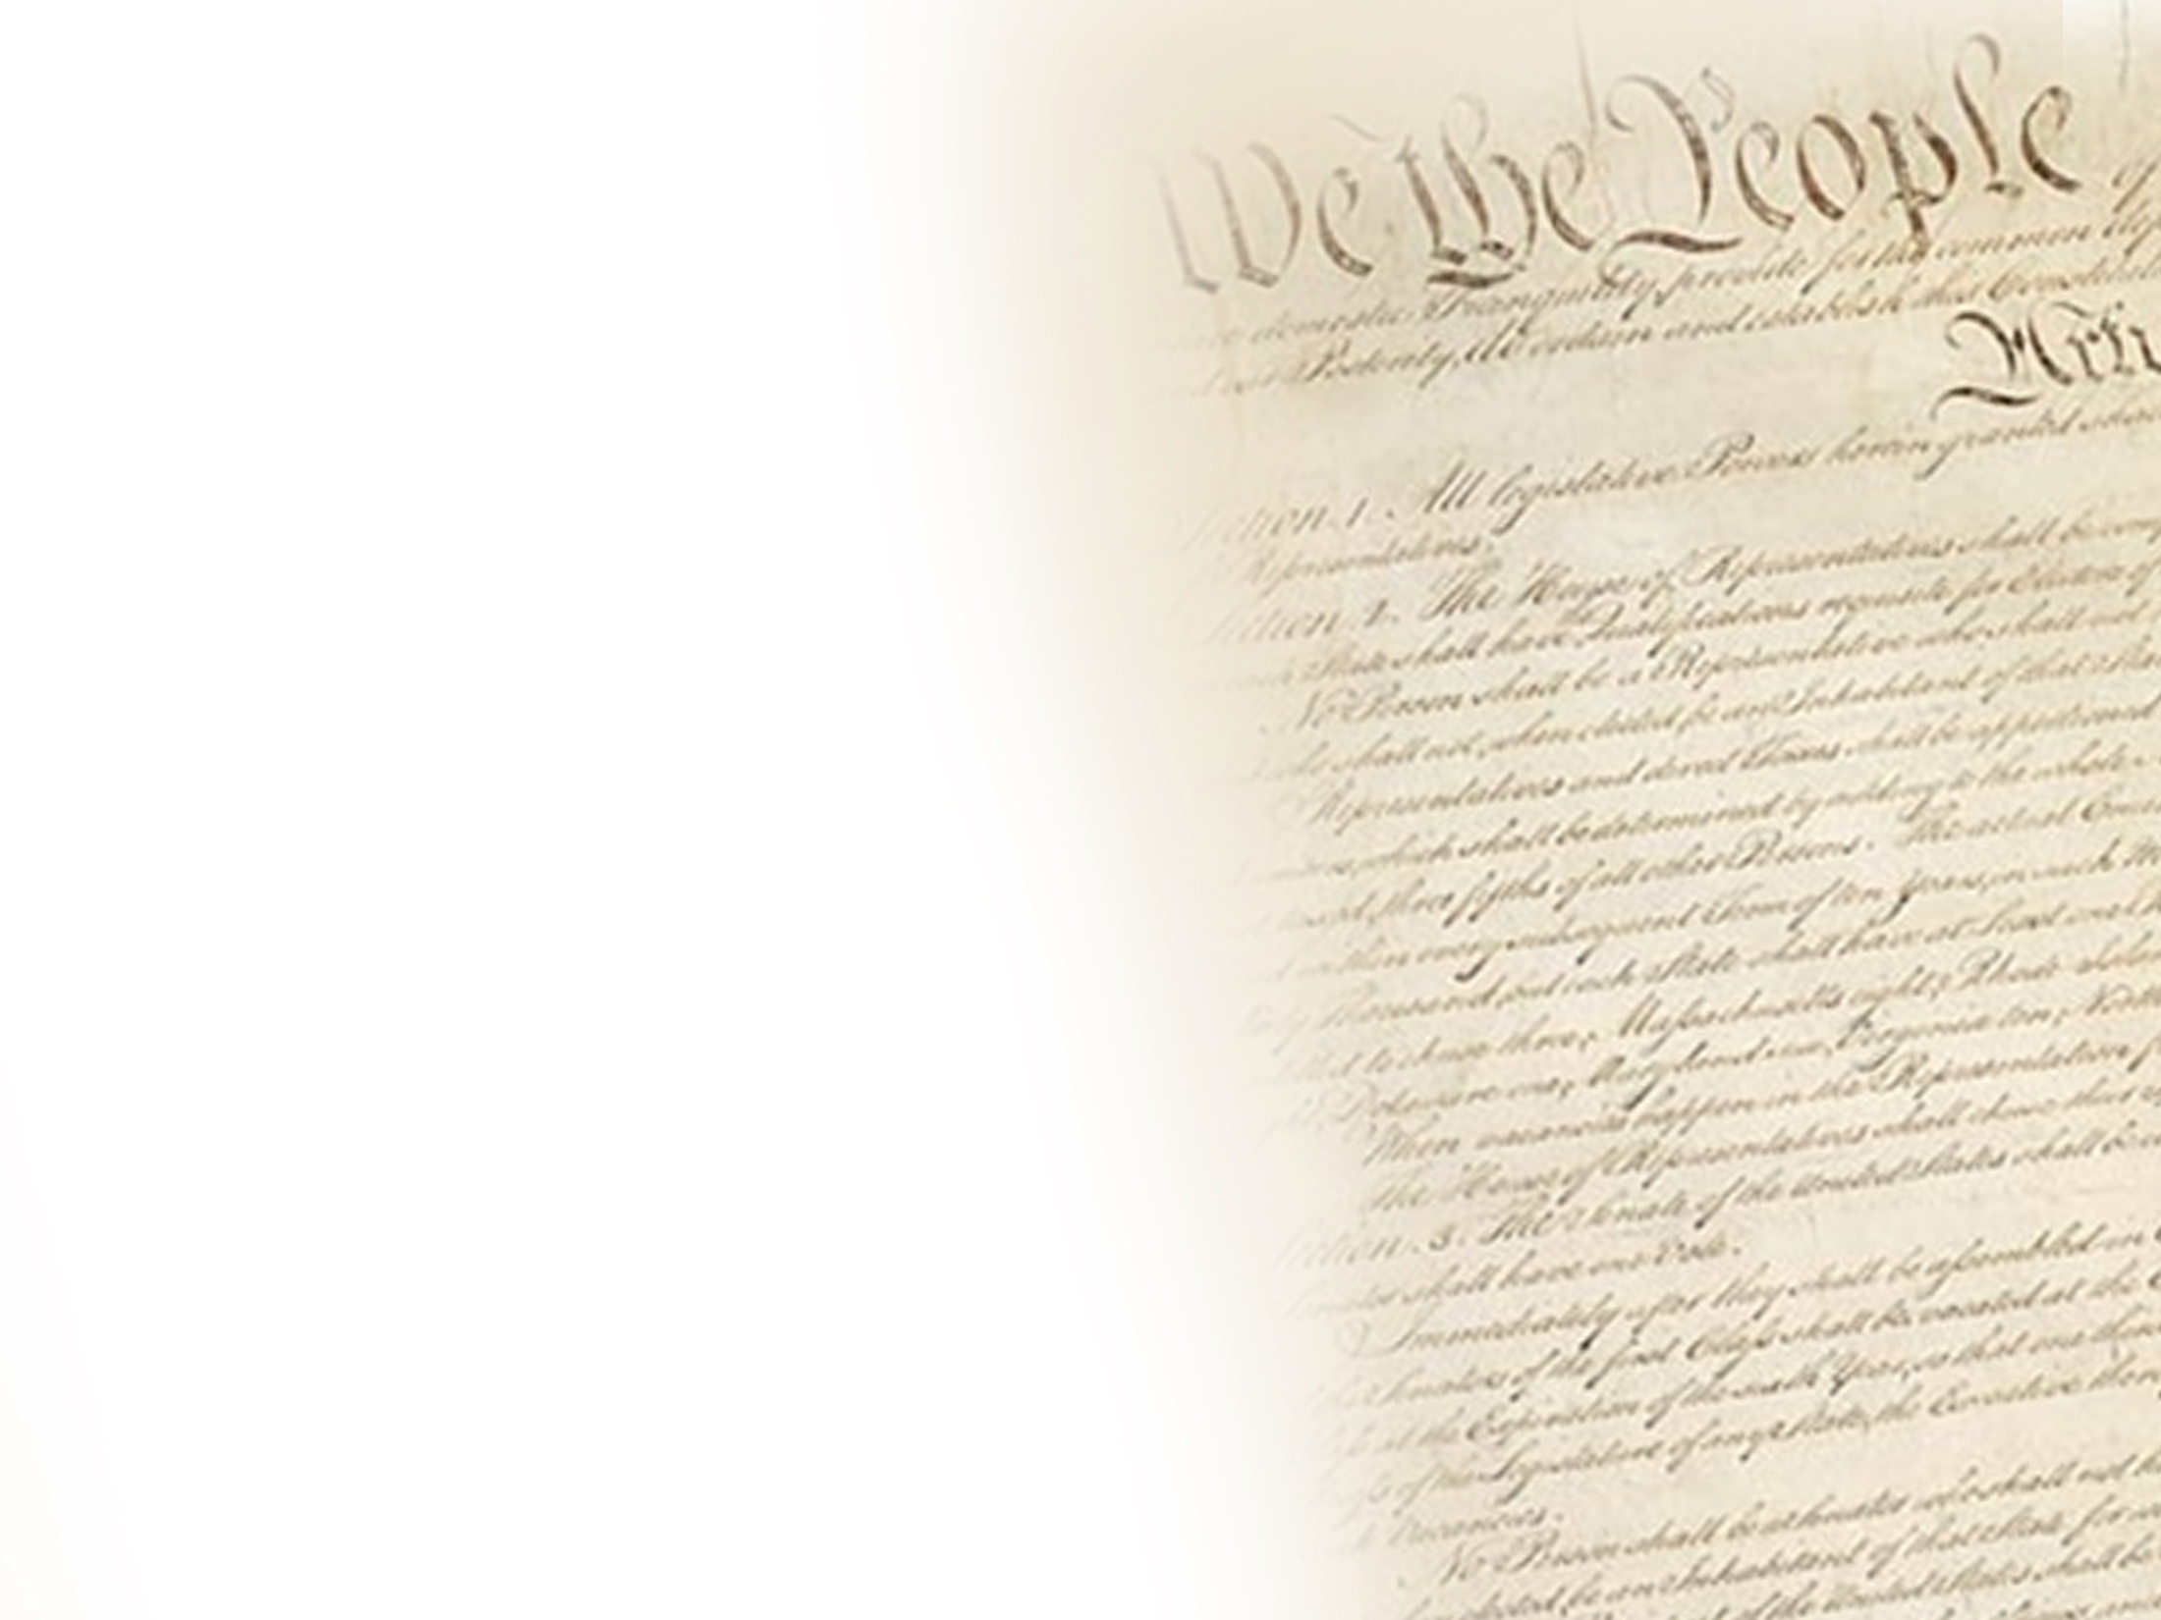
WHY WE DO ECONOMIC ANALYSES….
Why: To determine Federal Interest in navigable waterway improvements
Federal Interest in Navigation improvements:
U.S. Constitution
Linkage to navigable waterways
Navigation Project Purpose:
Move people, freight
Facilitate commerce
How is Federal Interest Determined?
National Economic Development (NED)
[The Congress shall have power]
To regulate commerce with foreign Nations, and among the several States, and with the Indian Tribes –
Notes:
Econ Slide #2: Why does USACE do economic analysis of navigable waterway improvements?
Take-Away
Economics is done to determine federal interest in navigable waterway improvements
Navigable Waterway – facilitates movement of people and freight for commercial purposes
Derived from the commerce clause of the Constitution. (Article 1. Section 8, Clause 3:).
Linked to the navigable waterways of the US by custom and court decisions defining the federal power to regulate commerce (Gibbons vs Ogden)
Deals with what taxpayer cash can and cannot be spent on; basis for federal participation
Determined based on National Economic Development
Therefore, if navigable waterway improvement project facilitates the movement of people and freight in a manner that contributes to NED, then the project is in the Federal Interest.

Slide 9
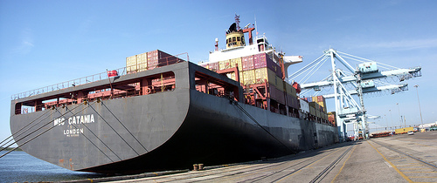
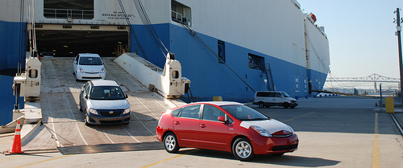
NATIONAL ECONOMIC DEVELOPMENT (NED)
NED = contribution to national value of goods and services
NED Benefit = Positive contribution
NED Cost = Negative contribution
Unit of measurement: Benefits and costs expressed in dollars
Benefit to Cost Ratio (BCR)
NED Benefits/NED Costs
BCR must exceed 1 to be authorized
NED Plan = plan that most reasonably maximizes net NED Benefits
Notes:
Econ Slide #3: National Economic Development (NED)
Take Away:
National Economic Development (NED): contributions to the national output of goods and services.
NED Benefits- Contributions that increase the value of the national output of goods and services.
NED Costs- Contributions that decrease the value of the national output of goods and services
Benefit to Cost Ratio:
BCR = NED Benefits / NED Costs
BCR must exceed 1 to demonstrate federal interest
NED Plan- The plan that most reasonably maximizes net NED benefits
Unit of Measurement: Ultimately, the intent of economic analysis is to measure the change in the relative value of the resources used to move the commodities against the relative value of the resources used to construct the project. Since there is a wide variability in the nature, quantity, and relative value of resources that need to be coordinated to move the cargo, they are expressed in monetary units for evaluation and comparison purposes.

Slide 10
NATIONAL ECONOMIC DEVELOPMENT (NED)
NED does not consider:
Local and regional job creation
Competition amongst regional ports
Notes:
Econ Slide #4: National Economic Development (NED)
Take-Away:
NED does not consider local and regional job creation. Establishment of the federal interest The question at hand is: “Will this action benefit the country?” Local and regional job creation are RED benefits, and not appropriate for use in project justification.
It is not the role of USACE to pick winners and losers between the nations seaports. While competition amongst regional ports is the reality, we make no assumptions or predictions about the outcome of said competition.

Slide 11
NED & JACKSONVILLE HARBOR
HarborSym Model used
NED Benefits of the Project:
Vessels use capacity more efficiently
Cargo can be moved on a smaller number of larger, more technologically advanced vessels
Reduced exposure to tidal delay
NED Benefits > NED Costs
Deepening Jacksonville Harbor:
Contributes to reduction in opportunity cost of trade
Trade = major contributor to national output
Therefore, contributes an increase to net value of national output
Notes:
Econ Slide #5: National Economic Development (NED)
Take-Away:
HarborSym was used to estimate the transportation cost savings.
Monte Carlo simulation model used to estimate commodity movement cost
Build model of the Harbor under different configurations
Design the future port traffic given those different configurations
Run the traffic through each configuration
NED Benefits:
More efficient capacity use
More cargo can be moved on a smaller # of vessels
Less exposure to tidal delay
NED Costs < NED Benefits: Analysis results that deepening up to 50’ was economically justified
Bottom Line:
Deepening Jax Harbor reduces the cost of trade
Trade is a major portion of national output of goods and services
Reducing the opportunity cost of trade increases the net value of the national output of goods and services.
Therefore deepening Jacksonville Harbor is a positive contribution to National Economic Development, and is in the federal interest.

Slide 12
WHY IS 45 FEET THE NED PLAN?
NET NED BENEFITS
NET NED BENEFTS MAXIMIZED
45 feet Maximizes net NED benefits
47 feet is economically justified
Notes:
Econ Slide #6: National Economic Development (NED)
Take-Aways:
45’ maximizes net NED Benefits.
47’ is economically justified.

Slide 13
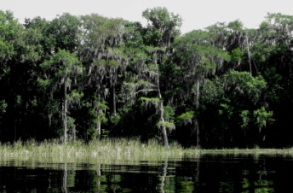
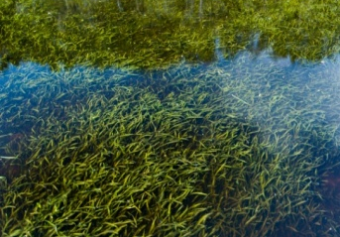
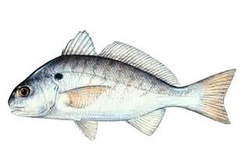
ENVIRONMENTAL ISSUES AND CONCERNS
Status of the environmental models, and providing results for public review
Credentials of the salinity and ecological models
Salinity effects within the main stem and tributaries
Mitigation for salinity effects
Environmental Monitoring and Adaptive Management (Corrective Action)
Notes:
Salinity means the saltiness of the water. Salinity level is a very important factor in determining where aquatic plants and animals may live.

Slide 14
ENVIRONMENTAL MODELS COMPLETED
All Results Are On The USACE Website
Main Stem Salinity Modeling (EFDC)
Main Stem Ecological Modeling
Eelgrass, Wetlands, Fish and Macroinvertebrates (Shrimp)
Tributary and Salt Marsh Salinity Modeling (MIKE21)
ADCIRC Modeling: Water Level Effect on Salt Marsh
Report will be posted by September 30
Water Quality Modeling
Report will be posted by September 30
Notes:
This is a checklist of the environmental models that we have completed for the deepening study.

Slide 15
SALINITY MODEL CREDENTIALS (EFDC; MIKE21)
Environmental Protection Agency (EPA): “(EFDC) has evolved over the past two decades to become one of the most widely used and technically defensible hydrodynamic models in the world.”
Both EFDC and MIKE models have undergone extensive worldwide reviews, documentation, and applications by research institutions, governmental agencies, and consulting organizations
Examples of the modeling applications:
EFDC : St. Johns River Total Maximum Daily Load Study; SJRWMD Water Supply Impact Study; Savannah and Charleston Deepening Studies
MIKE : New York and New Jersey Harbor Deepening Study; Southwest Louisiana Study
Notes:
Why did we pick these particular salinity models? Again, they are called EFDC and MIKE21. We picked them because they have excellent credentials.

Slide 16
ECOLOGICAL MODEL CREDENTIALS (Eelgrass, Wetlands, Fish, Macroinvertebrates)
Developed specifically for the St. Johns River by SJRWMD senior scientists
Adapted for the deepening study with the help of agencies and academia
Notes:
Why did we pick these particular ecological models? Again, we ran a separate model on eelgrass, wetlands, fish, and macroinvertebrates.

Slide 17
MODEL REVIEW (Credentials)
Regulatory and Resource Agencies
Recognized Experts on Eelgrass, Wetlands, Fish, and Macroinvertebrates
Independent External Peer Review
USACE District Quality Control
USACE Environmental Center of Expertise
USACE Agency Technical Review
Public Review
Notes:
None of the agencies or expert modelers have questioned the use of the models that we have selected.

Slide 18
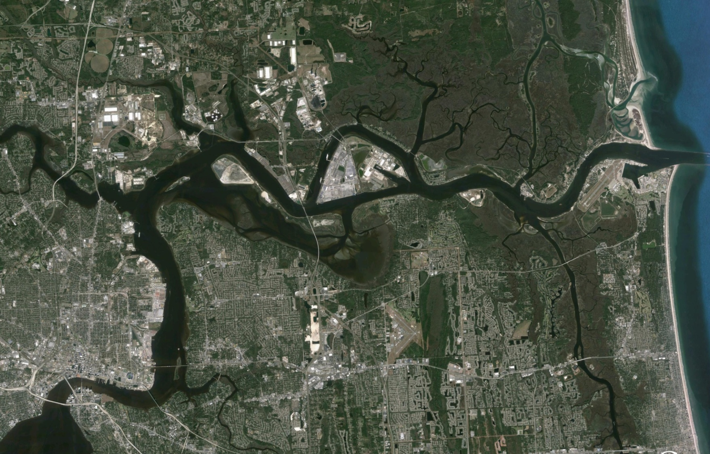
OVERVIEW OF LOWER STUDY AREA SALINITY RESULTS
(Change in Depth-Averaged Median Salinity Due to Deepening)
18
Dames Pt. Bridge
Salinity Range: 0.4 - 36.5 ppt
Baseline Median: 25.2 ppt
Change: - 0.1 ppt
Clapboard & Cedar Pt. Creeks
Change: 0.0 to - 0.4 ppt
West of IWW
Change: 0.1 ppt
Acosta Bridge
Salinity Range: 0.1 – 34.5 ppt
Baseline Median: 12.0 ppt
Change: 0.2 ppt
ppt: parts per thousand
Notes:
This is an overview of how the proposed deepening may affect salinity in this part of the river. ORIENTATION
You will note that the ranges of salinity are quite large (USE CALL OUTS). These are areas where fresh and salt water mix. This is an estuary.
The key point on this figure is that the changes in salinity caused by the deepening are small.
The period of record that we used in our salinity modeling was on the dry side. This means that we are looking at worst case scenarios for salinity change.
The USACE and JAXPORT reduced the effect that deepening would have on salinity levels by eliminating Segment 2 from the study footprint (show Segment 2).

Slide 19
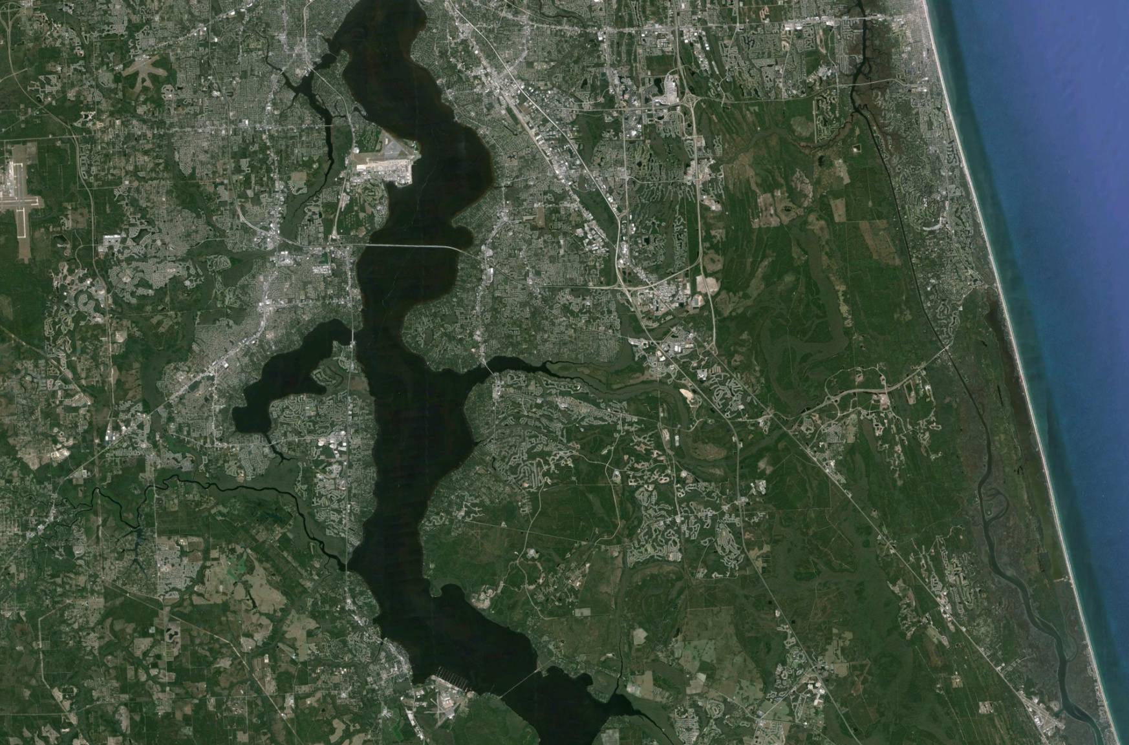
OVERVIEW OF UPPER STUDY AREA SALINITY RESULTS
(Change in Depth-Averaged Median Salinity)
19
Buckman Bridge
Salinity Range: 0.1- 28.1 ppt
Baseline Median: 2.0 ppt
Change: 0.0 ppt
Ortega & Cedar Rivers
Change: 0.0 - 0.5 ppt
Julington & Durbin Creeks
Change: 0.0 ppt
Shands Bridge
Salinity Range: 0 – 13.9 ppt
Baseline Median: 0.4 ppt
Change: 0.0 ppt
ppt: parts per thousand
Notes:
And this is an overview of how the proposed deepening may affect salinity in this upstream part of the river. ORIENTATION
Salinity ranges are quite large.
Changes in salinity are minor. Mostly 0.0 ppt or very near zero.
You may be wondering why there is a 0.5 ppt change for the Ortega River.
First Point: This is because we used an even more extreme, or drier, period of record for the Ortega than the main stem of the river.
Second Point: The 0.5 ppt change would occur near the mouth of the Ortega River, and would only occur during very dry years. In a dry year even without the deepening the salinity would be quite high in this area.
5. We can discuss some more afterwards.

Slide 20
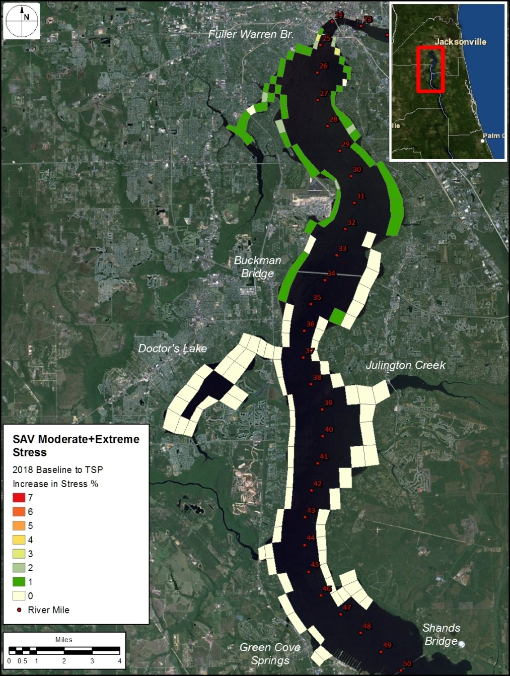
20
ECOLOGICAL MODEL
SAV (Eelgrass): Increase in Salinity Stress Frequency
From 2018 Baseline to 2018 TSP(47ft)
River Mile | Eelgrass Bed Extent (Baseline) | Eelgrass Bed Stress Condition (Baseline) | Difference from Baseline to TSP
24.5 – 26 | Very Sparse | Stressed | 1 - 3%
26-31 | Sparse | Stressed | 0 - 2%
31-35 | Persistent | Stressed | 0 - 1%
35-36 | Persistent | Stressed | 0 - 1%
Notes:
This slide shows some of our SAV (eelgrass) model results.
ORIENTATION. Landmarks (bridges), eelgrass areas-ephemeral and persistent beds.
The main point we wanted to show is where eelgrass could be affected by the deepening. Point to area. The model is predicting that eelgrass in this area would experience a 1-3 % increase in stress frequency due to the deepening.

Slide 21
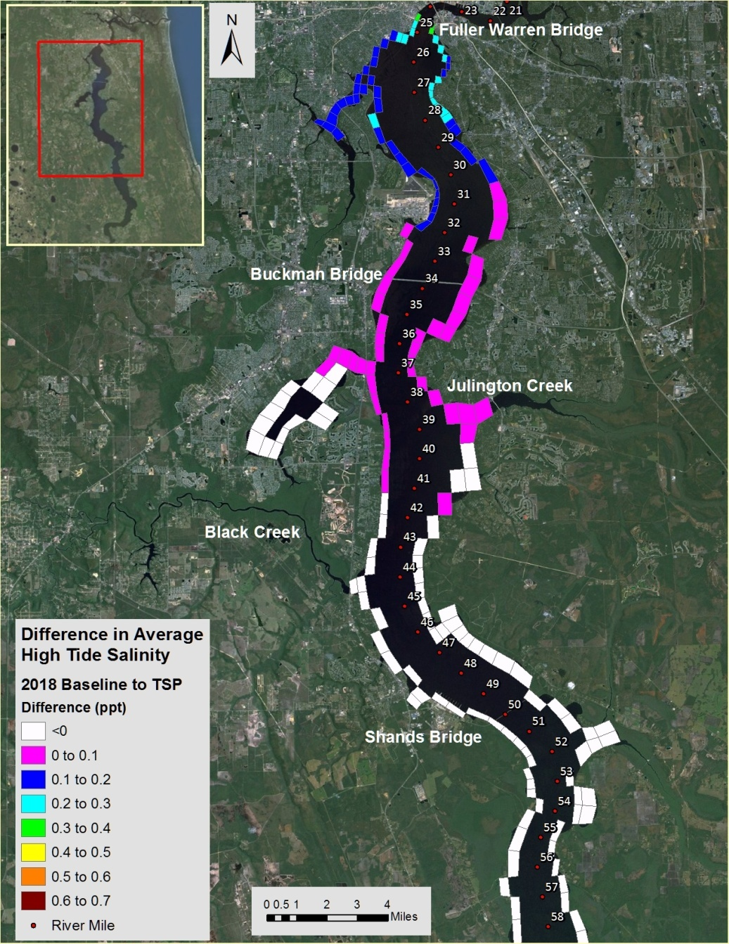
ECOLOGICAL MODEL Wetlands: Difference in Average High Tide Salinity From 2018 Baseline to 2018 TSP(47ft)
21
BASELINE
TO TSP (DIFFERENCE)
Notes:
Main Points
This graphic shows some of our wetland model results. ORIENTATION
We are interested in how high tide salinity may affect wetlands.
This is the take home point, we see that the changes in average high tide salinity caused by the deepening are small, 0.1-0.3 ppt, which would not result in any significant changes in wetlands.
Complex slide, we would be happy to discuss in more detail after the presentation.

Slide 22
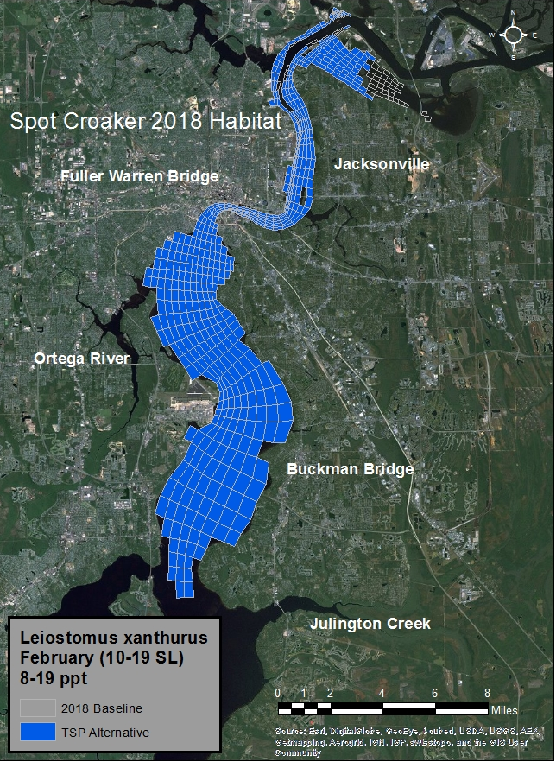
22
FISH MODEL Difference in Salinity-based Habitat From 2018 Baseline to 2018 TSP(47ft)
Typical Example
Notes:
1. Our fish and macroinvertebrate models evaluated how the deepening may affect salinity based habitat for a number of species.
This is a graphic for spot croaker. Our model is indicating a 3.3 % loss of salinity based habitat. Point out Mill Cove area.

Slide 23
SUMMARY OF SALINITY AND WATER LEVEL IMPACTS
EELGRASS
1%-3% increase in stress frequency between Acosta and Buckman Bridges
No beds would disappear because of the deepening
WETLANDS
Due to minor changes in salinity, wetlands would not significantly change due to deepening
Deepening may contribute in a small way to ongoing changes in plant composition and soil subsidence
Proposed deepening would not cause changes in water level that would affect salt marsh or other wetlands
Rising sea level will cause water level and salinity changes in the river that will have much greater impact than the deepening
FISH AND MACROINVERTEBRATES
0-8% change in salinity-based habitat for some fish and shrimp

Slide 24
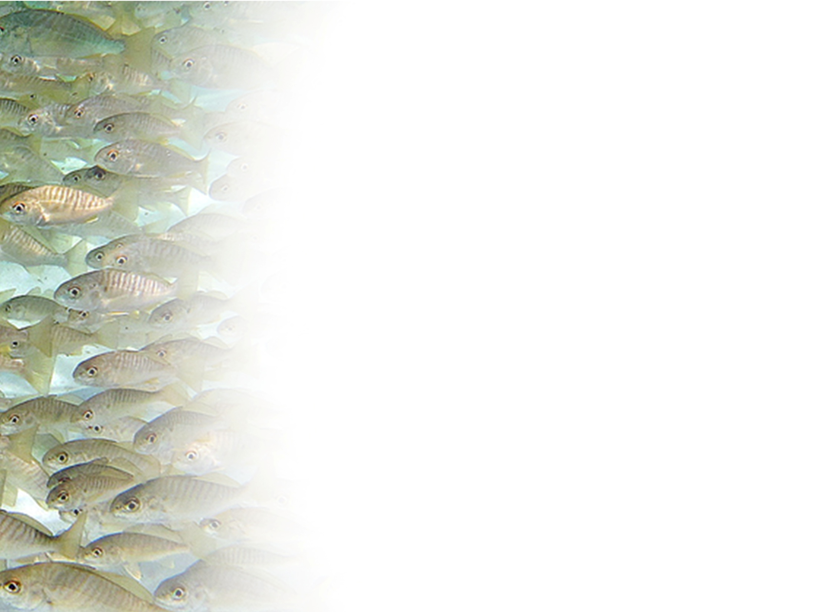
RECOMMENDED BASE MITIGATION PLAN
Acquisition of lands for conservation:
Freshwater Conservation Area
~595 acres identified for purchase for both eelgrass and wetland effects
Salt marsh Conservation Area
~44 acres identified for purchase for fisheries effects
Specific conservation parcels will be designated upon the appropriation of final project funding and coordination with the appropriate resource agencies.
USACE continues to coordinate with regulatory agencies on other mitigation options such as wetland and eelgrass restoration projects.
Notes:
We are proposing a base mitigation plan for the minor effects that we just discussed.
This is a provisional plan. We have coordinated the plan with the agencies but it has not been approved .

Slide 25
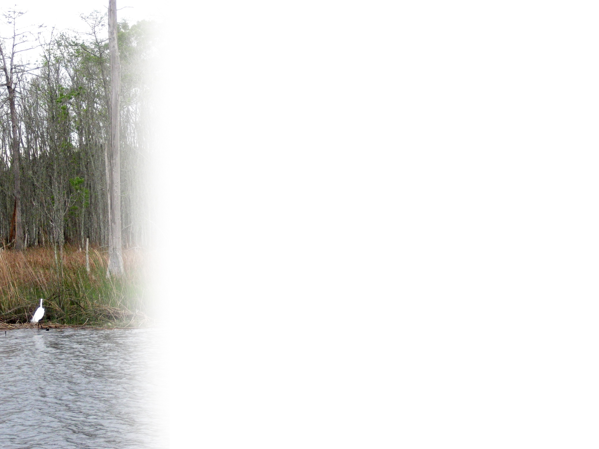
MONITORING
USACE proposes a long-term monitoring plan to include:
Placement of water quality monitoring stations in the main stem and selected tributaries
Eelgrass, wetlands, and fisheries monitoring
Additional modeling to help determine causes of any observed changes

Slide 26
ADAPTIVE MANAGEMENT PLAN (Corrective Action)
Addresses environmental risk and uncertainty
Establishes numeric salinity and biological thresholds that would trigger modeling and mitigation actions
Outlines path forward should additional salinity changes occur as a function of the deepening project beyond that mitigated for
ADAPTIVE MANAGEMENT/ CORRECTIVE ACTION PLAN
MONITORING
ACTION TAKEN *
THRESHOLD(S) REACHED
* INCLUDES MORE MITIGATION

Slide 27
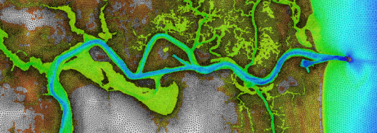
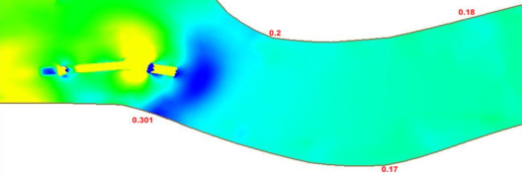
ENGINEERING OVERVIEW
Groundwater Analysis
Are there impacts to the aquifers?
Air Draft Restrictions
Will new ships fit under power lines and Dames Point Bridge?
Storm Surge Analysis
Will the project increase water surface elevations during a storm?
Shoaling Analysis
How much additional material for future maintenance dredging?
Shoreline Erosion
Changes to river dynamics as a result of construction & operations?
BUILDING STRONG®
U.S. ARMY CORPS OF ENGINEERS | Jacksonville District
Notes:
Deepening from the entrance Channel to approximately River Mile 13.
Breakpoint will shift 47|49

Slide 28
GROUNDWATER ANALYSIS
No impact to Floridan Aquifer (primary drinking water source for area)
USGS Groundwater Model – Surficial Aquifer
Little to no affect to surficial aquifer and only in areas likely to be impacted by existing conditions
Cross sections generated based on available data at four locations along the channel
Cross sections located at residential areas most likely to use surficial aquifer
Four possible geologic scenarios tested at each location
Most conservative scenario shows increase of 4 ppt salinity within 75 feet of channel on one section – most likely scenario indicates < 0.2 ppt
Surficial Aquifer
49 feet
Channel Extent
40 – 80 feet
10-100 feet
River Bottom
Intermediate Confining Unit
300 – 500 feet
Floridan Aquifer
Notes:
1. Important to note that where the increase salinity is noted, the area has been long exposed to high salinity groundwater.
2. VERY IMPORTANT – deepening will have no impact on Floridan Aquifer, primary drinking water source for area.

Slide 29
GROUNDWATER ANALYSIS
APPROXIMATE LOCATIONS OF EXISTING RIVER DEPTHS
-49’
-60’
DOWNTOWN (LANDING)
-82’
-53’
-59’
-50’
-49’
-56’

Slide 30
AIR DRAFT RESTRICTIONS
TOP OF MAST
Air Draft for Operating Range
(167 feet to 155 feet)
Constructed Height of Vessel (199 feet)
SUSAN MAERSK
WATER LEVEL
Vertical Clearance:
Dames Point Bridge: 174 feet
JEA Power Lines (Blount Island): 175 feet
Normal Operations Draft (32 feet to 44 feet)
BOTTOM OF VESSEL
Information courtesy: Maersk
BUILDING STRONG®
US ARMY CORPS OF ENGINEERS | Jacksonville District

Slide 31
STORM SURGE & SEA LEVEL CHANGE ANALYSIS
Based on:
FEMA Storm Surge Study Mesh
Hurricane Dora
Synthetic Storm Surge and Sea Level Change Scenarios
Storm Surge/ Sea Level Change Scenarios
Scenario | Channel Depths | Sea Level Rise (SLR) | Storm Event
1 | 2068 FWOP | 0.4 ft | 50-yr
2 | 2068 FWOP | 0.4 ft | 100-yr
3 | 2068 TSP 47 ft | 0.4 ft | 50-yr
4 | 2068 TSP 47 ft | 0.4 ft | 100-yr
5 | 2068 FWOP | 1 ft | 50-yr
6 | 2068 FWOP | 1 ft | 100-yr
7 | 2068 TSP 47 ft | 1 ft | 50-yr
8 | 2068 TSP 47 ft | 1 ft | 100-yr
9 | 2068 FWOP | 2 ft | 50-yr
10 | 2068 FWOP | 6 ft | 50-yr
Mesh resolution: Minimum element size ~ 100 feet
FWOP: Future Without Project
Notes:
Jacksonville Harbor ADCIRC (hydrodynamic) + SWAN (wave) Mesh based on Georgia / Northeast Florida FEMA Storm Surge Study mesh
Refined & adapted ADCIRC mesh for St. Johns River & Jacksonville Harbor Project area
Calibrated & Validated with Hurricanes Dora and Frances Water-levels
Simulated Hurricane Dora (w/o SLC) for with & without Project Condition
>-Maximum WSE in Jacksonville Harbor Project Vicinity; Hurricane Dora (1964) Simulation with Existing Channel Conditions and No SLC
Simulated Synthetic 50-yr RT and 100-yr-RT storm events in combination with USACE SLC for with & without project conditions

Slide 32
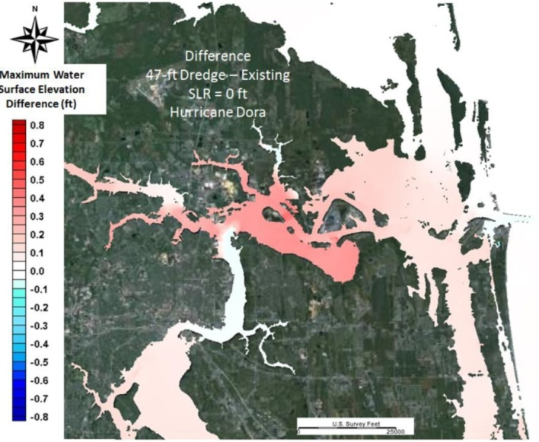
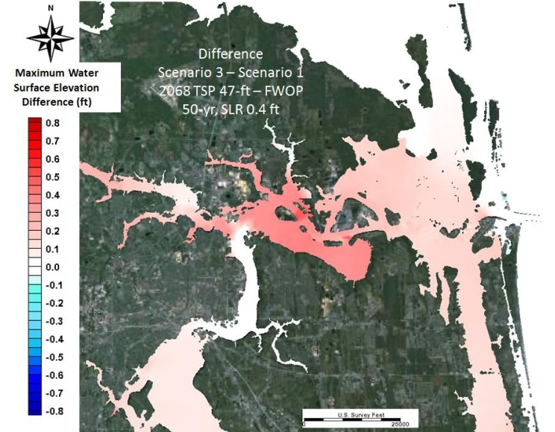
PROJECT IMPACT ON STORM SURGE
A
DIFFERENCE BETWEEN
47-FOOT TSP AND EXISTING
SEA LEVEL RISE = 0
HURRICANE DORA
A
B
B
DIFFERENCE BETWEEN 47-FOOT TSP AND FUTURE WITHOUT PROJECT AT YEAR 2068
SEA LEVEL RISE = .4 FEET
50-YEAR STORM EVENT
PROJECT AND SEA LEVEL CHANGE MAXIMUM WSE (FEET-NAVD88)
SCENARIOS | Mayport |  | Dames Point Bridge |  | Trout River |  | San Marco
 | Max WSE (ft) | Diff (ft) | Max WSE (ft) | Diff (ft) | Max WSE (ft) | Diff (ft) | Max WSE (ft) | Diff (ft)
SCENARIO 1 [2068 FWOP, 50-yr, 0.4'SLR] | 8.01 |  | 6.57 |  | 7.82 |  | 7.59
SCENARIO 3 [TSP 47’, 50-yr, 0.4'SLR] | 8.15 | 0.14 | 6.86 | 0.29 | 7.90 | 0.08 | 7.65 | 0.06
SCENARIO 2 [2068 FWOP, 100-yr, 0.4'SLR] | 10.41 |  | 9.04 |  | 11.41 |  | 10.04
SCENARIO 4 [TSP 47’, 100-yr, 0.4'SLR] | 10.53 | 0.12 | 9.31 | 0.08 | 11.60 | 0.18 | 10.12 | 0.08
Notes:
Dora- Difference in Maximum WSE in Jacksonville Harbor Project Vicinity; Hurricane Dora (1964) Simulation; TSP 47 ft Configuration Minus Existing Channel
->Difference in Maximum WSE in Jacksonville Harbor Project Vicinity; Hurricane Dora (1964) Simulation; TSP 47 ft Configuration Minus Existing Channel
Synthetic 50 yr return period storm with historic SLR
> Difference in Max WSE = 2068 TSP 47 ft – 2068 FWOP, TR=50-yr, SLC = 0.4ft

Slide 33
SHOALING ANALYSIS - METHODOLOGY
5
3
1
4
2
6
7
8
LOCATIONS FOR COMPARISONS OF BED LEVELS
COMPARISONS OF OBSERVED & SIMULATED BED LEVEL
AdH – Adaptive Hydraulics model (USACE certified)
Used the AdH sediment transport module
The model was calibrated and results compared well with observed data

Slide 34
SHOALING ANALYSIS - RESULTS
Modeling was performed to confirm the maintenance dredging requirement and to identify the advanced maintenance areas
Historic Dredging Rates estimate a 17% increase in annual dredging volume
Modeling results predict a 20% increase in annual dredging volume

Slide 35
SHORELINE EROSION OVERVIEW
The St. Johns River is not a static entity – but rather highly dynamic and its banks are subject to erosion/accretion by a wide variability in conditions produced by the natural environment:
Major factors:
Underlying geologic conditions
Tidal range
Water currents
Wave climate (storms/wind and vessel wake)
Shoreline configuration/presence of structures

Slide 36
FACTORS OF CONSIDERATION
SHORELINE EROSION
Comparison of the factors between existing conditions and the future project:
Effects of vessel operations:
Conducted ship wake analysis (Non-Dynamic and Dynamic)
Effects of physical construction of the channel:
Analysis of predicted changes in tidal range (~ 0.2 feet)
Current velocities
Side slope analysis of the predicted channel slopes
Non-dynamic: site-specific
Dynamic: continuous run

Slide 37
SHIP WAKE ANALYSIS (non-dynamic)
Large ships moving along confined deep channels cause a drop in water level followed by a resulting surge as the ship proceeds along the channel.
The drop in water level is drawdown.
We analyze vessel drawdown to quantify and understand the surge wave generated by the vessels that use the project.
CHANNEL | DESIGN VESSEL | DRAWDOWN (FEET)
Existing 40-foot | PANAMAX at 37-foot draft | 1.04
Existing 40-foot | Post PANAMAX at 37-foot draft | 1.40
Deepened 47-foot | PANAMAX at 37-foot draft | 0.28
Deepened 47-foot | Post PANAMAX at 44-foot draft | 0.47
Our analysis indicates that, generally, vessel drawdown decreases with the project
Using Existing and With-Deepening Project Cross-Section at the St. Johns Bluff Reach and a vessel speed of 7 knots at slack tide

Slide 38
SHIP WAKE ANALYSIS (dynamic)
Mile Point / Maximum Differences | Stages (feet)
In Bound at High Water | Varies from -0.16 to 0.19
Out Bound at High Water | Varies from -0.13 to 0.10
In Bound at Low Water | Varies from -0.79 to 0.23
Out Bound at Low Water | Varies from -0.39 to 0.13
In Bound against Maximum Current | Varies from -1.41 to 0.08
Out Bound with Maximum Current | Varies from -1.05 to 0.07
St. Johns Bluff / Maximum Differences | Stages (feet)
In Bound at High Water | Varies from -0.07 to 0.30
Out Bound at High Water | Varies from -0.03 to 0.98
In Bound at Low Water | Varies from -0.72 to 0.16
Out Bound at High Water | Varies from -0.59 to 0.02
In Bound against Maximum Current | Varies from -1.57 to 1.25
Out Bound with Maximum Current | Varies from -0.95 to -0.13
Water stages associated with ship passage tend to decrease with the project
Results depend on location in river, local bathymetry, and whether ship is running with or against tidal currents
Maximum increases in water surface elevation occur along St. Johns Bluff Reach south bank
Summary of the Minimum and Maximum Water Stage Differences Between the Existing and With-Project Conditions Due to Ship Passage

Slide 39
SHIP WAKE ANALYSIS RESULTS
Maximum ship wake increase of 1 foot occurs on south bank; average increase is 4 inches
Maximum occurs for less than 60 seconds
Occurs when fully loaded design vessel (SUSAN MAERSK) is outbound against flood tide at high water

Slide 40
PREDICTED CHANGES IN CURRENT VELOCITIES
COMPARISON OF OVERALL CURRENTS (FT/S) FOR THE EXISTING AND 47-FT DEPTH CONDITIONS IN THE CHANNEL
Location | Existing condition |  |  | With-project (47-ft depth) condition
 | Minimum | Maximum | Average | Minimum | Maximum | Average
1 | 0.006 | 4.69 | 1.61 | 0.02 | 4.66 | 1.59
2 (Mile Point) | 0.07 | 3.86 | 1.50 | 0.06 | 4.05 | 1.53
3 (Ramoth) | 0.02 | 4.09 | 1.65 | 0.00 | 3.38 | 1.29
4 (Blount) | 0.06 | 2.00 | 0.85 | 0.04 | 1.76 | 0.69
5 | 0.001 | 2.16 | 0.94 | 0.005 | 1.87 | 0.76
6 | 0.01 | 2.30 | 0.99 | 0.01 | 2.97 | 1.18
Maximum and average currents tend to decrease throughout the project
Average currents range from a decrease of 0.36 feet/second to an increase of 0.2 feet/second
6
5
1
3
4
2

Slide 41
SIDE SLOPE ANALYSIS
EXISTING CHANNEL
PROPOSED WIDENING
PROPOSED WIDENING
EXISTING CHANNEL
EXISTING CHANNEL
PROPOSED WIDENING
We have performed a cross sectional analysis every one hundred feet along the river for the length of the project.
BUILDING STRONG®
US ARMY CORPS OF ENGINEERS | Jacksonville District

Slide 42
PUBLIC COMMENTS
Public comments are due October 24, 2013
Please send all comments to:
Attn: Paul Stodola
U.S. Army Corps of Engineers
P.O. Box 4970
Jacksonville, FL 32232-0019
(904)232-3271 Paul.E.Stodola@usace.army.mil
The Draft Jacksonville Harbor General Reevaluation Report II (GRR2) and Supplemental Environmental Impact Statement (SEIS) can be found at the following locations:
Library Locations: Main, Highlands, Mandarin, Regency
Online: http://www.saj.usace.army.mil/Missions/CivilWorks/Navigation/ NavigationProjects/JacksonvilleHarborChannelDeepeningStudy.aspx

