Slide 1

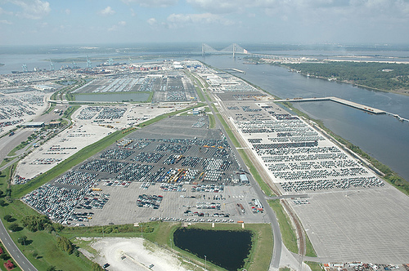

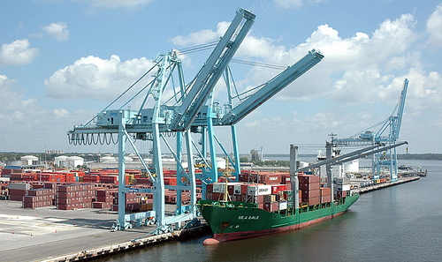


JACKSONVILLE HARBOR DEEPENING STUDY
ECOLOGICAL MODELING PRELIMINARY RESULTS
Steven Schropp, Ph.D., Taylor Engineering, Inc.
David Stites, Ph.D., Taylor Engineering, Inc.
October 22, 2012
BUILDING STRONG®
BUILDING STRONG®
US ARMY CORPS OF ENGINEERS | Jacksonville District
U.S. ARMY CORPS OF ENGINEERS | Jacksonville District

Slide 2
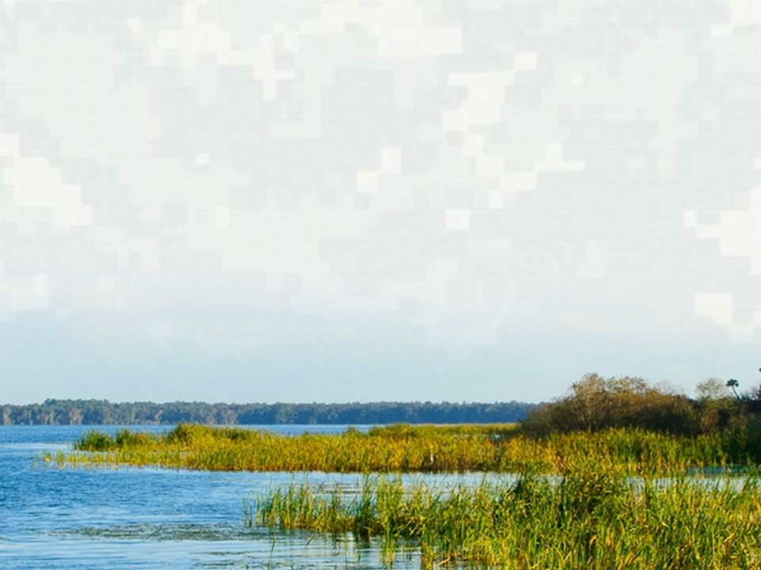
ECOLOGICAL MODELING OVERVIEW
Study Area
  River mouth to Lake George
  Lower part of river subject to salinity change
Ecological Models
  Wetland vegetation
  Submerged aquatic vegetation
  Benthic macroinvertebrates
  Fish
  Plankton
GRR Study Area
BUILDING STRONG®
US ARMY CORPS OF ENGINEERS | Jacksonville District

Slide 3

WETLAND VEGETATION MODEL
Evaluation Topic
  Marsh community shifts due to salinity change
  Evaluation Method
  Average salinity for 6-yr simulation period
  Vertical average of littoral cells
  Marsh boundaries defined by salinity “break points”
  Modeled salinity movement predicts community boundary and areal change
BUILDING STRONG®
US ARMY CORPS OF ENGINEERS | Jacksonville District

Slide 4
WETLAND VEGETATION MODEL
Wetland Community Transition | Salinity Break Point (PSU)
Hardwood swamp/ Tidal swamp | 3.21
Tidal swamp/Lower tidal swamp | 4.13
Lower tidal swamp/Intermediate marsh | 4.93
Intermediate marsh/Sand cordgrass marsh | 5.77
BUILDING STRONG®
US ARMY CORPS OF ENGINEERS | Jacksonville District

Slide 5
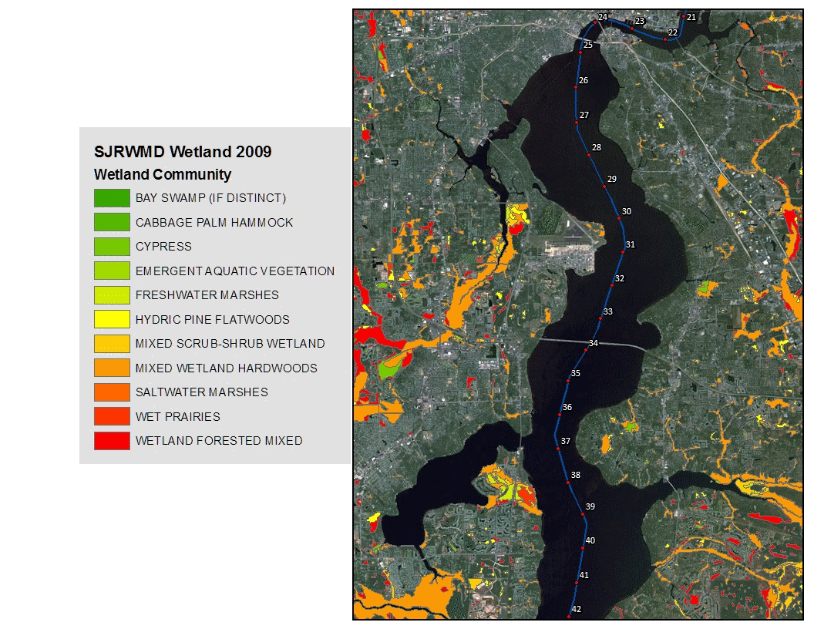
WETLAND VEGETATION MODEL
Wetland Areas
BUILDING STRONG®
US ARMY CORPS OF ENGINEERS | Jacksonville District

Slide 6
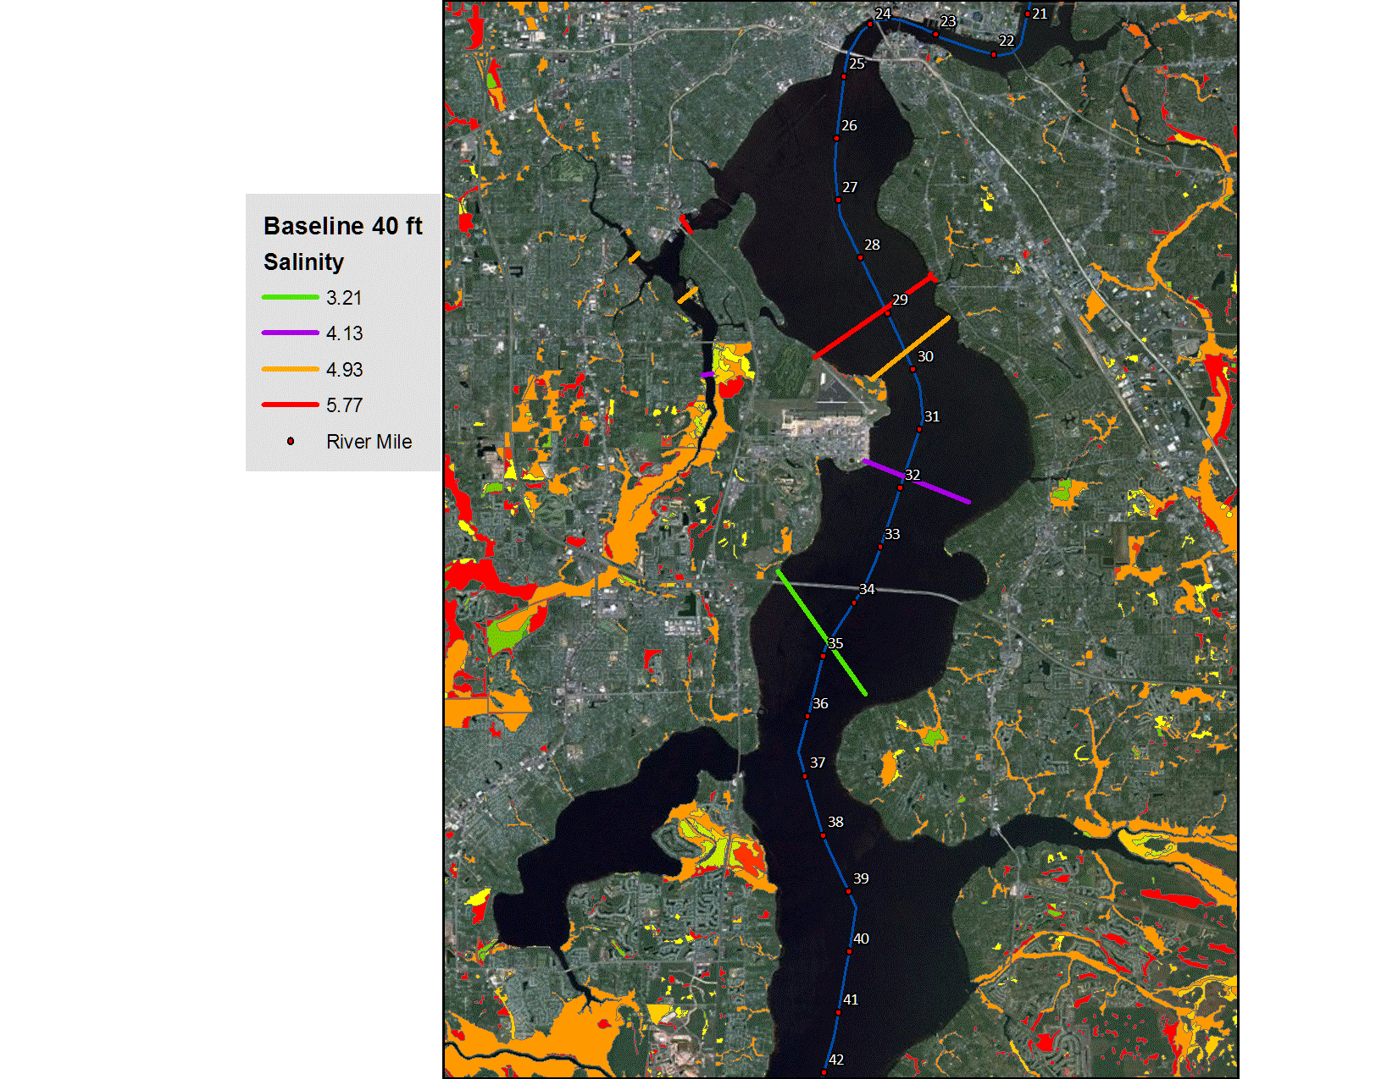
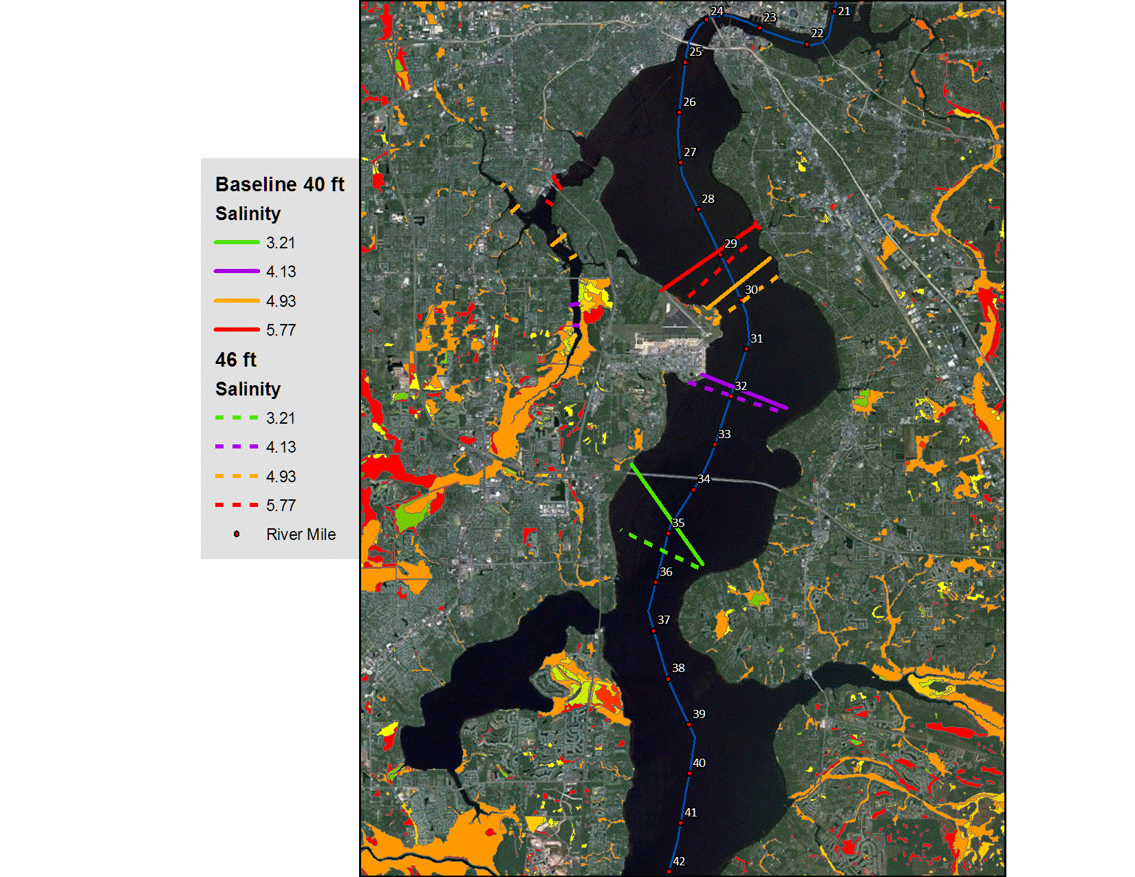
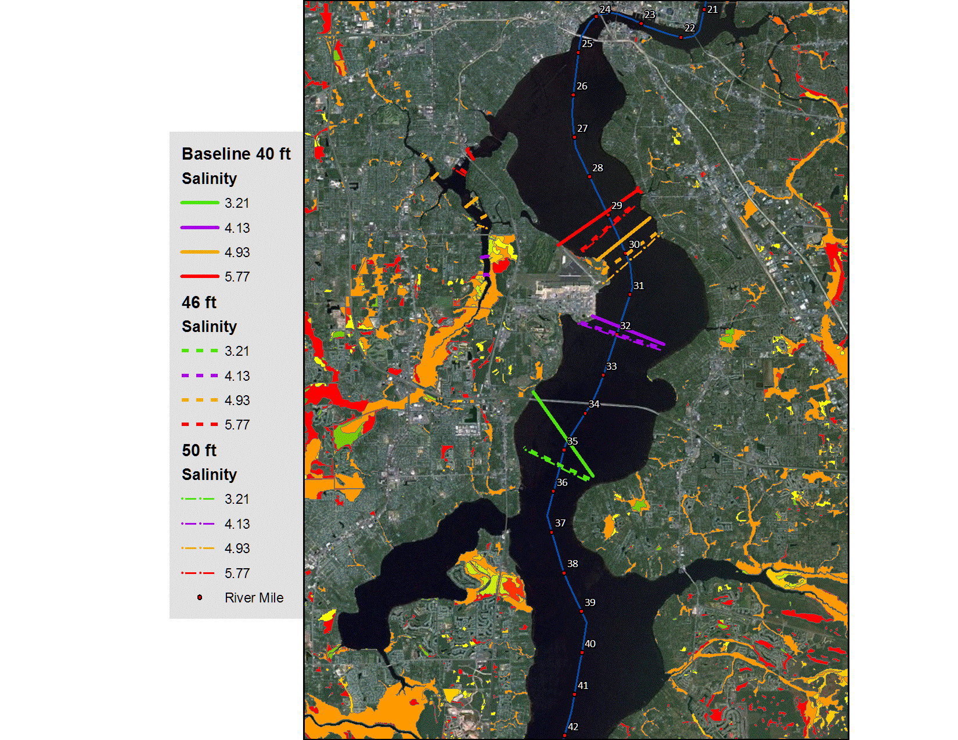
WETLAND VEGETATION MODEL
Salinity Breakpoints
Current Condition
BUILDING STRONG®
US ARMY CORPS OF ENGINEERS | Jacksonville District

Slide 7
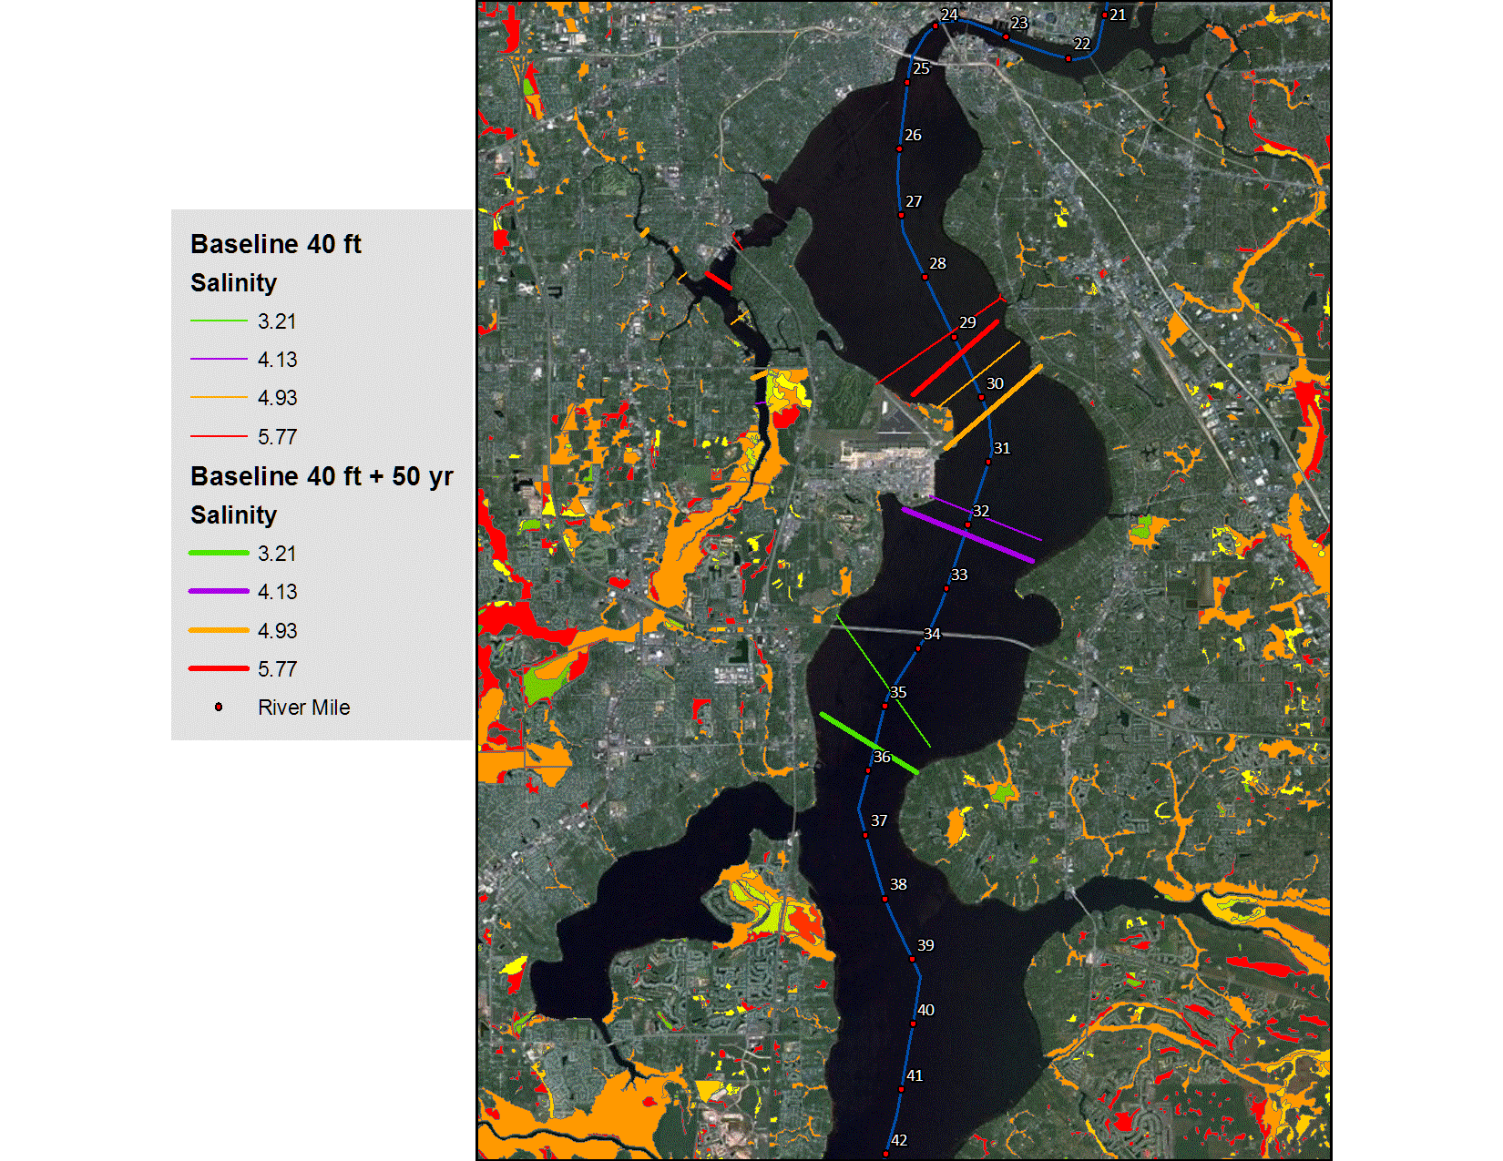
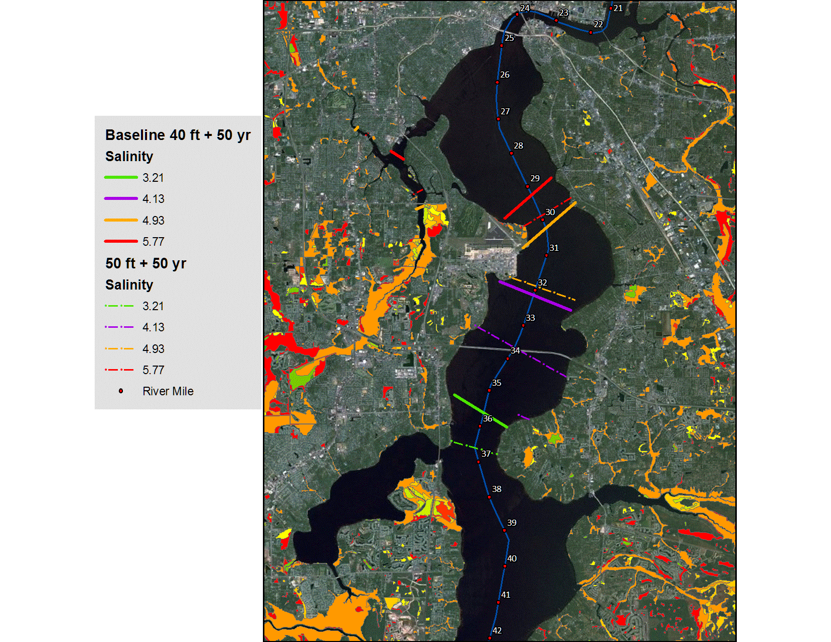
WETLAND VEGETATION MODEL
Salinity Breakpoints
50-yr Horizon
BUILDING STRONG®
US ARMY CORPS OF ENGINEERS | Jacksonville District

Slide 8
WETLAND VEGETATION MODEL
 |  | River Mile
Wetland Community | Salinity Break Point (PSU) | 40 ft (Baseline) | 46 ft | 50 ft | Baseline + 50 yr | 50 yr Base + 46 ft | 50 yr Base + 50 ft
Freshwater swamp/ Freshwater tidal swamp | 3.21 | 34.80 | 35.36 | 35.42 | 35.63 | 36.53 | 36.61
Freshwater tidal swamp/ Lower tidal swamp | 4.13 | 31.80 | 31.98 | 32.03 | 32.14 | 33.23 | 33.65
Lower tidal swamp/ Intermediate marsh | 4.93 | 29.70 | 30.03 | 30.21 | 30.24 | 31.83 | 31.89
Intermediate Marsh/ Sand cordgrass marsh | 5.77 | 28.92 | 29.22 | 29.28 | 29.26 | 29.75 | 29.88
BUILDING STRONG®
US ARMY CORPS OF ENGINEERS | Jacksonville District

Slide 9
WETLAND VEGETATION MODEL
 |  | Distance (Miles) Upstream From Baseline |  |  | Distance (Miles) Upstream from 50-yr Baseline
Wetland Community | Salinity Break Point (PSU) | 46 ft | 50 ft | Baseline + 50 yr | 50 yr Base + 46 ft | 50 yr + 50 ft
Freshwater swamp/ Freshwater tidal swamp | 3.21 | 0.56 | 0.62 | 0.83 | 0.90 | 0.98
Freshwater tidal swamp/ Lower tidal swamp | 4.13 | 0.18 | 0.23 | 0.34 | 1.09 | 1.51
Lower tidal swamp/ Intermediate marsh | 4.93 | 0.33 | 0.51 | 0.54 | 1.59 | 1.65
Intermediate Marsh/ Sand cordgrass marsh | 5.77 | 0.30 | 0.36 | 0.34 | 0.49 | 0.62
BUILDING STRONG®
US ARMY CORPS OF ENGINEERS | Jacksonville District

Slide 10
SUBMERGED AQUATIC VEGETATION (SAV) MODEL
Evaluation Topic
  Salinity stress on eelgrass
Evaluation Methods
  Salinity in littoral cells, vertically averaged
  7-, 30-, and 90-day average salinity
  Stress Levels
    No effect
    Low Stress
    Moderate Stress
    Extreme Stress
  Total littoral area affected
  Changes in individual model cells
BUILDING STRONG®
US ARMY CORPS OF ENGINEERS | Jacksonville District

Slide 11
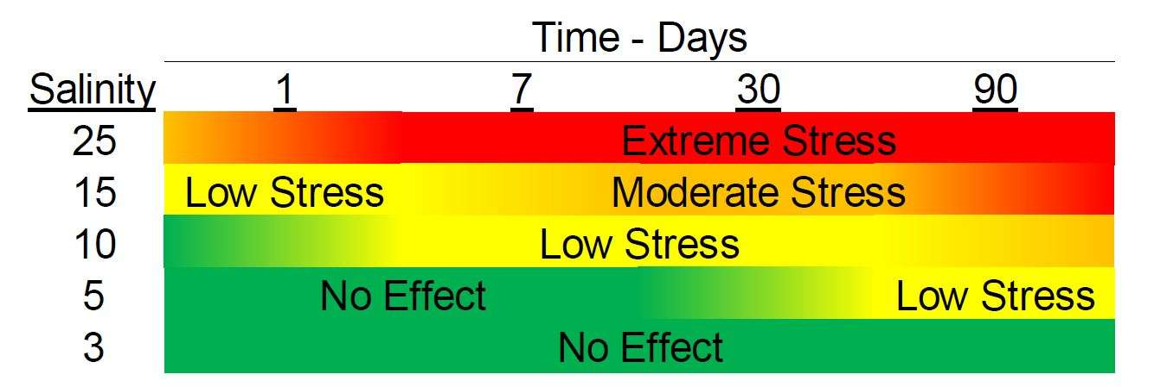
SUBMERGED AQUATIC VEGETATION (SAV) MODEL
Source: SJRWMD WSIS Final Report
BUILDING STRONG®
US ARMY CORPS OF ENGINEERS | Jacksonville District

Slide 12
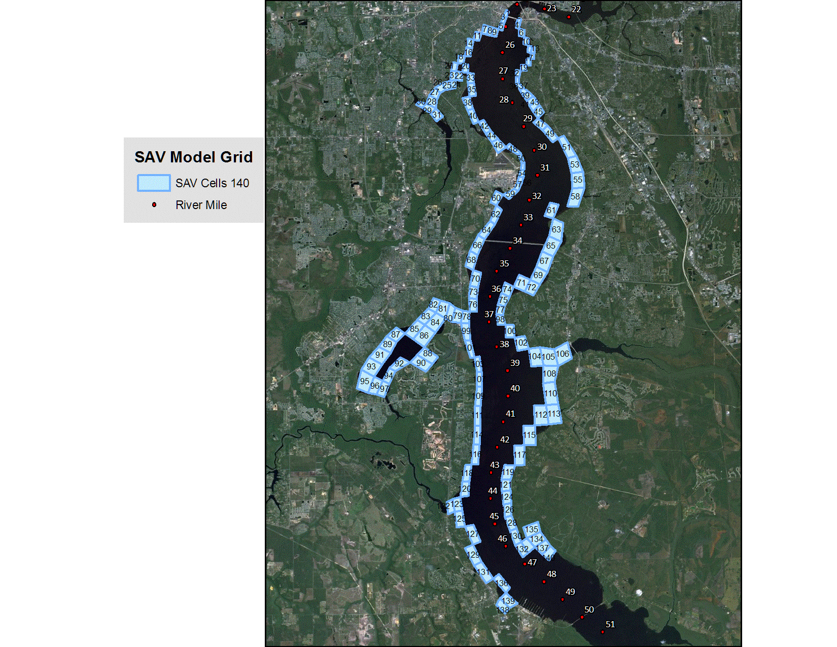
SUBMERGED AQUATIC VEGETATION (SAV) MODEL
SAV Model Grid
BUILDING STRONG®
US ARMY CORPS OF ENGINEERS | Jacksonville District

Slide 13
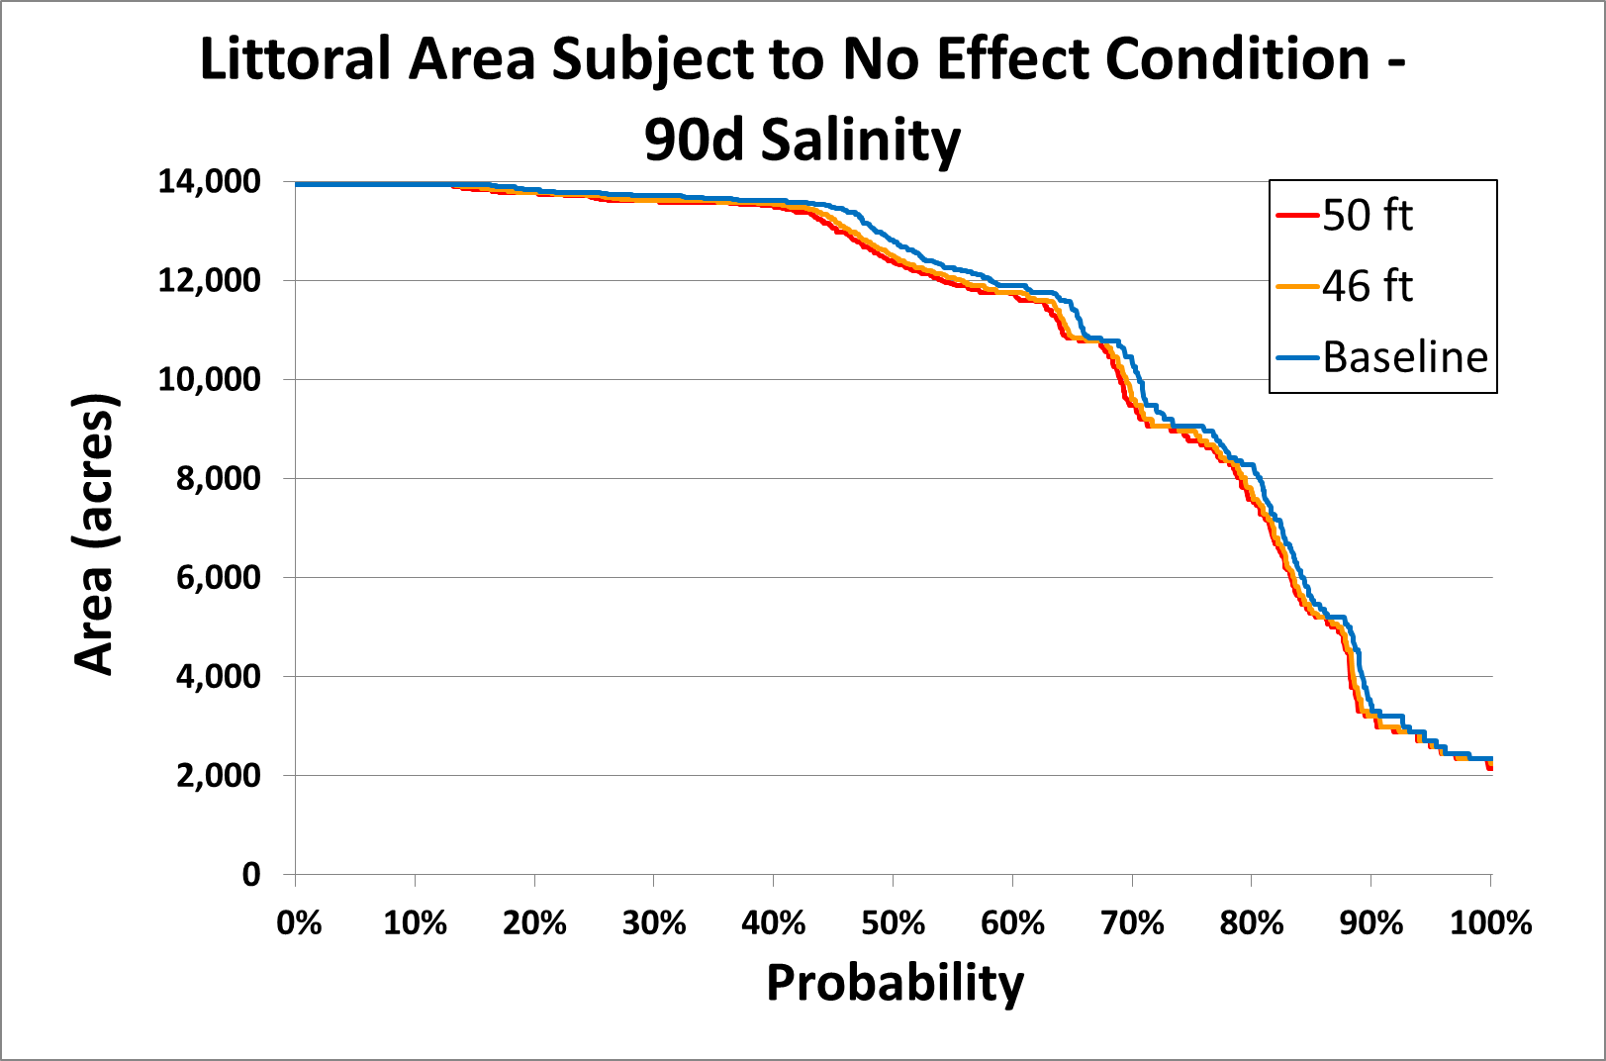
SUBMERGED AQUATIC VEGETATION (SAV) MODEL
BUILDING STRONG®
US ARMY CORPS OF ENGINEERS | Jacksonville District

Slide 14
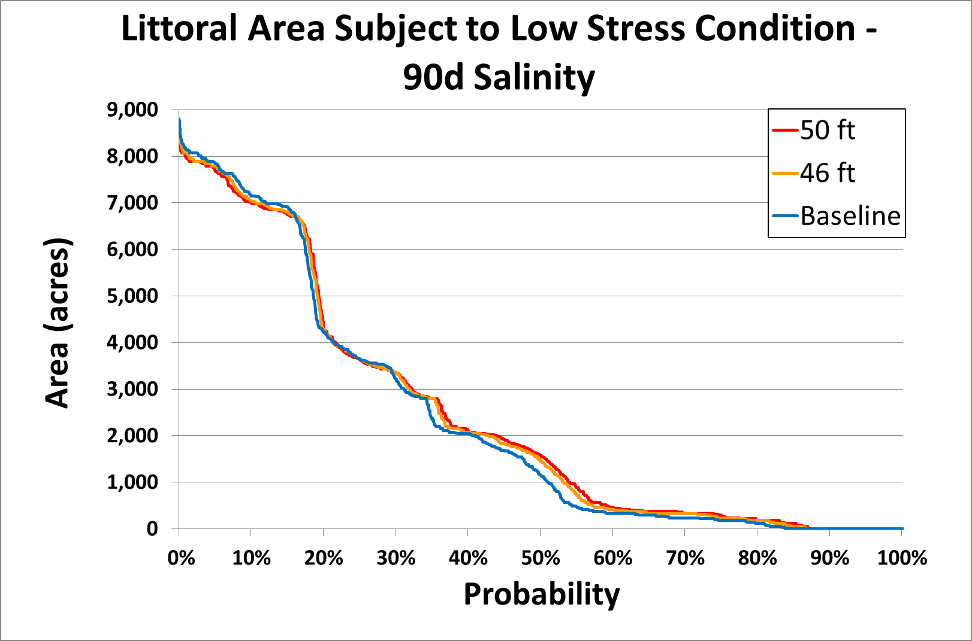
SUBMERGED AQUATIC VEGETATION (SAV) MODEL
BUILDING STRONG®
US ARMY CORPS OF ENGINEERS | Jacksonville District

Slide 15
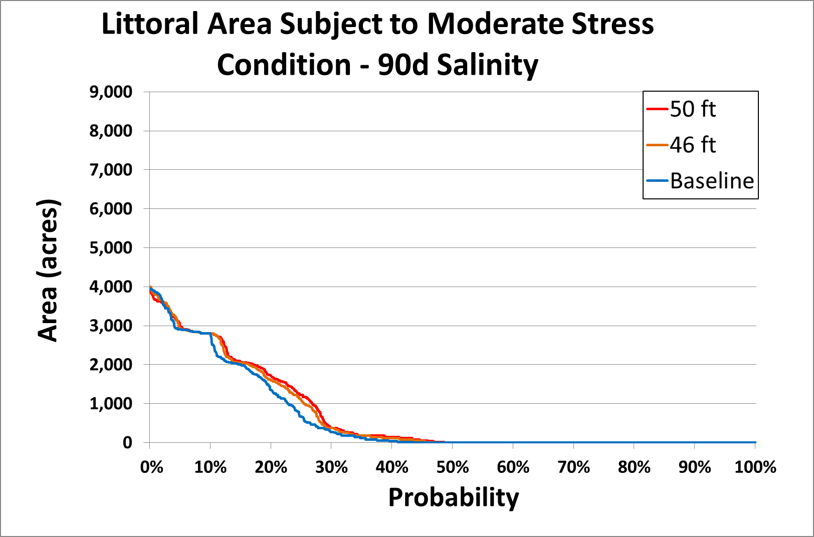
SUBMERGED AQUATIC VEGETATION (SAV) MODEL
 | Acres
Probability (%) | 40 ft Baseline | 50 ft | ∆ Acres | % Total Area
10 | 2,805 | 2,806 | 1 | 0.0
20 | 1,353 | 1,722 | 369 | 2.6
30 | 275 | 368 | 93 | 0.7
40 | 35 | 141 | 106 | 0.8
50 | 0 | 0 | 0 | 0.0
BUILDING STRONG®
US ARMY CORPS OF ENGINEERS | Jacksonville District

Slide 16
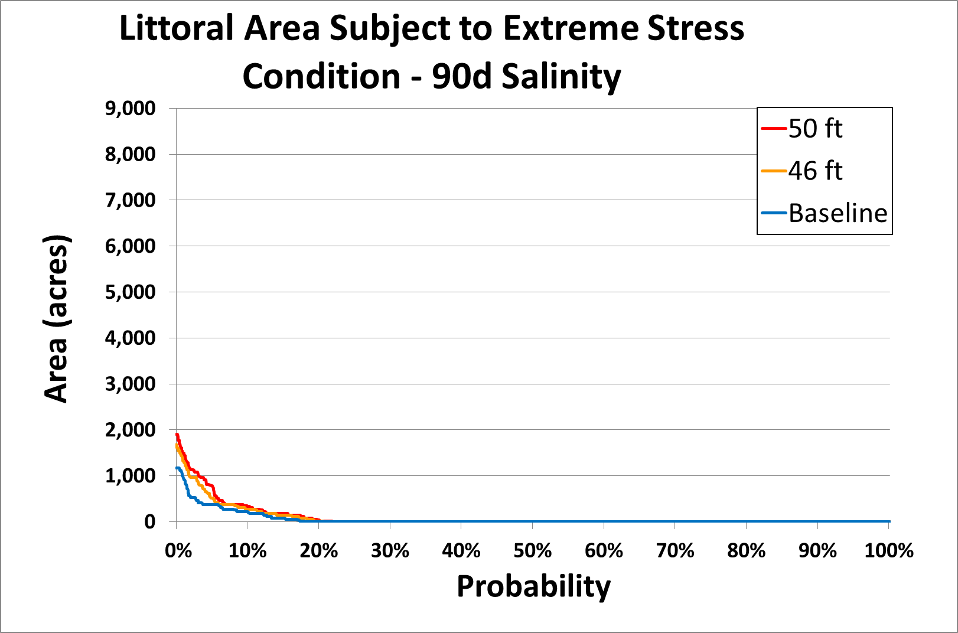
SUBMERGED AQUATIC VEGETATION (SAV) MODEL
 | Acres
Probability (%) | 40 ft Baseline | 50 ft | ∆ Acres | % Total Area
10 | 219 | 332 | 113 | 0.8
20 | 0 | 35 | 35 | 0.3
30 | 0 | 0 | 0 | 0.0
BUILDING STRONG®
US ARMY CORPS OF ENGINEERS | Jacksonville District

Slide 17
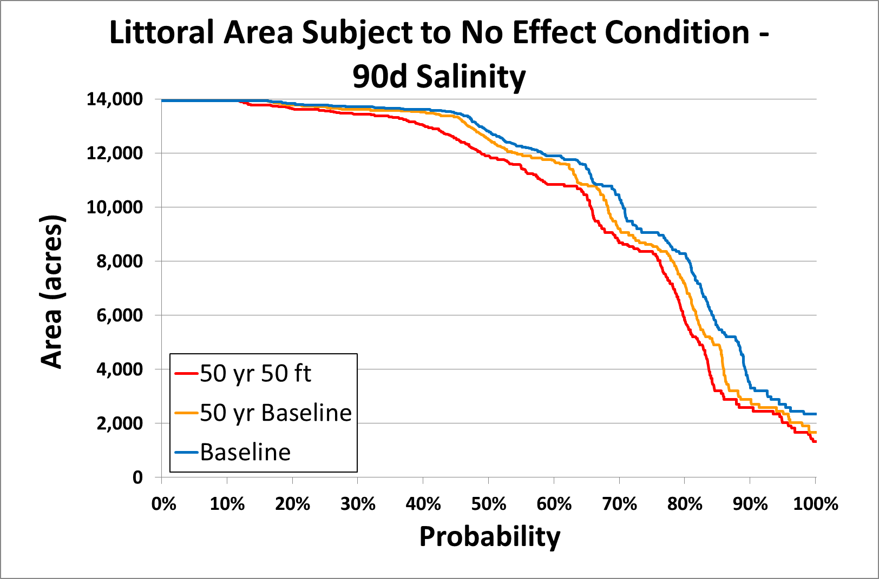
SUBMERGED AQUATIC VEGETATION (SAV) MODEL
BUILDING STRONG®
US ARMY CORPS OF ENGINEERS | Jacksonville District

Slide 18
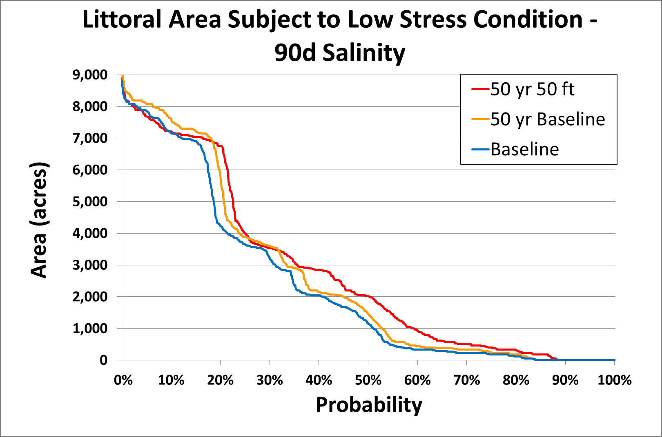
SUBMERGED AQUATIC VEGETATION (SAV) MODEL
BUILDING STRONG®
US ARMY CORPS OF ENGINEERS | Jacksonville District

Slide 19
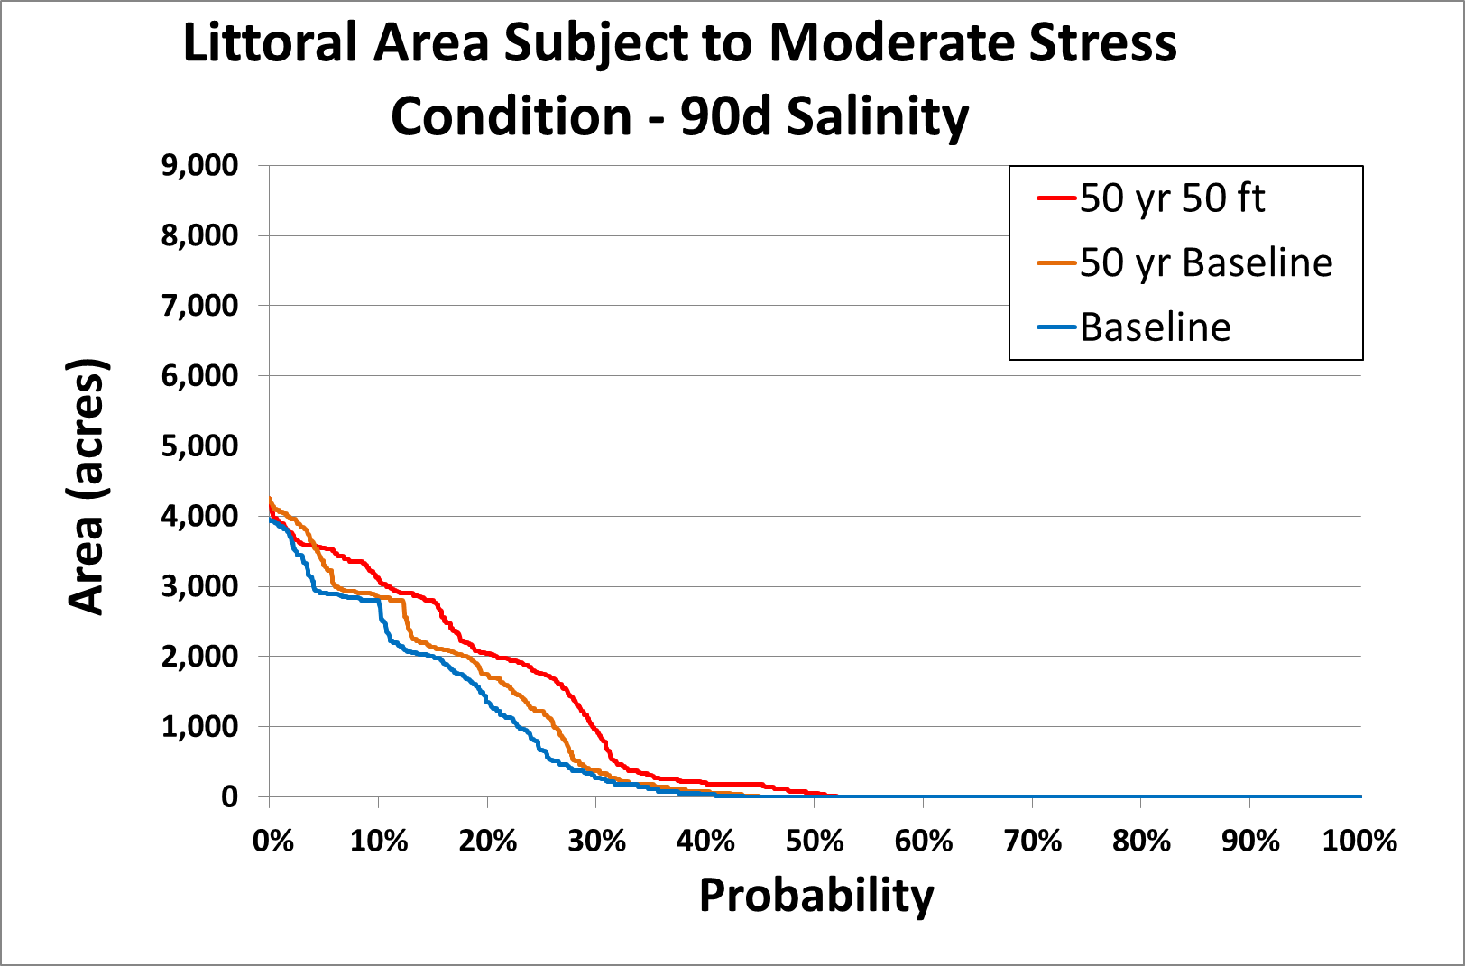
SUBMERGED AQUATIC VEGETATION (SAV) MODEL
 | Acres
Probability (%) | 50 yr Baseline | 50 yr 50 ft | ∆ Acres | % Total Area
10 | 2,854 | 3,120 | 266 | 1.9
20 | 1,742 | 2,046 | 304 | 2.2
30 | 368 | 947 | 579 | 4.2
40 | 80 | 199 | 119 | 0.9
50 | 0 | 57 | 57 | 0.4
60 | 0 | 0 | 0 | 0.0
BUILDING STRONG®
US ARMY CORPS OF ENGINEERS | Jacksonville District

Slide 20
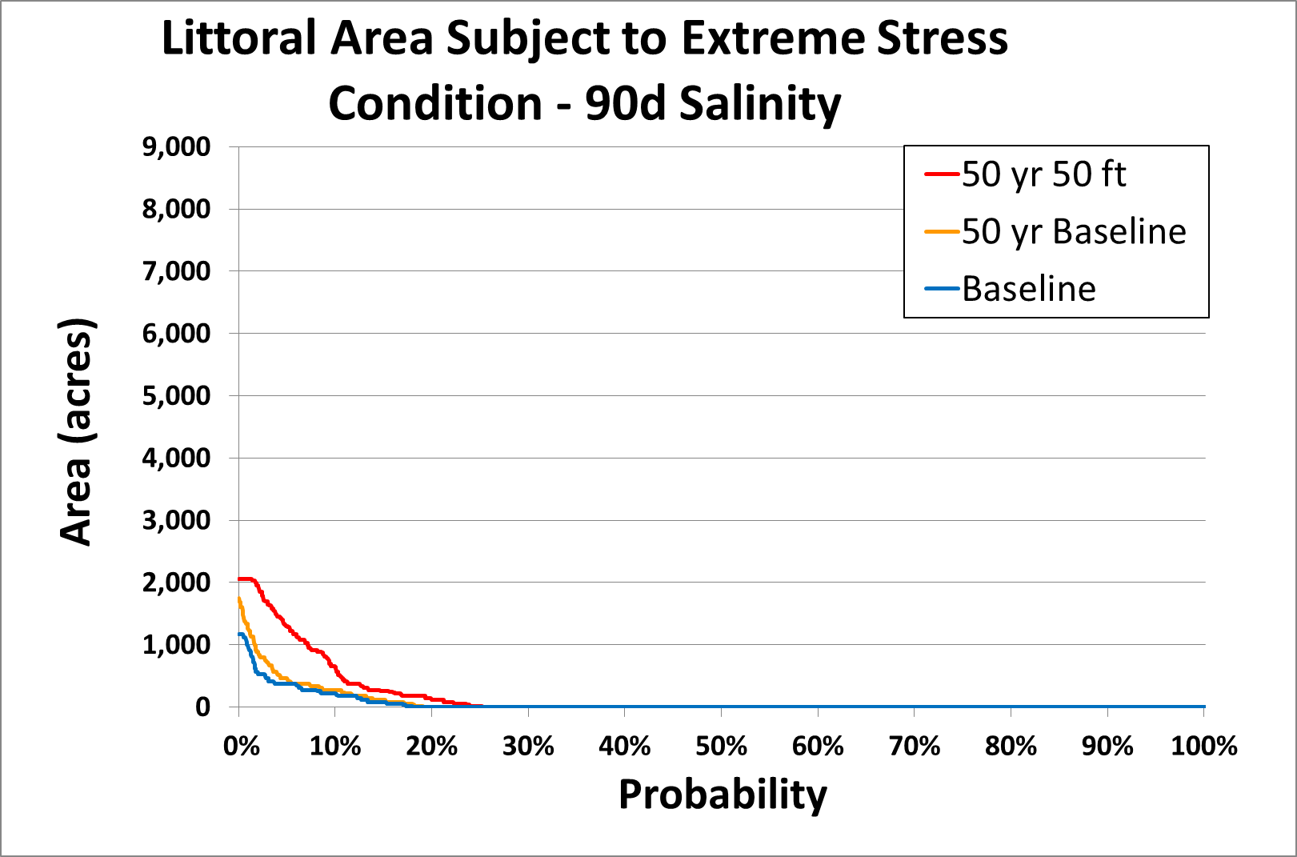
SUBMERGED AQUATIC VEGETATION (SAV) MODEL
 | Acres
Probability (%) | 50 yr Baseline | 50 yr 50 ft | ∆ Acres | % Total Area
10 | 275 | 645 | 370 | 2.7
20 | 0 | 114 | 114 | 0.8
30 | 0 | 0 | 0 | 0.0
BUILDING STRONG®
US ARMY CORPS OF ENGINEERS | Jacksonville District

Slide 21
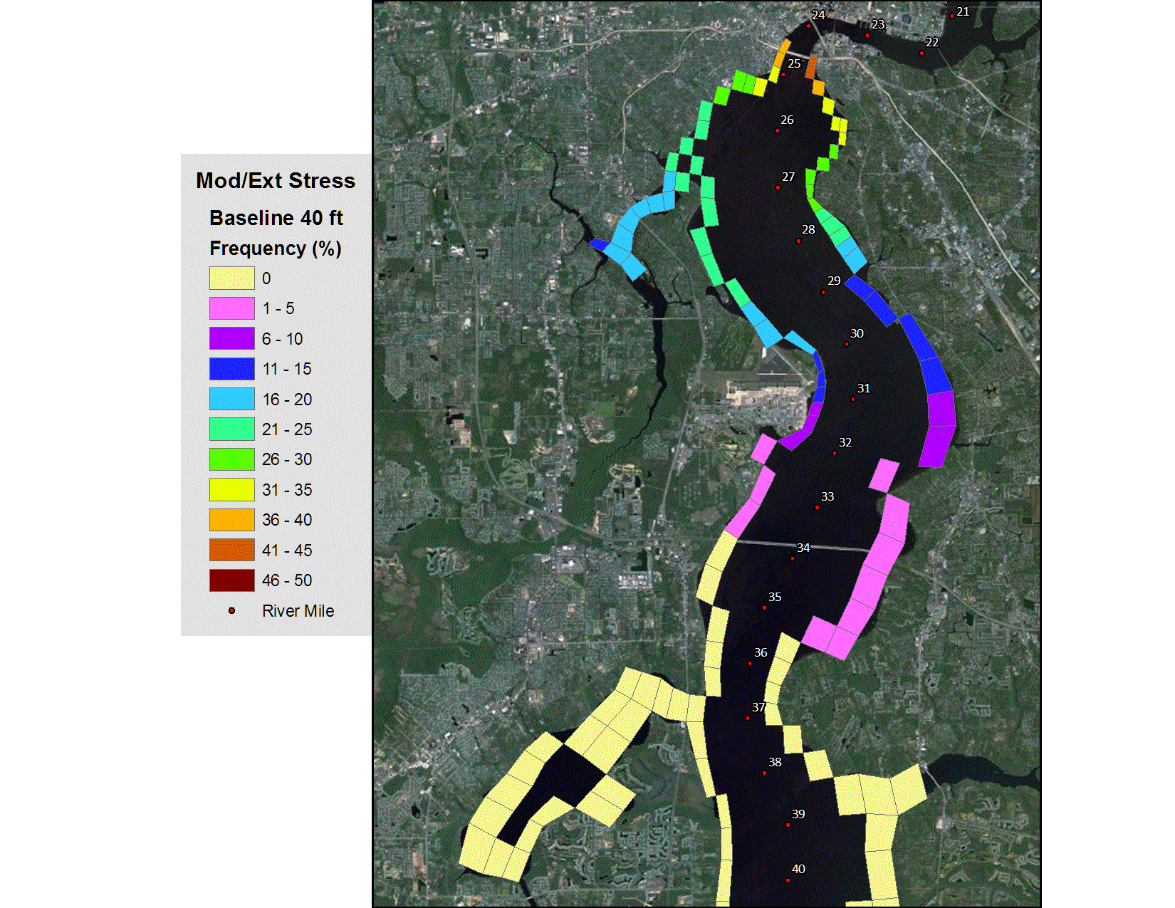
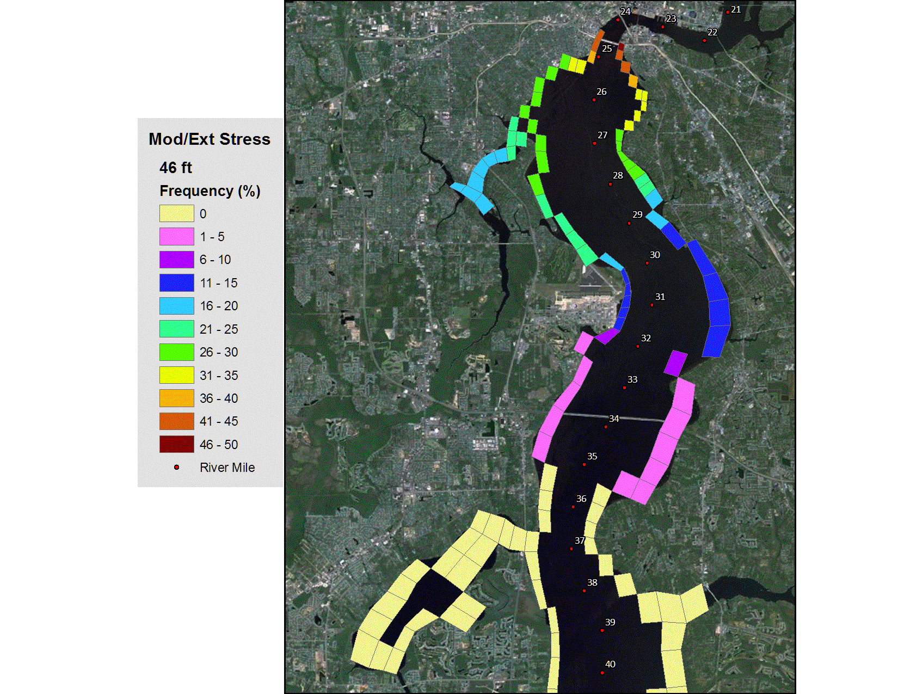

SUBMERGED AQUATIC VEGETATION (SAV) MODEL
Stress Frequency
BUILDING STRONG®
US ARMY CORPS OF ENGINEERS | Jacksonville District

Slide 22
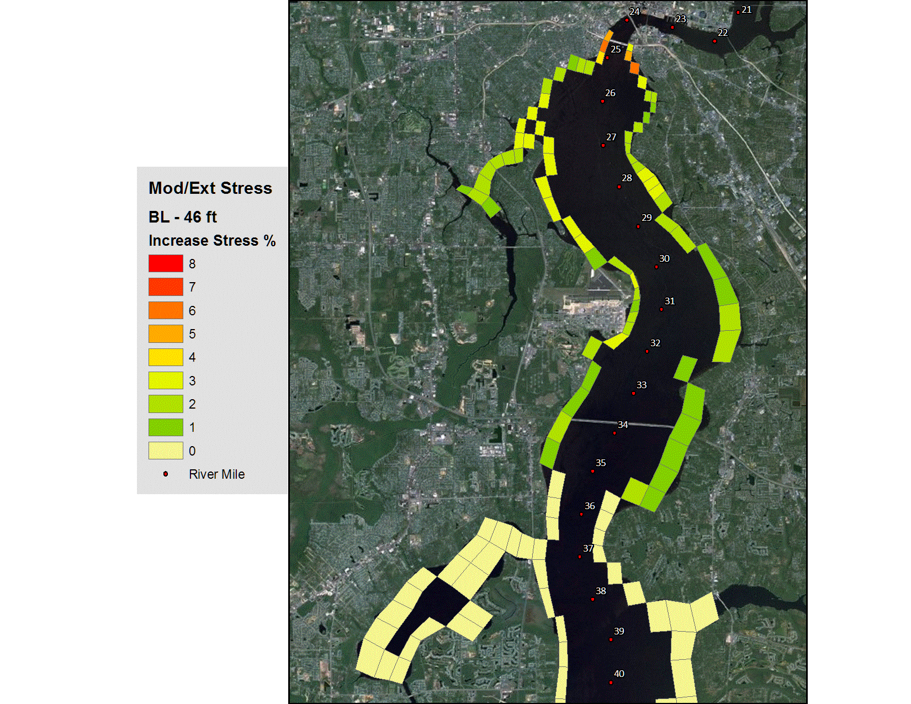
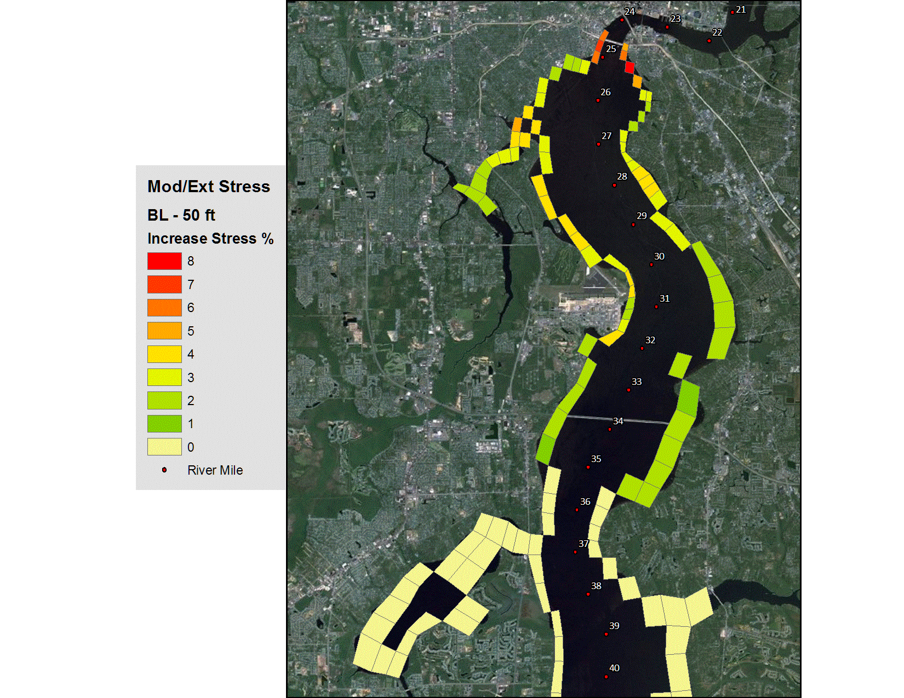
SUBMERGED AQUATIC VEGETATION (SAV) MODEL
Stress Increase
BUILDING STRONG®
US ARMY CORPS OF ENGINEERS | Jacksonville District

Slide 23
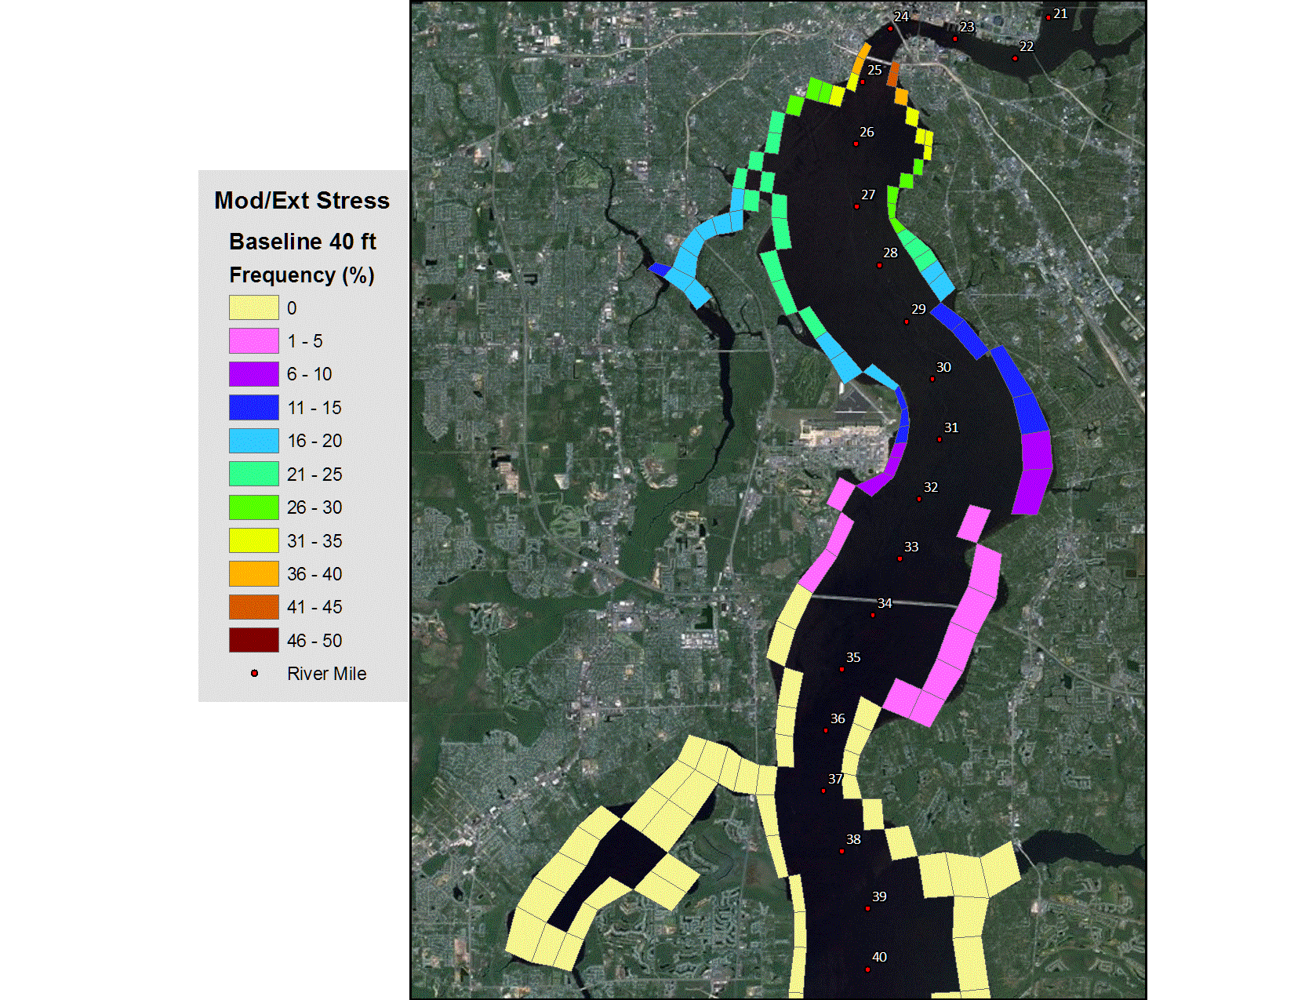

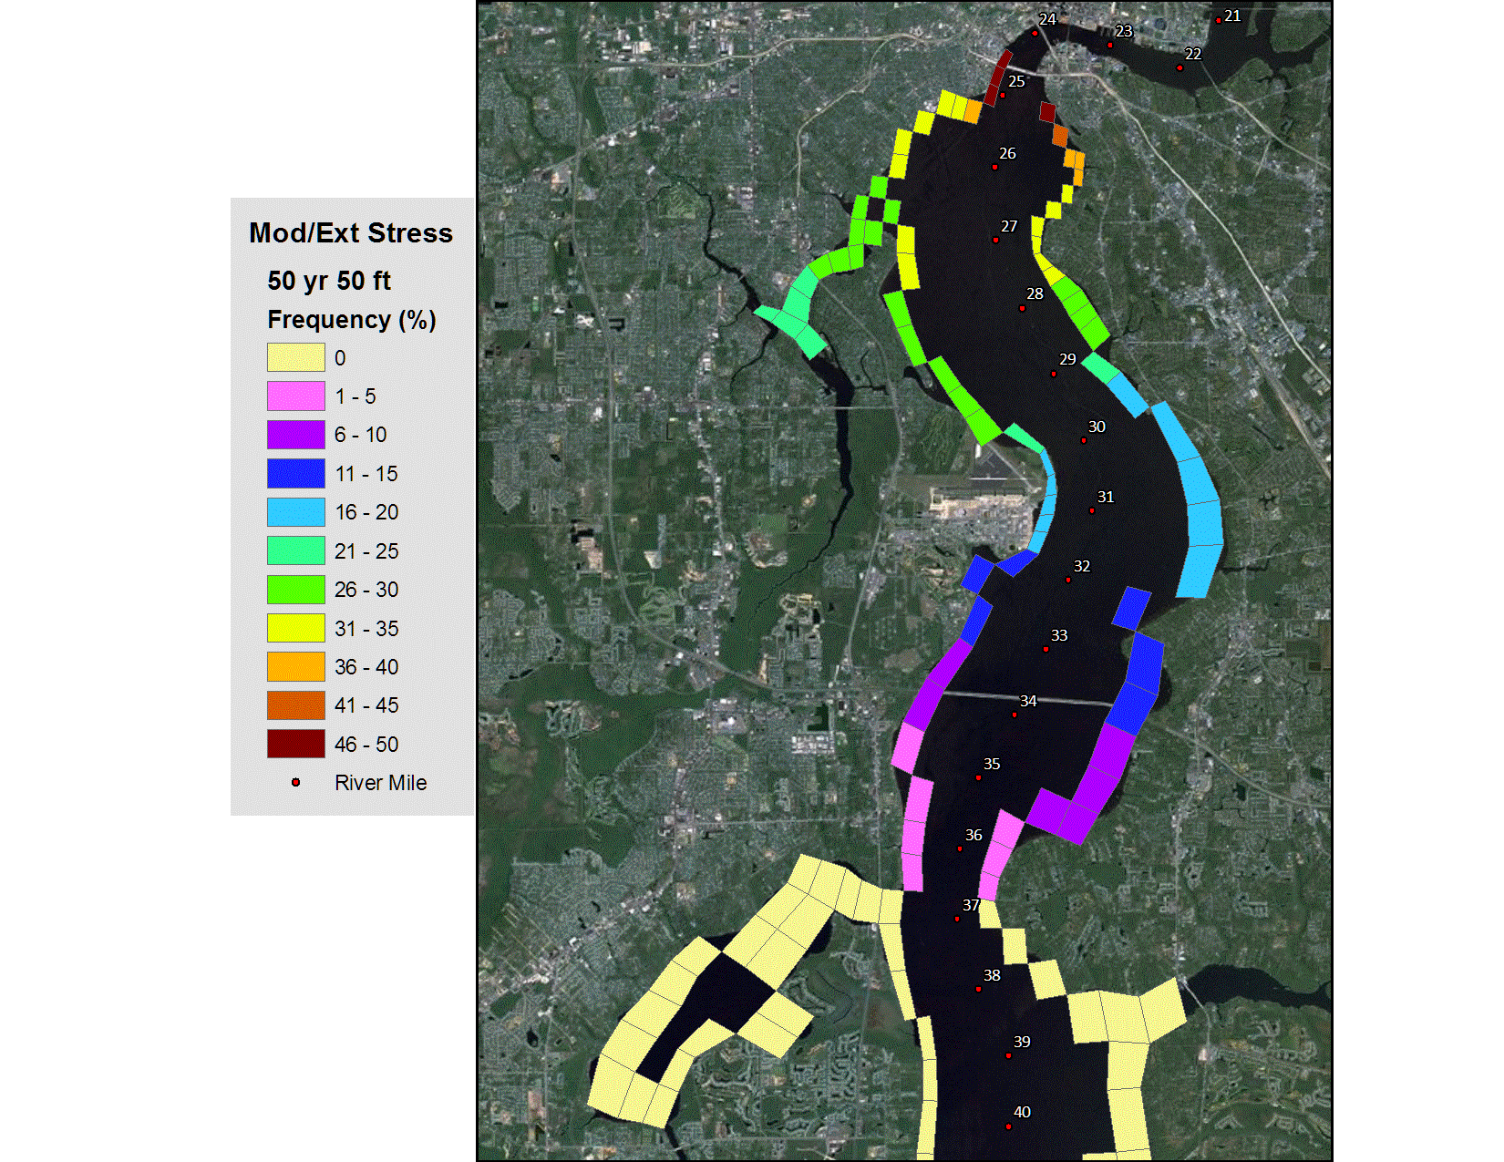
SUBMERGED AQUATIC VEGETATION (SAV) MODEL
50-yr Condition
Stress Frequency
BUILDING STRONG®
US ARMY CORPS OF ENGINEERS | Jacksonville District

Slide 24
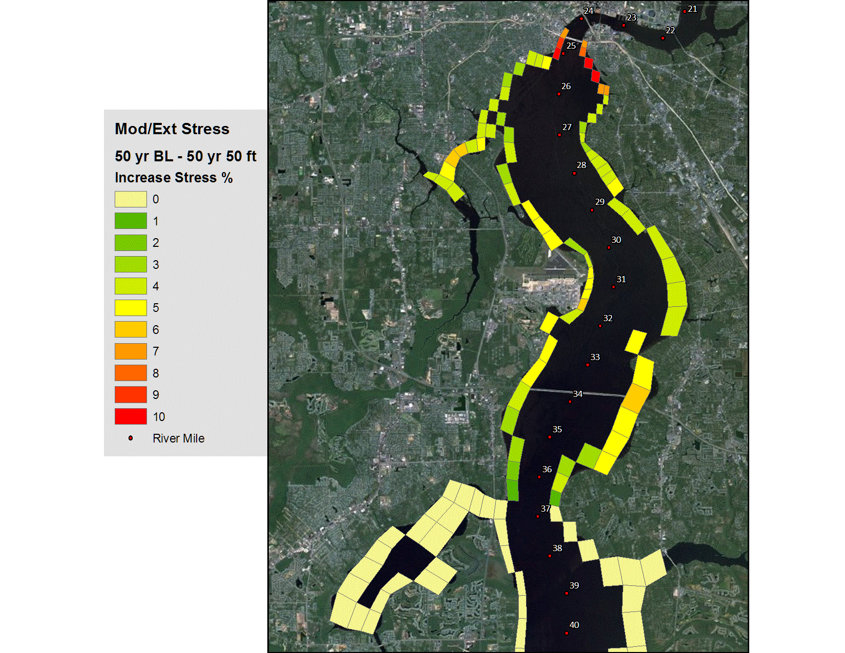
SUBMERGED AQUATIC VEGETATION (SAV) MODEL
50-yr Condition
Stress Increase
BUILDING STRONG®
US ARMY CORPS OF ENGINEERS | Jacksonville District

Slide 25
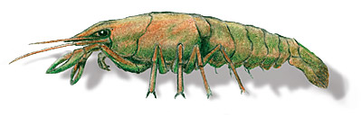
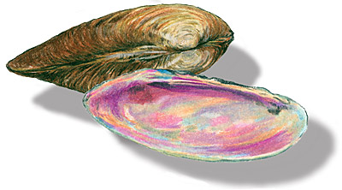
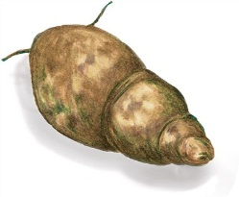
BENTHIC MACROINVERTEBRATE
(BMI) MODEL
Evaluation Topic
  BMI Habitat Area
  Effects Driver
  Salinity – extent and duration
Evaluation Methods
  Changes in area (acres) of each salinity category
  Analysis of changes in salinity duration at three river locations (Partial Duration Frequency analysis – PDFA)
  Regression model for total BMI abundance
BUILDING STRONG®
US ARMY CORPS OF ENGINEERS | Jacksonville District

Slide 26
BENTHIC MACROINVERTEBRATE
(BMI) MODEL
Results
  Little change in total area of each salinity class
    ≤ 0.5 ppt
    0.5 – 4.99 ppt
    5.0 – 11.99 ppt
    12.0 – 17.99 ppt
    18.0 ppt – 23.99 ppt
    24.0 ppt – 29.99 ppt
    ≥ 30.0 ppt
  Changes with 50 years of sea level rise and 155 mgd water withdrawal far exceed effects of different channel depths
  Salinity zone locations show much smaller upstream shift than inter-annual variations
  Variations in “elevated “ salinity durations occur primarily between Fuller Warren Bridge and Shands Bridge
BUILDING STRONG®
US ARMY CORPS OF ENGINEERS | Jacksonville District

Slide 27
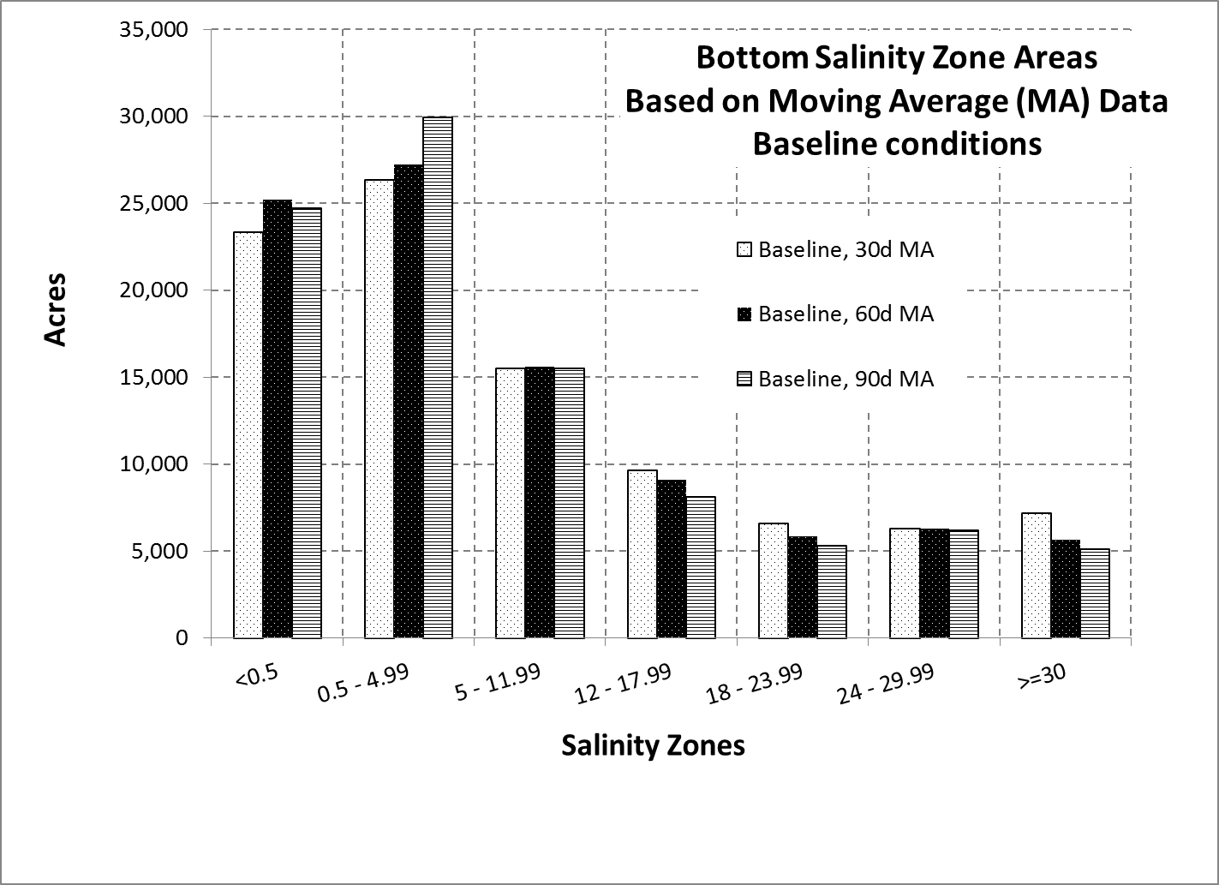
BENTHIC MACROINVERTEBRATE (BMI) MODEL

Slide 28
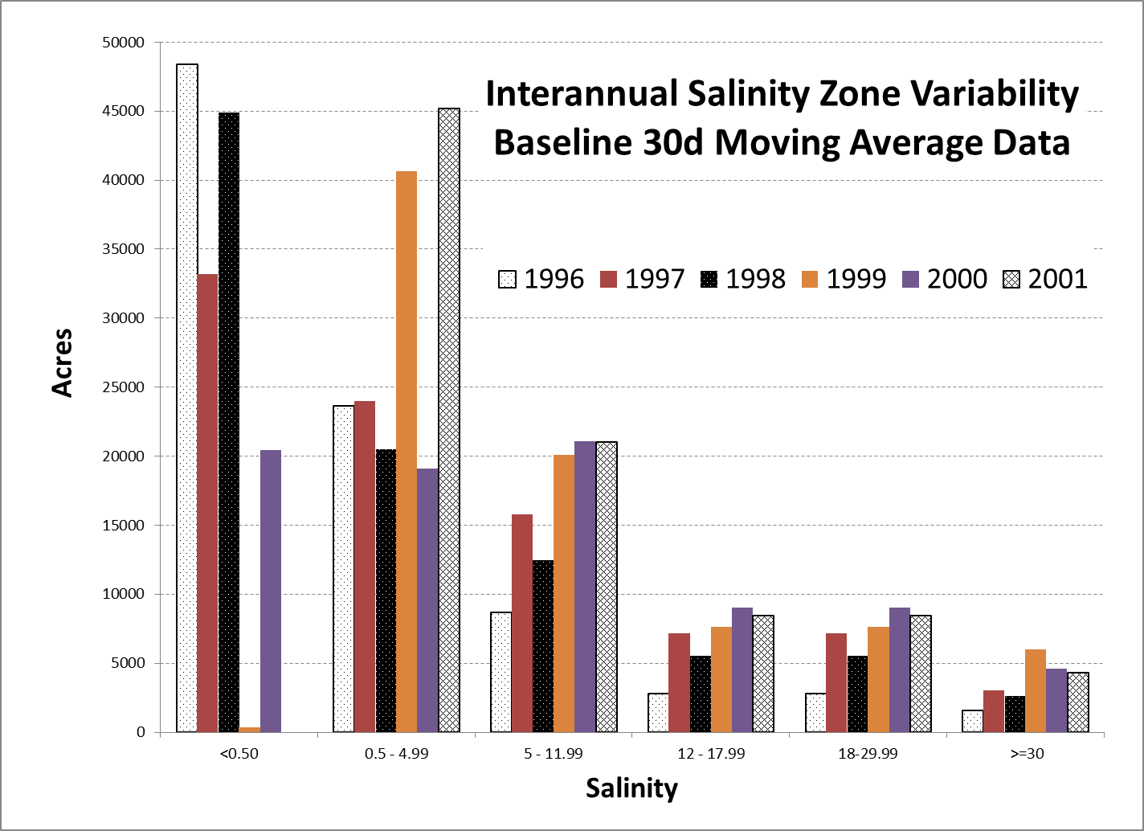

Slide 29
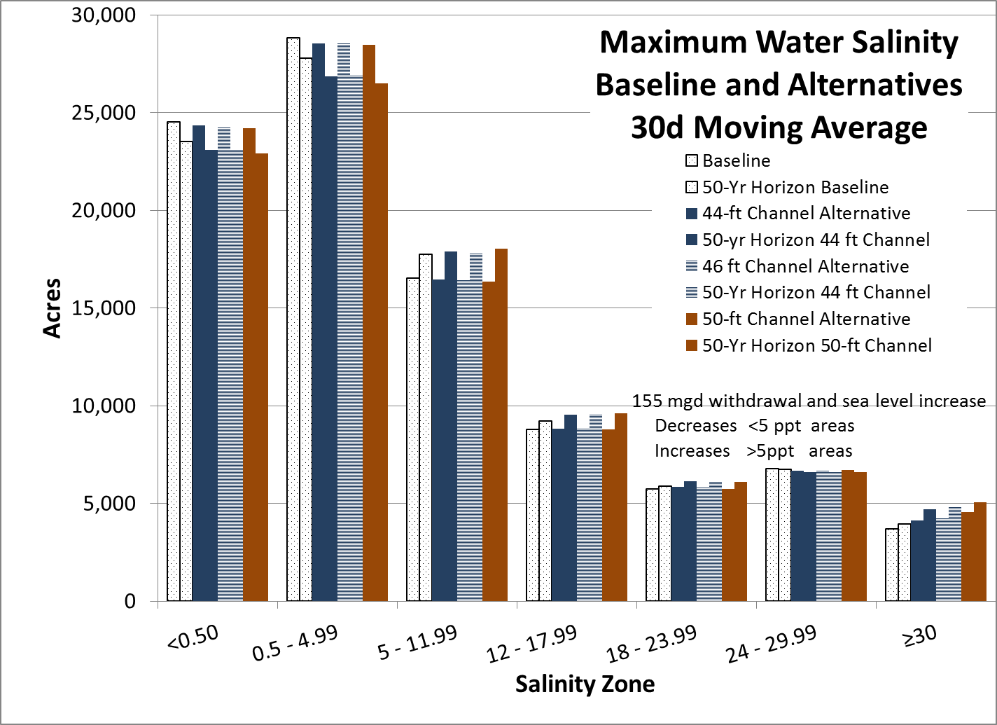

Slide 30
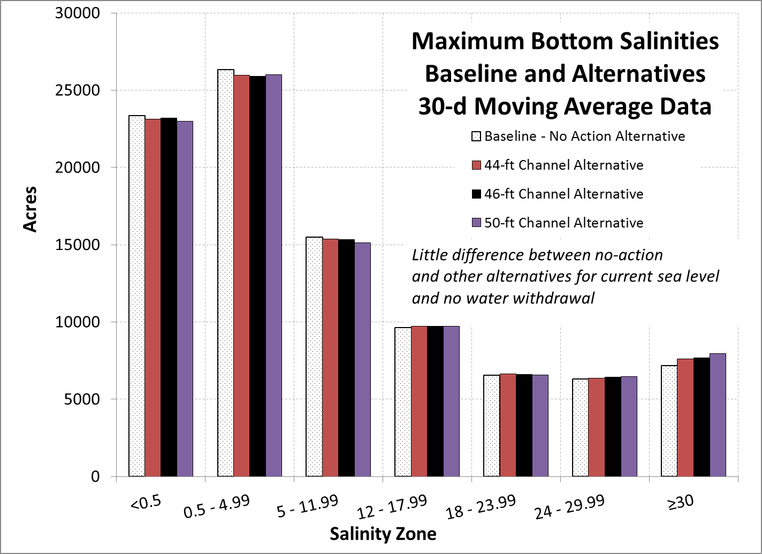

Slide 31
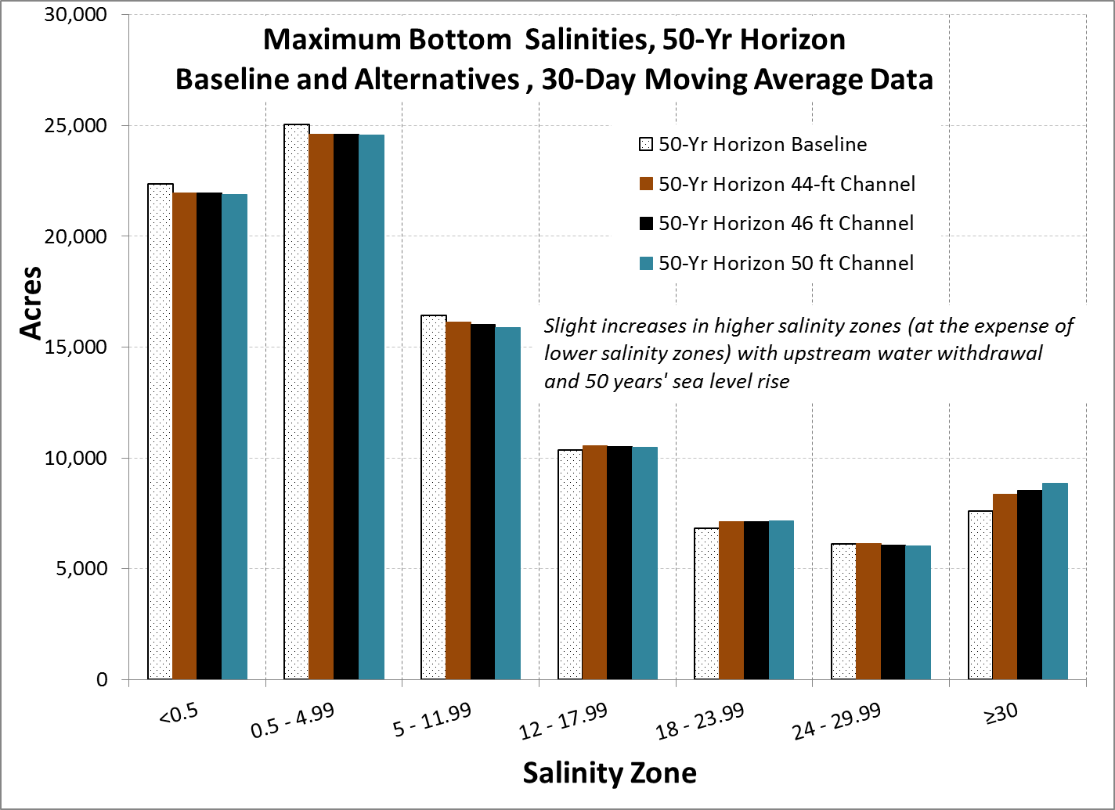

Slide 32
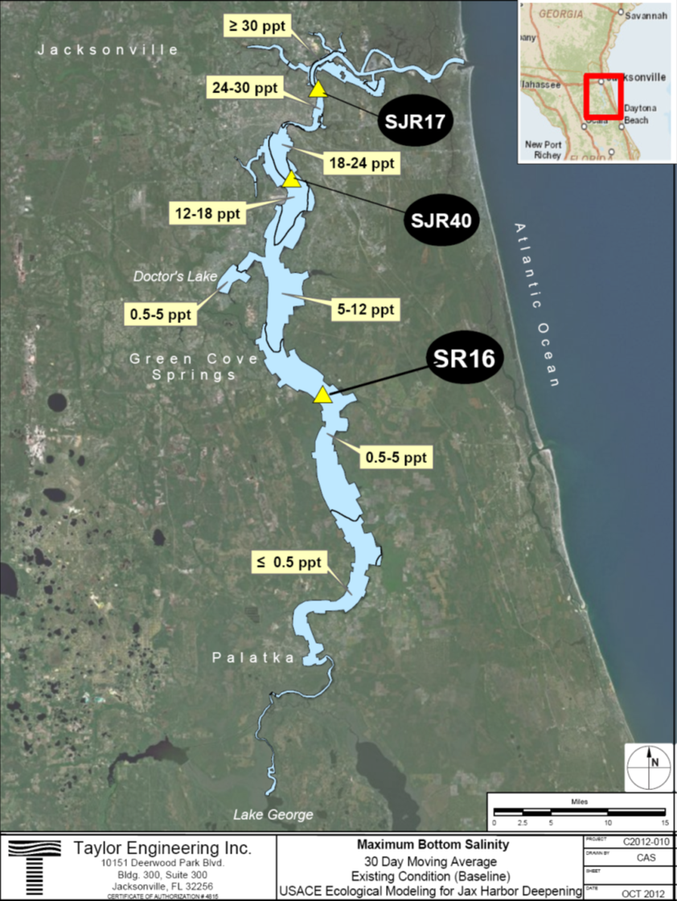

Slide 35
BENTHIC MACROINVERTEBRATE (BMI) MODEL
PDFA – Moving Average Maximum Bottom Salinities
Partial Duration Frequency Analysis (PDFA)
  Dataset – Maximum Bottom Salinity Day for 6-yr simulation
  PDFA calculates the number and duration of salinity events exceeding specific salinities
  Allows comparison of salinity events occurring in different project alternatives
    Baseline salinity events are compared to each alternative
  PDFA developed at three locations associated with SJRWMD sampling

Slide 37
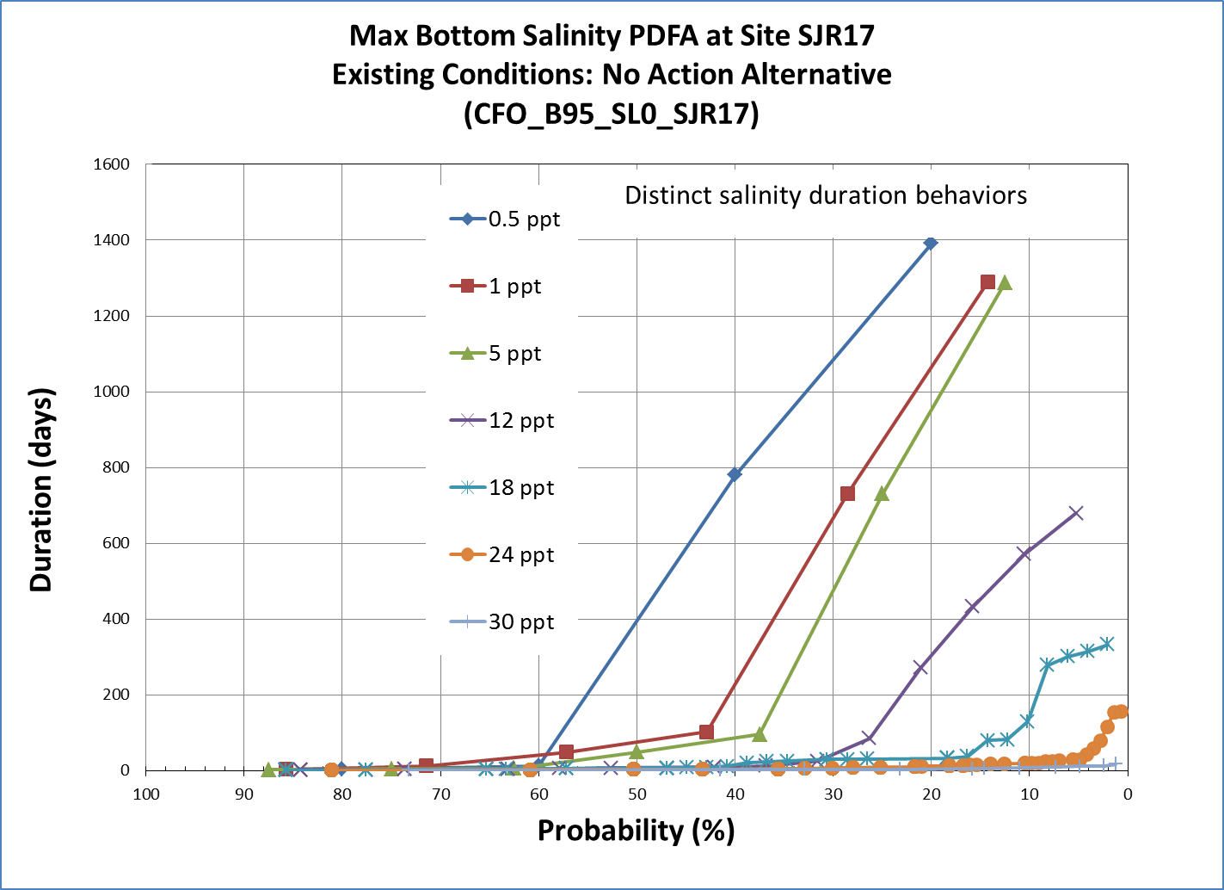

Slide 38
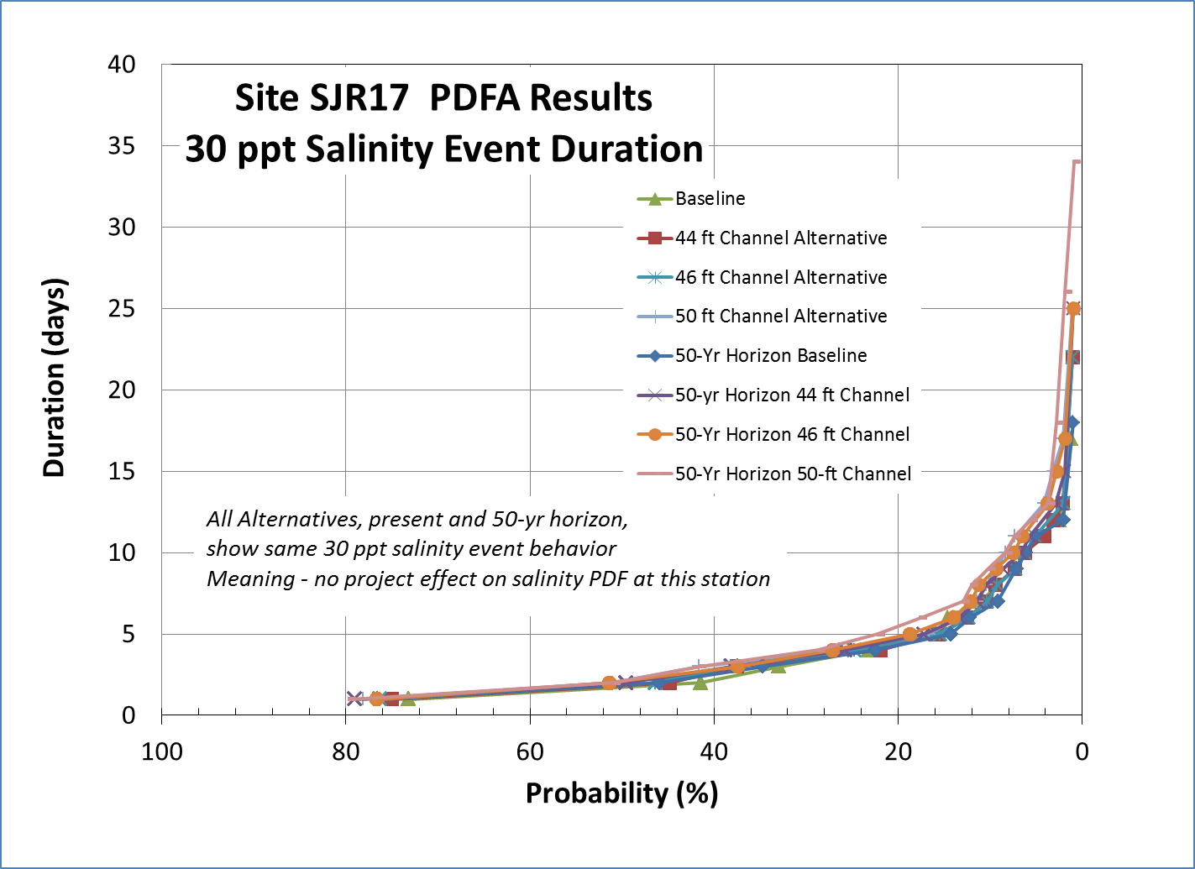

Slide 39
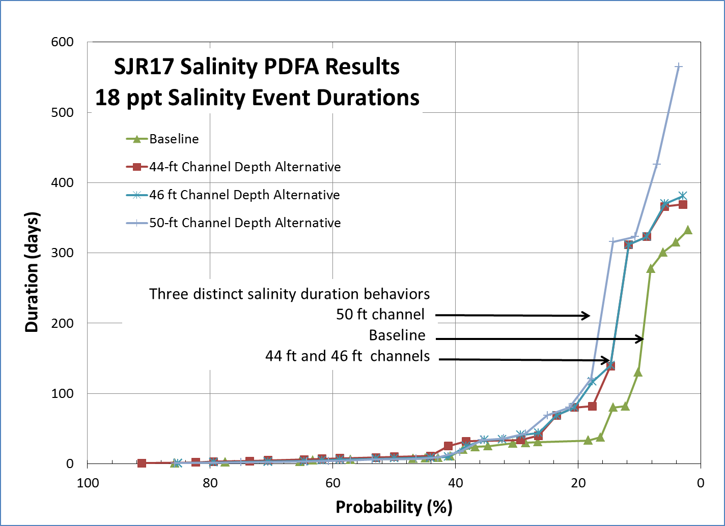

Slide 40
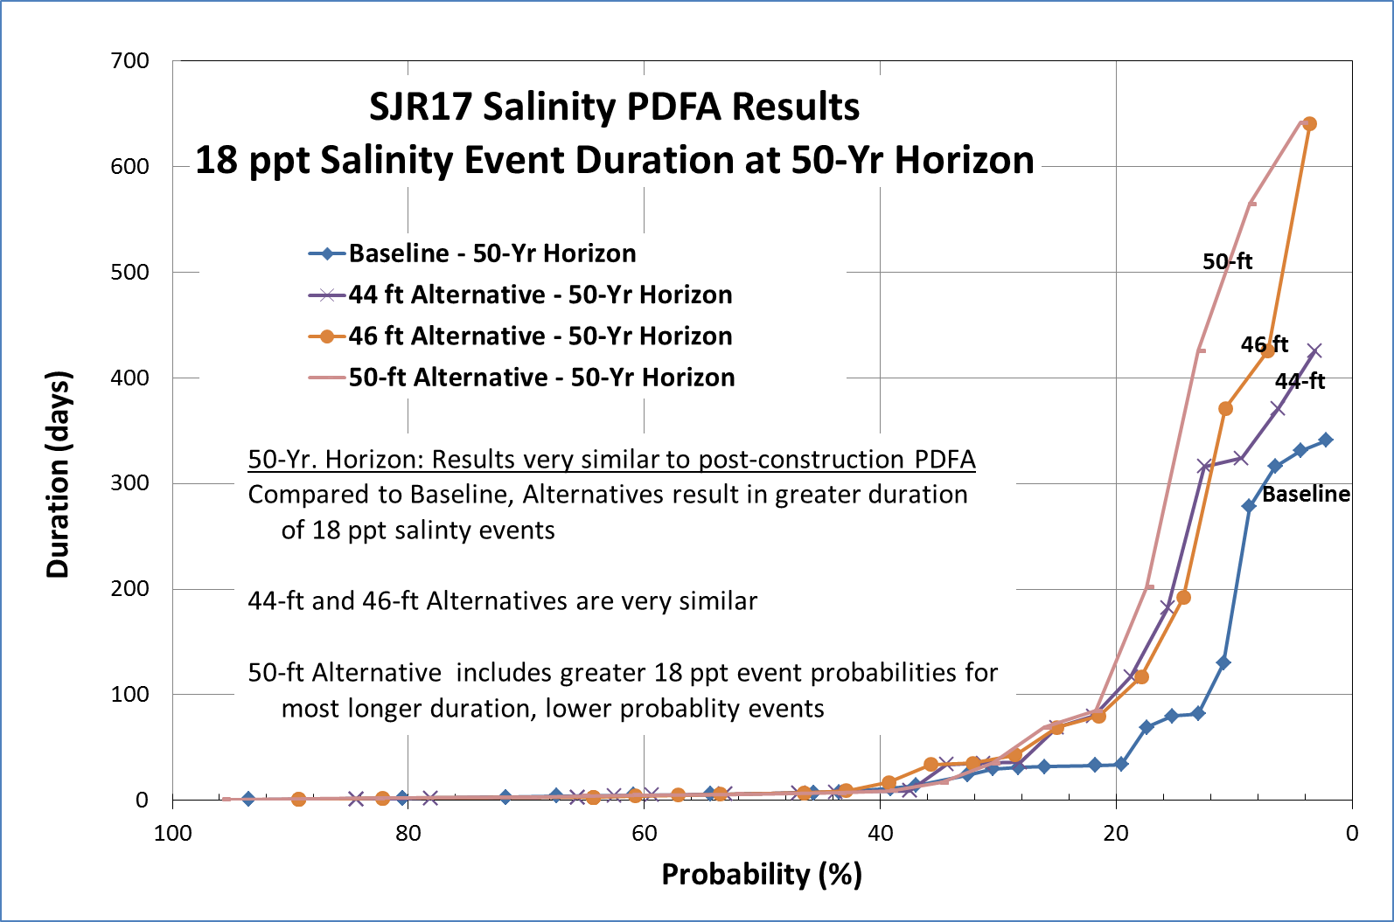

Slide 41
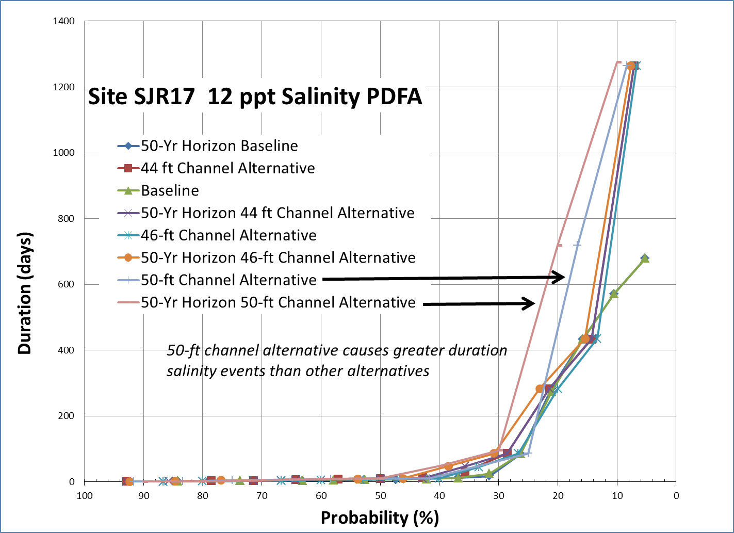
SJR17 PDFA Results
Little difference between baseline and
alternatives for 12 ppt and lower salinities

Slide 42
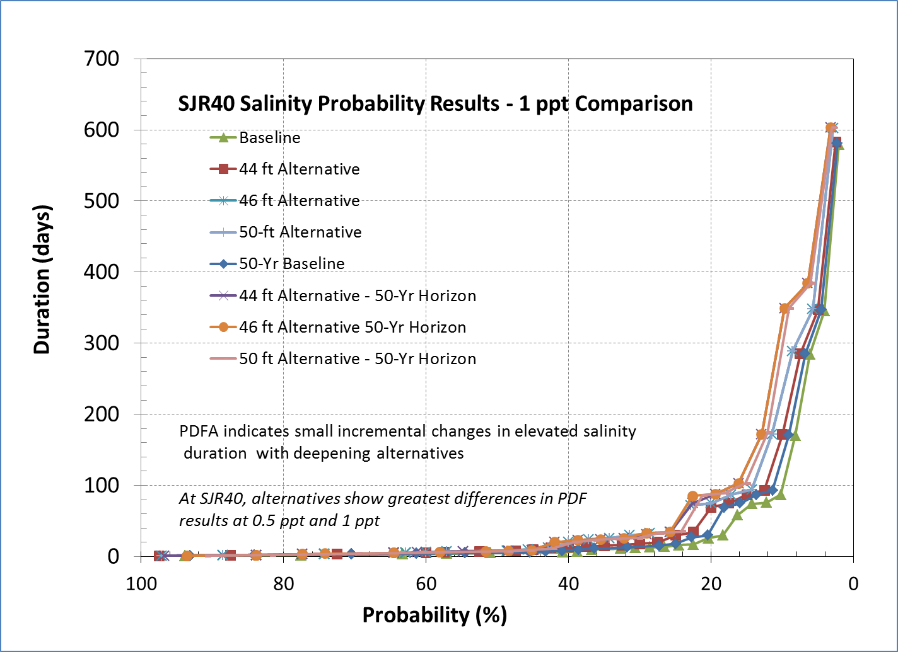
BENTHIC MACROINVERTEBRATE (BMI) Salinity Zones

Slide 43
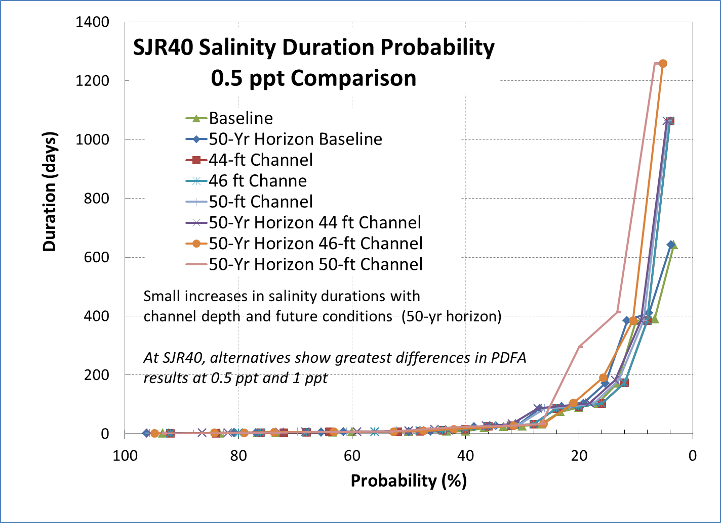

Slide 44
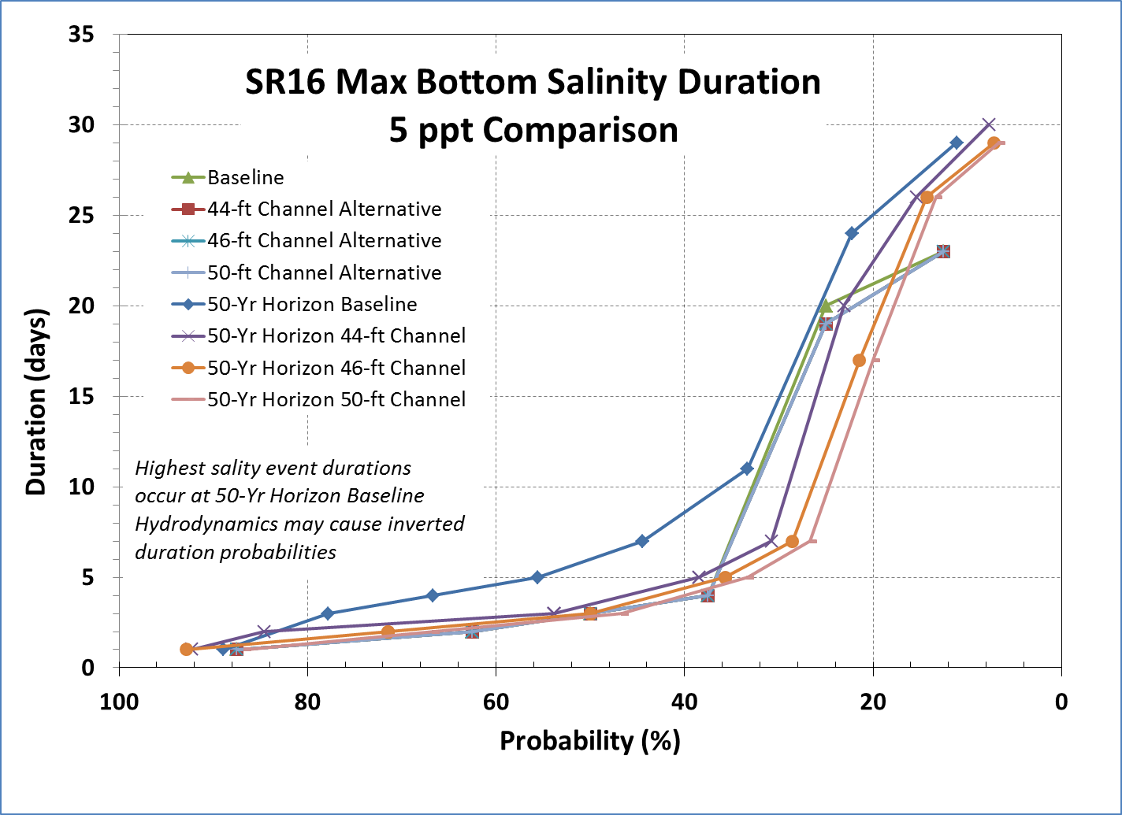

Slide 45
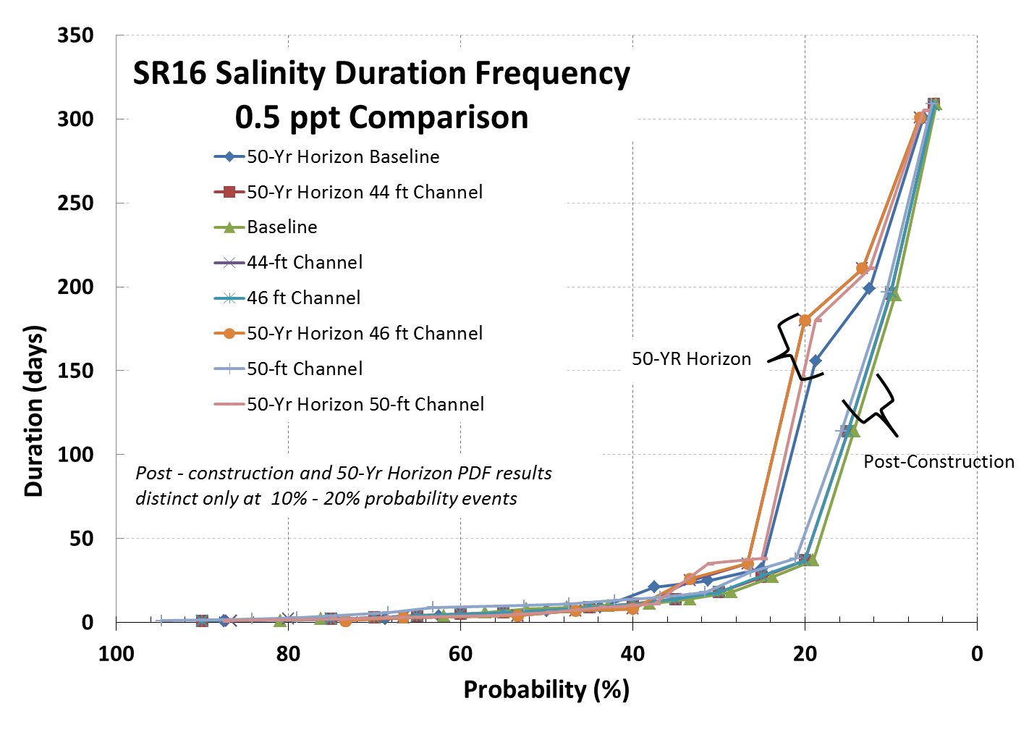

Slide 46
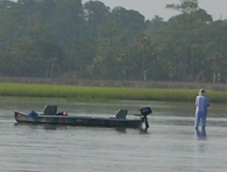
FISH MODEL
Evaluation Topic
  Fish abundance
Effects Drivers
  Salinity
  SAV cover
  Evaluation Methods
  Changes in area of each salinity category
  Changes in SAV cover
BUILDING STRONG®
US ARMY CORPS OF ENGINEERS | Jacksonville District

Slide 47
FISH MODEL
Results
  Lower salinity waters (5ppt and less) dominate the study area.
  Little change in area (acres) associated with each salinity range
  Project alternatives result in only minor upstream-downstream shifts in salinity zones
  Inter-annual salinity zone changes far exceed changes associated with comparison of baseline and action alternatives
BUILDING STRONG®
US ARMY CORPS OF ENGINEERS | Jacksonville District

Slide 52
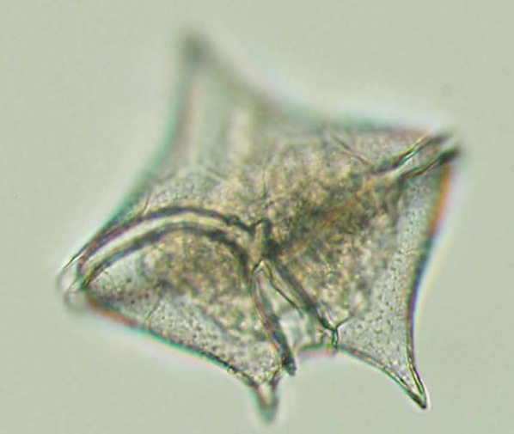
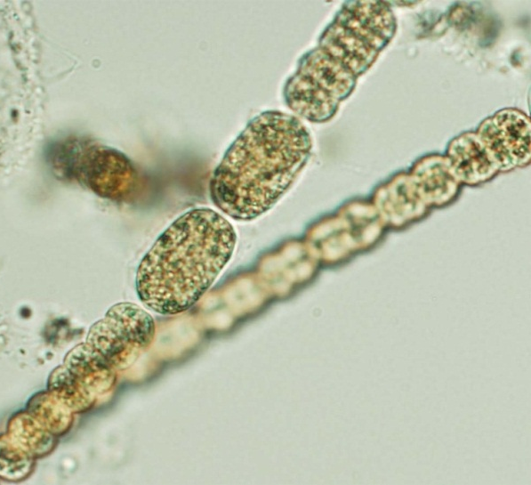
PLANKTON MODEL
Evaluation Topics (algal bloom metrics)
  Marine algal blooms
  Nitrogen (N) loading via N₂-fixation
  Freshwater bloom
  (chlorophyll-a maximum/dissolved oxygen minimum)
  magnitude
  Freshwater bloom duration
BUILDING STRONG®
US ARMY CORPS OF ENGINEERS | Jacksonville District

Slide 53
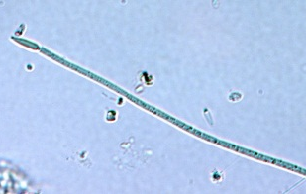
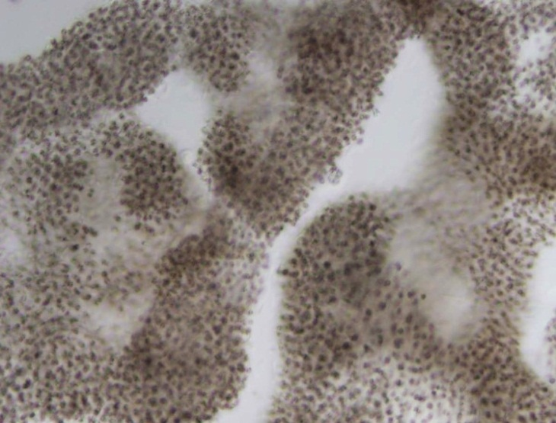
PLANKTON MODEL
Evaluation Method
  Regression models
  Water age measures are independent variables
BUILDING STRONG®
US ARMY CORPS OF ENGINEERS | Jacksonville District

Slide 54
PLANKTON MODEL
Results
  Regressions do not produce reasonable results with water age values from our EFDC model
  Regression equations are likely highly dependent on results from specific version of EFDC model
Alternate Evaluation
  Qualitative review of water age and plankton metric relationships
  General trends and magnitude of change in water age variables among project alternatives
BUILDING STRONG®
US ARMY CORPS OF ENGINEERS | Jacksonville District

Slide 55
JACKSONVILLE HARBOR DEEPENING STUDY
WEBSITE
WWW.SAJ.USACE.ARMY.MIL
BUILDING STRONG®
US ARMY CORPS OF ENGINEERS | Jacksonville District

