Slide 1
JACKSONVILLE HARBOR DEEPENING STUDY CIRCULATION AND SALINITY MODELING
Presented by:
Michael Kabiling, Ph.D., P.E., C.F.M. Senior Engineer, Taylor Engineering, Inc.
October 22, 2012

Slide 2
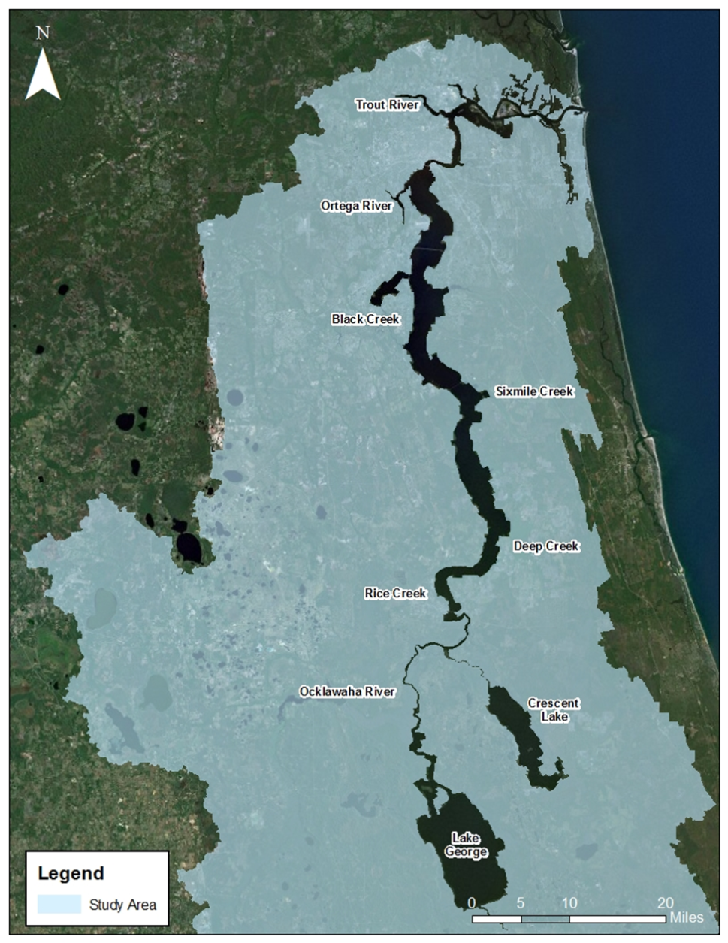
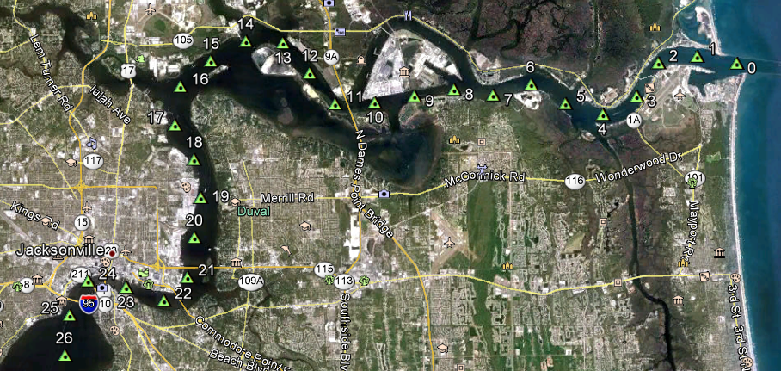
Study Area and Project Area
Lower (northern) 124 mi of the St. Johns River
From mouth near Mayport to upstream of Astor
Project area extends to the first 14 miles of the St. Johns River or from river mouth to the cruise terminal

Slide 3
Study Overview
N
River Mile 0
JEA COAL
TERMINAL
Atlantic
Ocean
OIL TERMINALS
JEA
FUEL DOCK
JPA MOL TERMINAL
JPA BULK
TERMINAL
30’ FEDERAL
CHANNEL
FORT
GEORGE
ISLAND
U.S. NAVY FUEL DEPOT
JPA
38 ’
River Mile 5
40’ 42’
JPA
River Mile 15
River Mile 13
River Mile 10
BEACH QUALITY
DREDGED
MATERIAL
PLACEMENT
ST
SERVICES
MAYPORT
50’
CHEVRON USA
BUCK ISLAND
JPA TALLEYRAND
TERMINAL
BARTRAM ISLAND
DREDGED MATERIAL
SITES
40’
34’
40’ FEDERAL CHANNEL 400’ – 1200’ wide
River Mile 20
LEGEND
Cuts F and G
JPA Facility
Jacksonville Harbor, Florida
Federal Channel

Slide 4
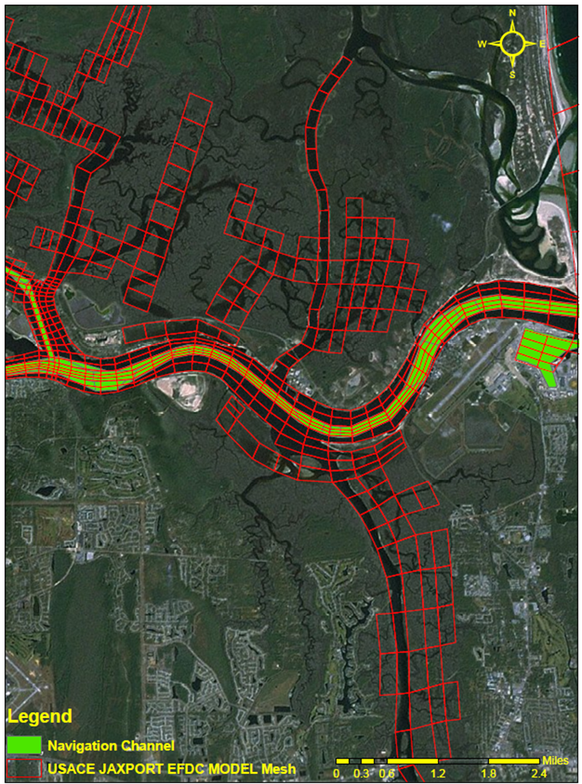
EFDC Hydrodynamic & Salinity Model Mesh
finer cells
in navigation channel
SJRWMD Mesh
USACE Mesh

Slide 5
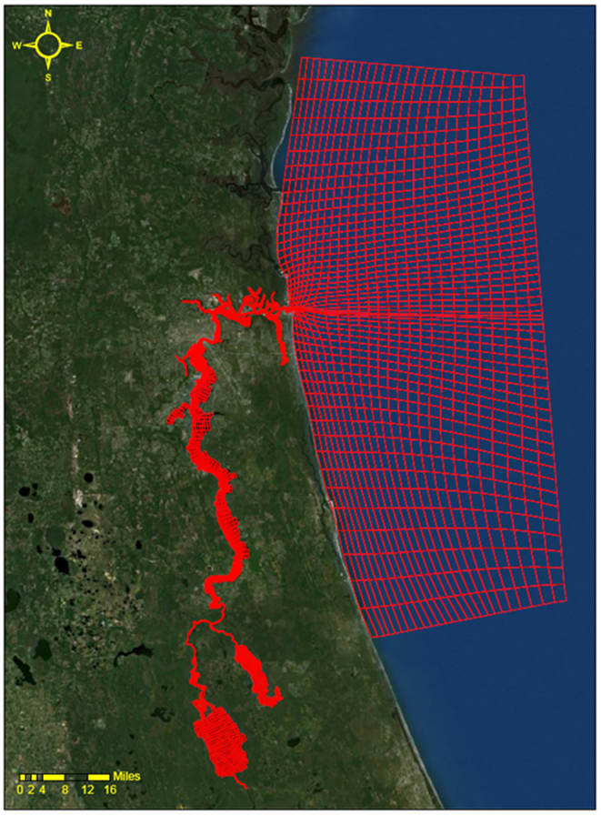
USACE EFDC Model Mesh
model domain comprises 4,824 curvilinear horizontal water cells
six equally divided layers in the vertical direction
model variables are
water surface elevation
velocity
salinity

Slide 6
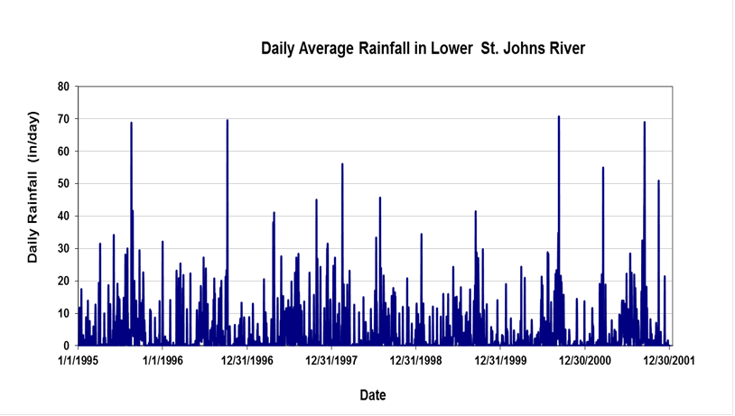
Model Boundary Conditions
Ocean water level
Lateral inflows
Rainfall and Evaporation
Jax Int’l Airport, Jax Beach, Federal Point, Crescent City, and Deland
Wind
Jax Int’l Airport, Hastings, Gainesville Reg. Airport, Daytona Beach Int’l Airport, and Umatilla
Salinity

Slide 7
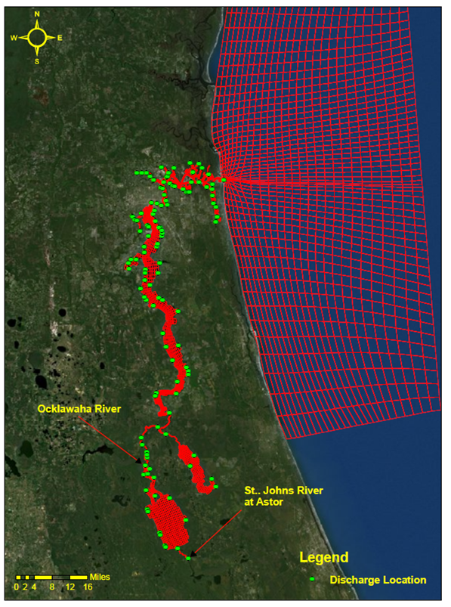
EFDC Model Lateral Inflows Conditions
146 point source discharges
surface tributaries
springs
wastewater treatment outfalls
Gauged inflows for model validation
SJRWMD HSPF Model flows
ungauged inflows (validation)
production runs
1995 landuse
small wastewater treatment outfalls, GW inflows — as annual average values

Slide 8
Hydrologic Conditions Based on USGS Gage Discharges
The 3 year period, 1999 — 2001, is lowest 3 consecutive year flow in the 78 year record.
Deland Annual Q (cfs)
Astor Annual Q (cfs)
Evaluation Period
Buffalo Bluff Annual Q (cfs)
LSJR Annual Q (cfs) (75–80%)
Discharge (cfs)
Year

Slide 9
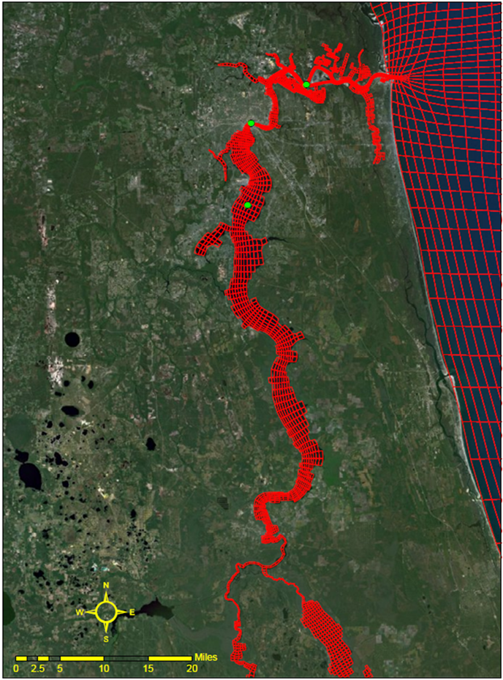
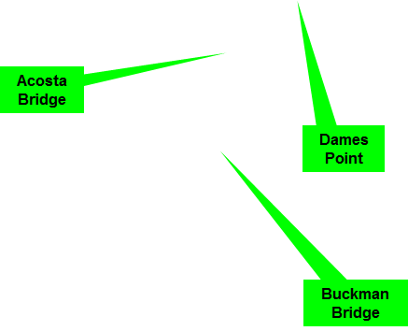
Model Validation Stations
Water Level Stations
Salinity Stations

Slide 10
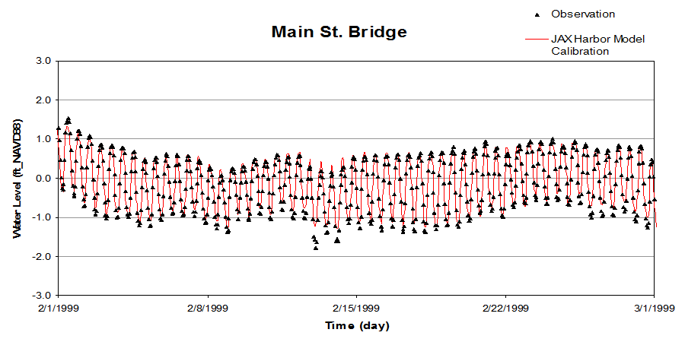
Model Re-Calibration (Water Level)
Statistics for Dry Period (12/1/1998 – 4/1/1999)
Station Parameters | Bar Pilot Dock | Long Branch | Main St. Bridge | Buckman Bridge | Shands Bridge
Correlation Coefficient, R | 0.992 | 0.988 | 0.986 | 0.976 | 0.974
Root Mean Square Error, RMSE (ft) | 0.285 | 0.154 | 0.148 | 0.118 | 0.108
Correlation Coefficient — ability to predict trend (~ 1.0 for perfect model)
RMSE — indication of model accuracy (~0.0 for perfect model)

Slide 11
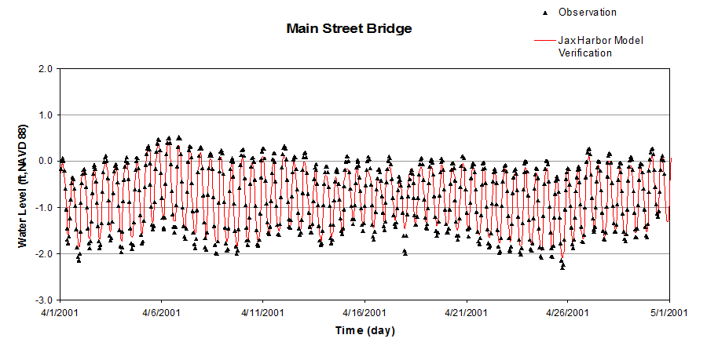
Model Re-Verification (Water Level)
Statistics for Dry Period (4/1/2001 – 8/1/2001)
Station Parameters | Bar Pilot Dock | Long Branch | Main St. Bridge | Buckman Bridge | Shands Bridge
Correlation Coefficient, R | 0.993 | n/a | 0.986 | 0.978 | 0.977
Root Mean Square Error, RMSE (ft) | 0.279 | n/a | 0.144 | 0.092 | 0.092

Slide 12
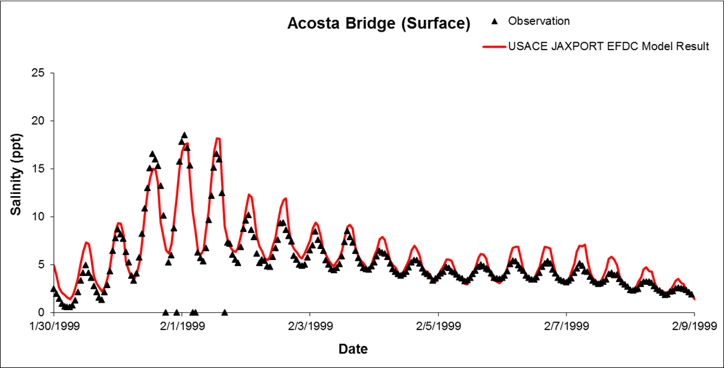
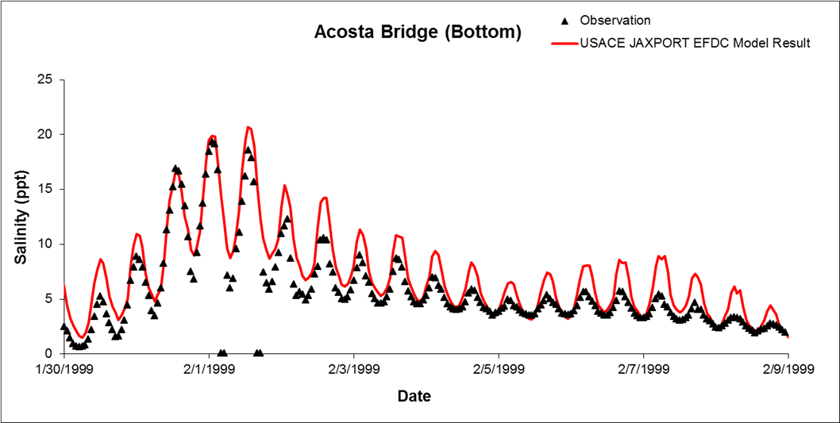
Model Re-Calibration (Salinity)
Stations | Wet Period (12/1/1997 – 4/1/1998) |  | Dry Period (12/1/1998 - 4/1/1999) |  | Wind Conditions (8/1/1996 – 12/1/1996)
 | Correlation Coefficient | RMSE (ppt) | Correlation Coefficient | RMSE (ppt) | Correlation Coefficient | RMSE (ppt)
Dames Point (Surface) | 0.889 | 3.835 | 0.864 | 2.278 | 0.925 | 3.677
Dames Point (Bottom) | 0.883 | 4.110 | 0.827 | 3.040 | 0.936 | 2.265
Acosta Bridge (Surface) | 0.956 | 0.466 | 0.938 | 1.581 | 0.938 | 1.931
Acosta Bridge (Bottom) | 0.955 | 0.460 | 0.940 | 2.308 | 0.928 | 1.954
Buckman Bridge (Surface) | 0.934 | 0.017 | 0.887 | 0.567 | 0.813 | 0.848
Buckman Bridge (Bottom) | 0.933 | 0.017 | 0.836 | 1.374 | 0.828 | 1.994
Dry Period
Dry Period
Correlation Coefficient — ability to predict trend (~ 1.0 for perfect model)
RMSE — indication of model accuracy (~0.0 for perfect model)

Slide 13
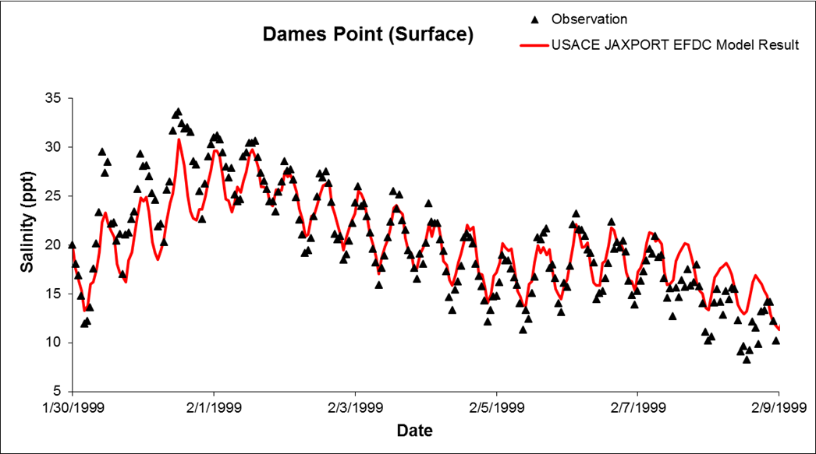
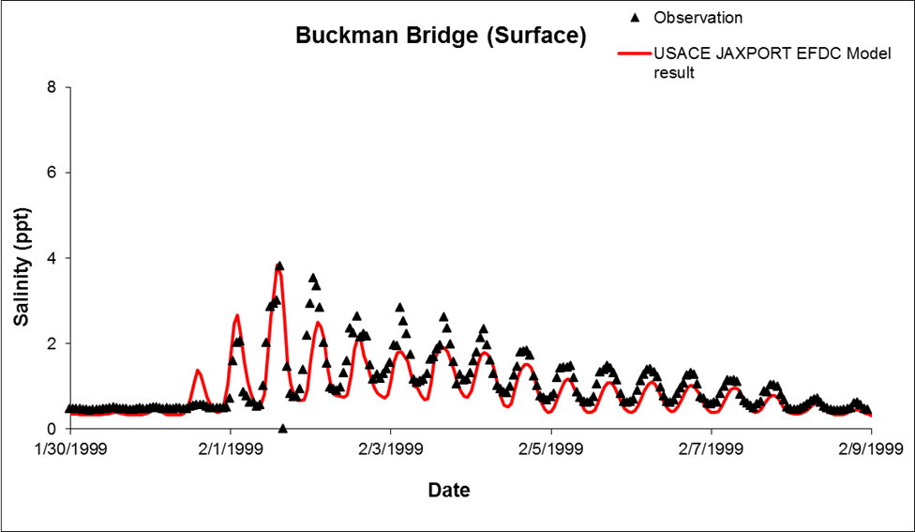
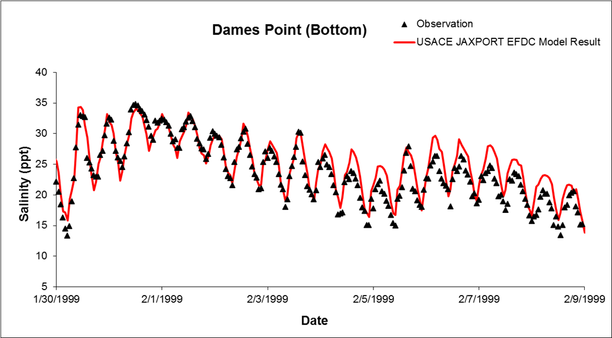
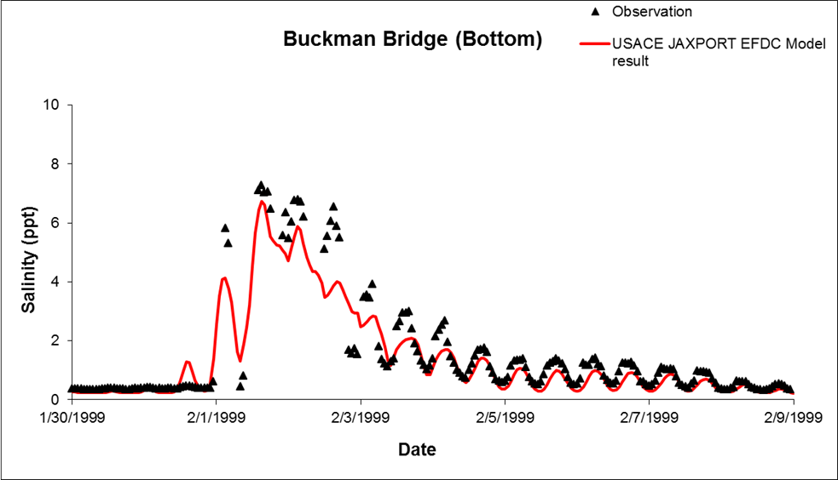
Model Re-Calibration (Salinity)
Dry Period

Slide 14
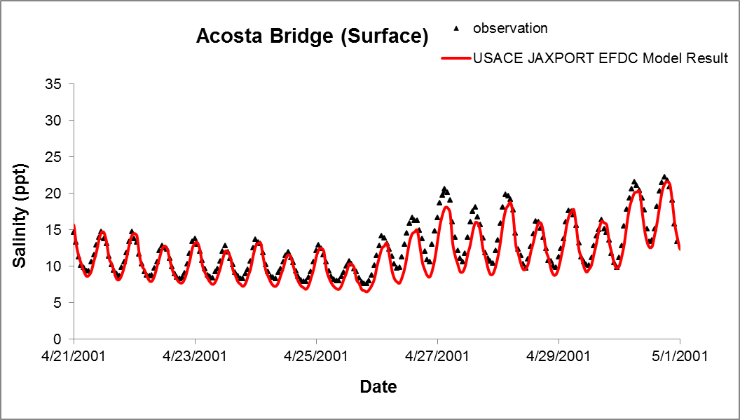
Model Re-Verification (Salinity)
Stations | Wet Period (8/1/2001 – 12/1/2001) |  | Dry Period (4/1/2001 – 8/1/2001)
 | Correlation Coefficient | RMSE (ppt) | Correlation Coefficient | RMSE (ppt)
Dames Point (Surface) | 0.893 | 5.963 | 0.788 | 2.376
Dames Point (Bottom) | 0.819 | 6.189 | 0.744 | 2.640
Acosta Bridge (Surface) | 0.899 | 2.665 | 0.909 | 2.008
Acosta Bridge (Bottom) | 0.907 | 0.904 | 0.940 | 1.866
Buckman Bridge (Surface) | 0.490 | 0.904 | 0.925 | 0.951
Buckman Bridge (Bottom) | 0.483 | 0.978 | 0.870 | 1.784
Dry Period
Dry Period

Slide 15
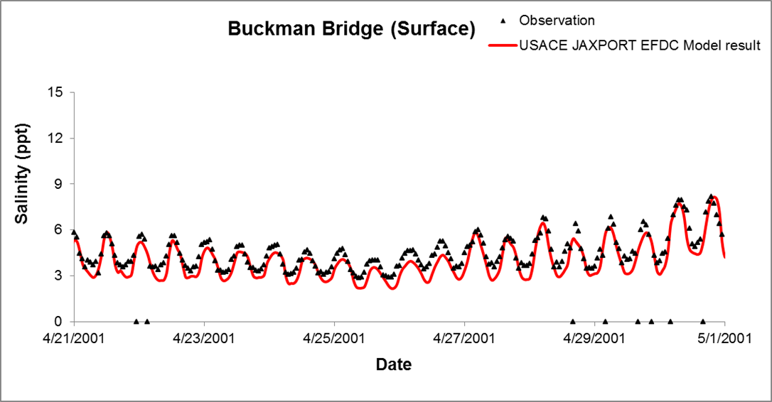
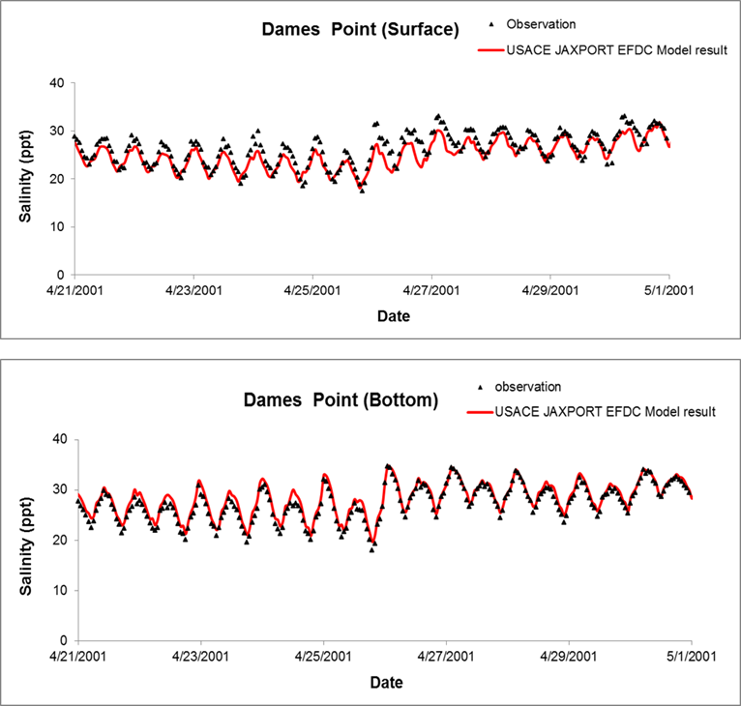
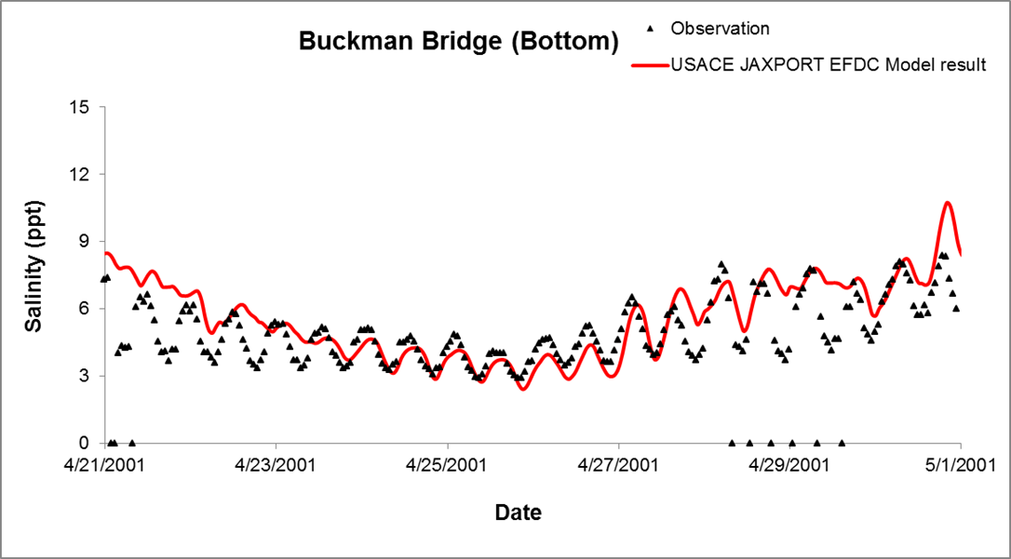
Model Re-Verification (Salinity)
Dry Period

Slide 16
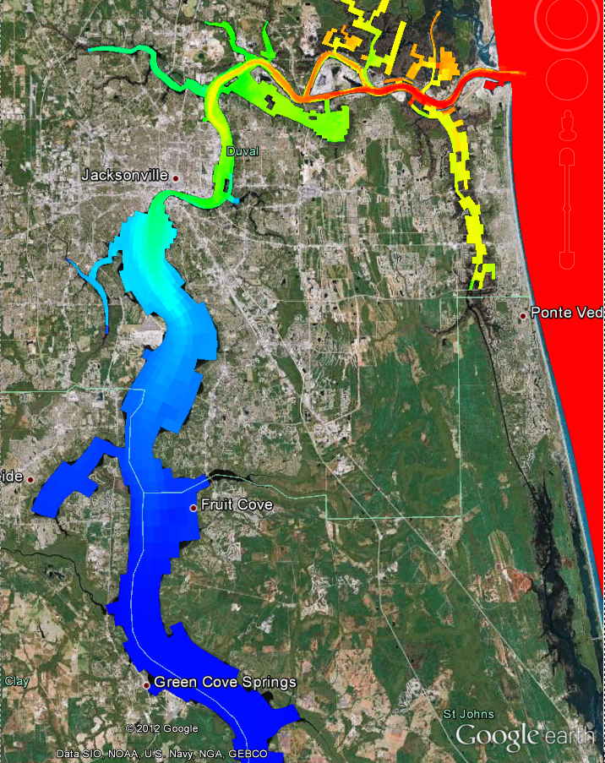
Model Validation
EFDC model is validated with water level and salinity data collected in1995 to 2005 for wet period, dry period, and wind condition.
Model is suitable for predicting hydrodynamic and salinity changes in the Lower St. Johns River from the potential channel deepening projects.

Slide 17
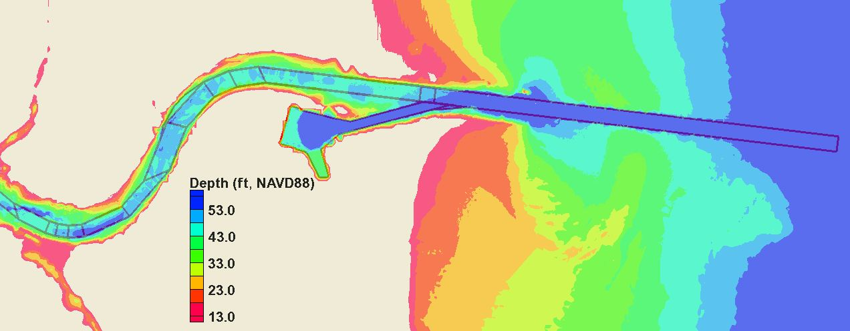
USACE Baseline Depths
2009 & 2010 river & channel surveys
Mayport and Mile Point projects

Slide 18
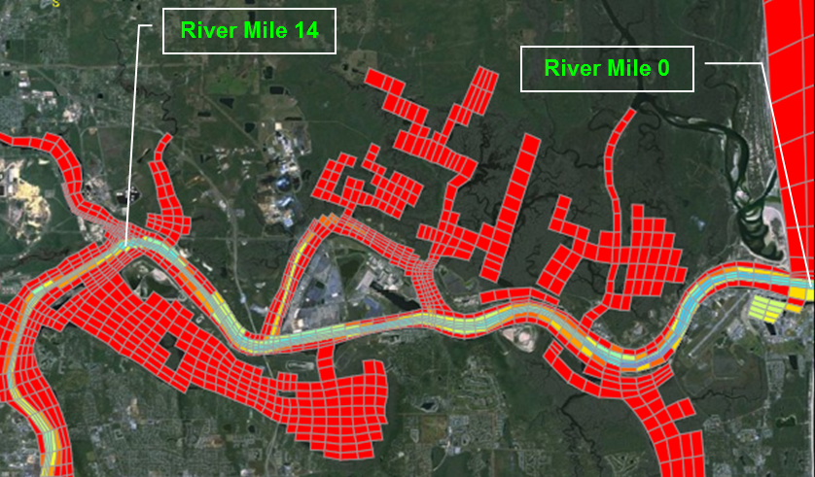
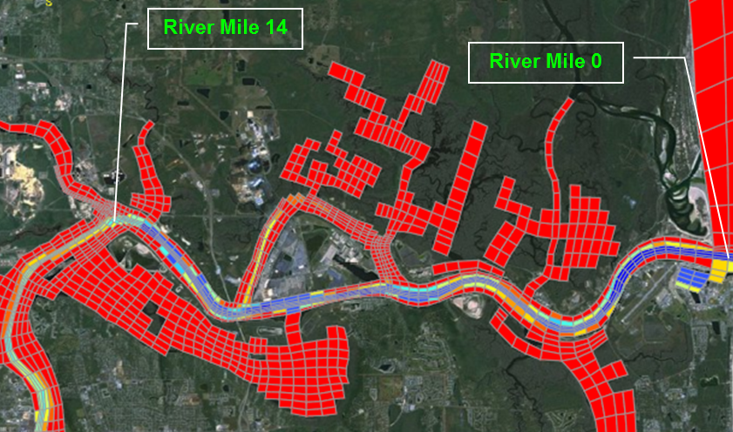
EFDC Model Applications (1996 – 2001)
SJRWMD Baseline
USACE Baseline at 40 ft
Compare with 44-, 46-, and 50-ft dredge
Compare with USACE recommended depth
USACE Baseline at 40 ft with SLC1 (0.39 ft) and 155 MGD Water Withdrawal
Compare with 44-, 46-, and 50-ft dredge
Compare with USACE recommended depth
Baseline at 40 ft
Project at 50 ft

Slide 19
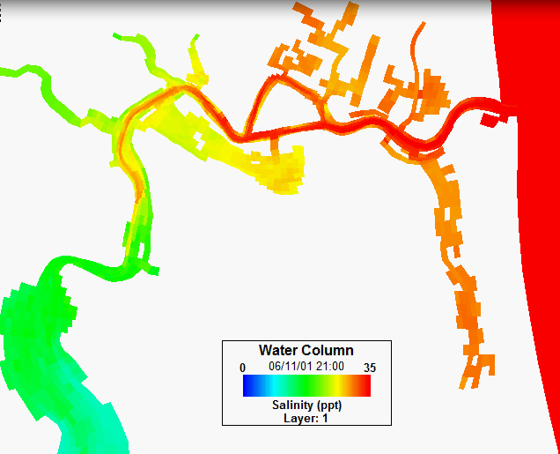
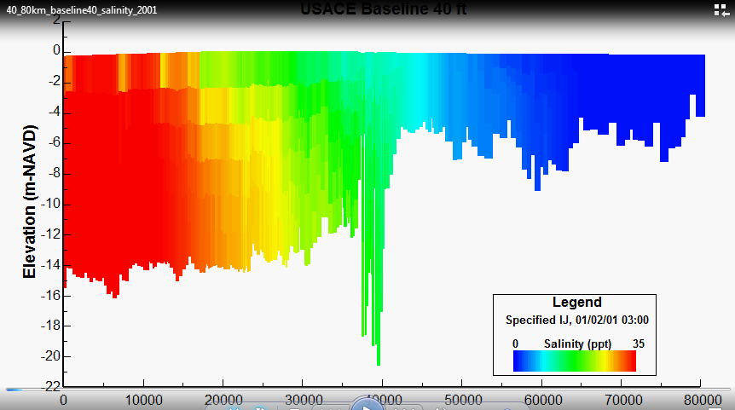
EFDC Results (Animations)
USACE Baseline at 40 ft
Velocity (Plan)
Salinity (Plan and Profile)
Project at 50 ft with SLC1 and 155 MGD Water Withdrawal
Velocity (Plan)
Salinity (Plan and Profile)
Buckman Bridge
Shands Bridge
River Mouth
Dames Point Bridge
Acosta Bridge

Slide 20
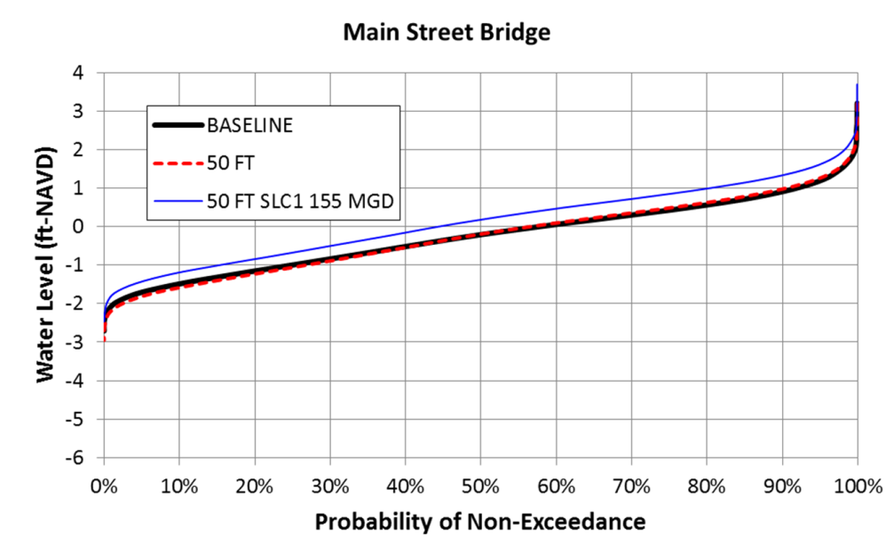
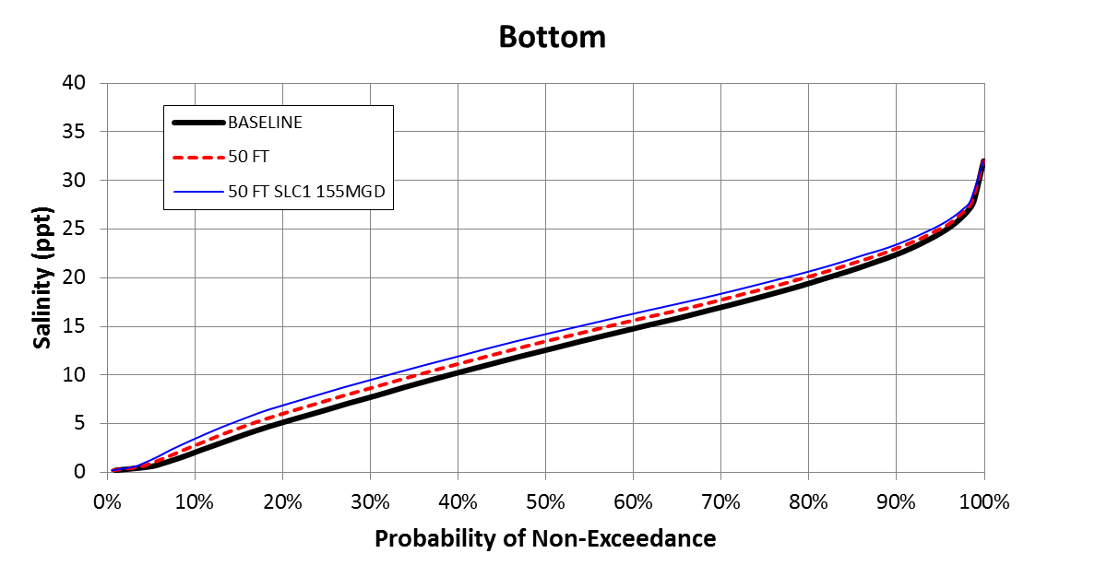
50-ft Channel Dredge Impact
Acosta Bridge Salinity
Project at 50 ft (Deepening Only ) — mean salinity increases by 0.8 ppt
Project at 50 ft (with SLC1 &WW) — mean salinity increases by 1.4 ppt
Main Street Bridge WL
Project at 50 ft (Deepening Only ) — increases tidal range by 0.2 ft
Project at 50 ft (with SLC1 &WW) — mean tide level up 0.3 ft – 0.4 ft
Acosta Bridge Surface Salinity (Baseline vs. Project at 50 ft)
Acosta Bridge Bottom Salinity (Baseline vs. Project at 50 ft)
Main Street Br WL (Baseline vs. Project at 50 ft)

Slide 21
Salinity Impact (Acosta Bridge) Channel Deepening Only
1% of 6 years = 22 days

Slide 22
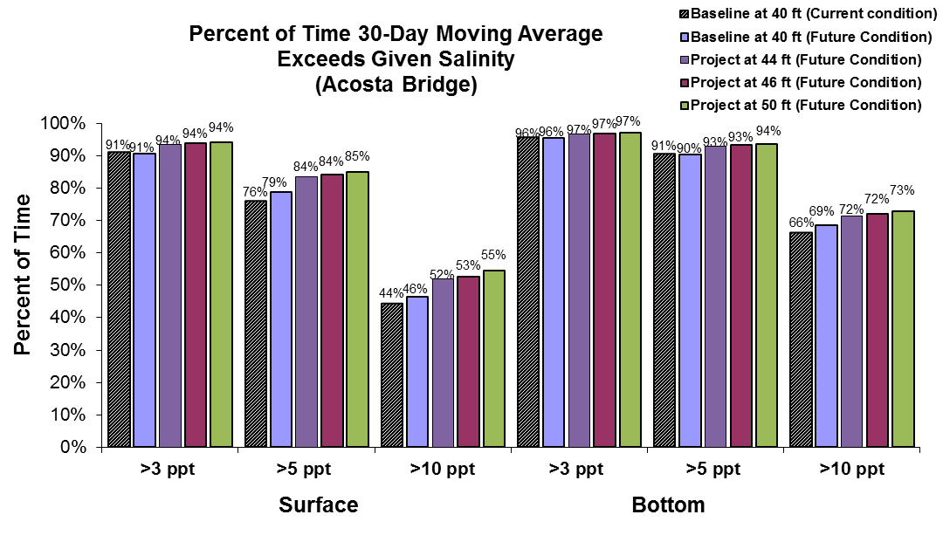
Salinity Impact (Acosta Bridge) with 0.39 ft SLR and 155 MGD Water Withdrawal
1% of 6 years = 22 days

Slide 23
Salinity Impact (Buckman Bridge) Channel Deepening Only
1% of 6 years = 22 days

Slide 24
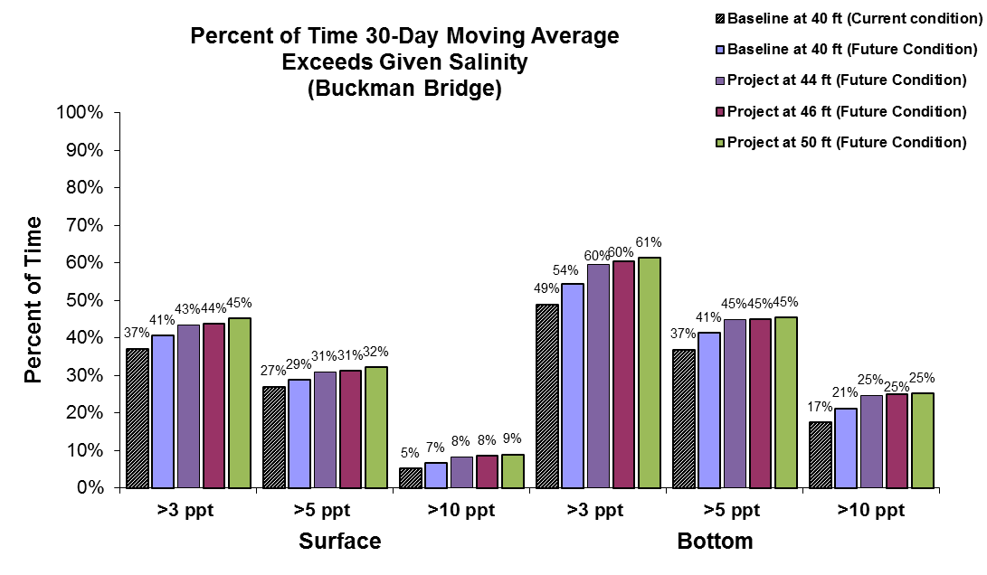
Salinity Impact (Buckman Bridge) with 0.39 ft SLR and 155 MGD Water Withdrawal
1% of 6 years = 22 days

Slide 25
GRR Circulation and Salinity Modeling
USACE contact:
Steven Bratos
Steven.M.Bratos@usace.army.mil

Slide 26
GRR Circulation and Salinity Modeling
Discussion

